Slide 1

Relationships, Sex & Health Education (RSHE) Consultation 2021
Parents and Carers Consultation
We wish to consult with you on:
Why new changes to Relationships, Sex and Health Education are in place
DfE guidance outlining the new curriculum changes
What the Catholic Church says
The Science curriculum
The right to withdraw from some lessons

Slide 2
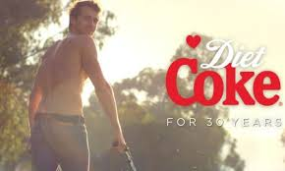

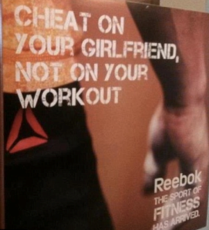

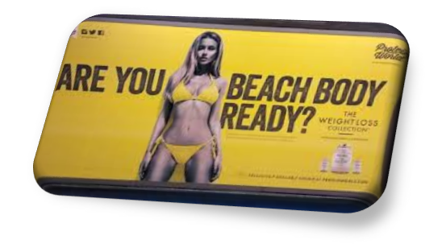
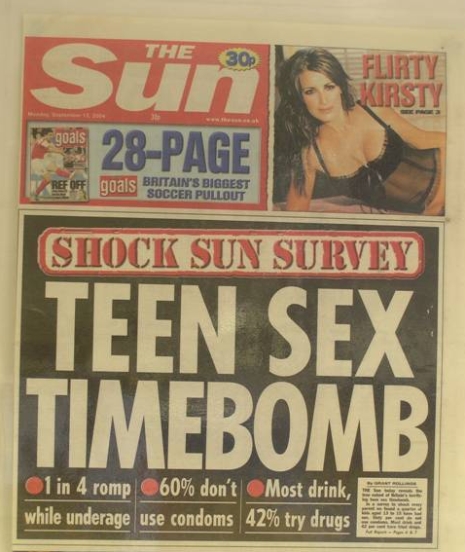



Today’s considerations
The internet
Television
Social media
Other media
Friends
Family
School
What impact do all of the above have on our children’s understanding of our world?

Slide 3
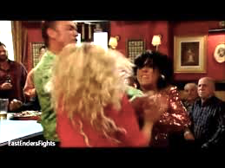
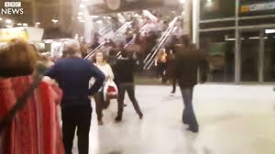
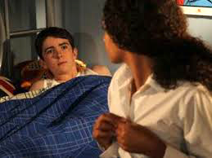
What ‘messages’ are in these TV scenes?
Eastenders fight scene
BBC News ‘ Manchester Arena Attack’
Hollyoaks teenage relationship

Slide 4

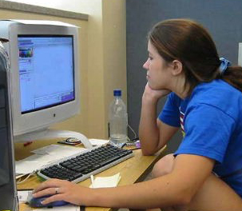
Staying safe on the internet
Do we always know who our children are speaking to or
getting their information from?
Are we always aware of the content or nature of conversation?
‘Hi. My name’s Jenny I like your pic ☺
What school do you go to?’
‘I go to The Cathedral School in Salford.’

Slide 5
Don’t forget…
We are educating children and young people
to live in the real world, with all its contradictions.
When it comes to sex, children’s heads are probably not empty – but they may be full of myths and half-truths.
Our focus should be on building healthy attitudes and positive relationships, not just fighting off perceived threats. This is why teaching Relationships, Sex and Health Education is so important.

Slide 6


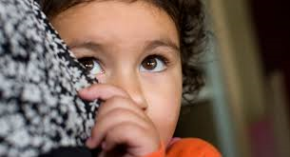
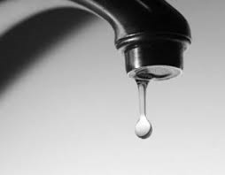
If RSHE is so important, which approaches are best?
1. Keep pupils uninformed about the world we live in. This leads to children listening to myths and untruths and taking them as the truth. This may cause even greater confusion.
2. Overload the children with information at once when they are older, leading to confusion and difficulty in ‘unlearning’ some of the myths and rumours they have already heard.
3. Using ‘scare tactics’ to make children fearful of such situations. Although this may work for some, there is evidence to suggests that ill-informed children go on to take even bigger risks later in life.
4. A drip feed approach at the right age and stage of development – given the appropriate information to make sensible, safe and informed decisions about how to keep themselves safe in relationships online and in the real world. This is the approach advised by the Government.

Slide 7
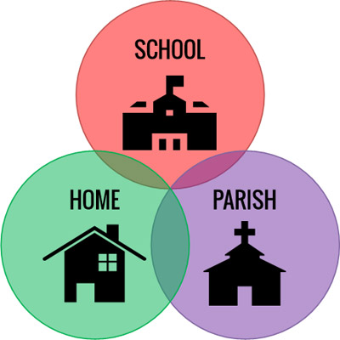
Is there a better way?
Would accurate information at the right age and stage of development, coming from school AND home, be a better way?
In a home-school-parish partnership together, we can ensure our children are learning the right information, at the right stage of development to ensure a healthier, safer and better informed future.

Slide 8
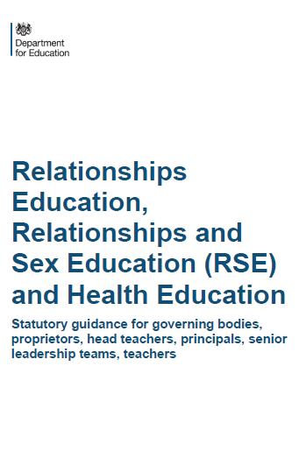
What is compulsory for schools to teach?
Primary
Relationships Education is compulsory
Health Education is compulsory
But Sex Education is at school’s discretion
Secondary
Relationships Education is compulsory
Health Education is compulsory
Sex Education is compulsory
(Guidance does not apply to: Sixth Forms colleges, 16-19 academies or FE colleges)
For further reading, please see the DfE guidance in your email pack

Slide 9
What are the expectations for Primary Relationships Education?
Teaching children about:
Families and people who care for me
Caring friendships
Respectful relationships
Online relationships
Being safe
For further reading, please see the DfE guidance in your email pack

Slide 10
Relationships Education
What should children know about relationships and why?
What a positive, healthy, caring, safe relationship looks and feels like.
How to speak up and get help when a relationship does NOT feel healthy/positive/safe.
How to make and maintain positive relationships (online and offline relationships).

Slide 11
What does the Government say is the aim
of Relationships Education?
‘Today’s children and young people are growing up in an increasingly complex world and living their lives seamlessly on and offline….children and young people need to know how to be safe and healthy, and how to manage their academic, personal and social lives in a positive way’
- DfE Guidance on Relationships Education, Sex Education and Health Education 2019

Slide 12
What are the expectations for
Primary Health Education?
Teaching children about:
Mental wellbeing
Internet safety and harms
Physical health and fitness
Healthy eating
Drugs, alcohol and tobacco
Health and prevention
Basic First Aid
For further reading, please see the DfE guidance in your email pack

Slide 13
Sex Education is discretionary at Primary… what exactly does the guidance say?
The DfE continues to recommend that ‘all primary schools should have a sex education programme tailored to the age and physical and emotional maturity of the pupils…drawing on knowledge of the human life cycle set out in National Curriculum Science- how a baby is conceived and born’
This part of the curriculum is usually delivered in upper KS2 classes and parents are always informed before teaching commences.

Slide 14
The right to withdraw from Sex Education
We aim to teach sex education to children in Year 5 and 6 (which goes beyond the existing national curriculum for science).
Before these lessons take place, the school will give parents the opportunity to understand what will be taught and how it will be approached, and view any materials so that you understand what we propose to teach and how.
If you continue to have concerns, you have the right to withdraw your child from any sex education lessons that go beyond that of the science national curriculum. Of course, children who have been withdrawn from lessons will be provided with alternative education, in school, at the time of delivery to the rest of the class.
We will continue to teach science sex education (which focuses on puberty and reproduction) as this is part of the Science National Curriculum for Y5 and Y6. As it is part of the science national curriculum it is compulsory. We will hold meetings with parents in Y5 and Y6 to discuss this and share materials. Parents do not have the right to withdraw children from the science curriculum.

Slide 15
Science and Sex Education
KS1 expectations:
identify, name, draw and label the basic parts of the human body and say which part of the body is associated with each sense
notice that animals, including humans, have offspring which grow into adults
Non statutory note: Pupils should be introduced to …the processes of reproduction and growth in animals. The focus at this stage should be on questions that help pupils to recognise growth; they should not be expected to understand how reproduction occurs

Slide 16
Science and Sex Education
KS2 expectations:
describe the differences in the life cycles of a mammal, an amphibian, an insect and a bird
describe the life process of reproduction in some plants and animals
describe the changes as humans develop to old age
learn about the changes experienced in puberty
Non statutory note: Pupils should find out about different types of reproduction, including sexual and asexual reproduction in plants, and sexual reproduction in animals. Pupils should be introduced to …the processes of reproduction and growth in animals.

Slide 17
Do schools have a choice?
By September 2021
Legally:
Schools MUST teach the Science curriculum
The DfE guidance 2019 states that Relationships and Health Education (including changing adolescent body) are compulsory
Plus
a ‘recommendation’ that all schools have a Sex Education Programme.
How schools do this is left up to them.

Slide 18

What does the Church say?
Catholic schools, like all other schools in England, are required to produce a written policy following the guidance issued by the Department for Education on Relationships education, relationships and sex education (RSE) and health education. The DfE guidance can be found here.
Catholic schools are also required to deliver RSE in accordance with the teaching of the Church. This approach is compatible with the guidance issued by the DfE.
Why is RSE in Catholic Schools important?
RSE is part of the mission of Catholic schools to educate the whole person. It should be carried out as part of the holistic education which seeks to form as well as inform young people in preparation for adult life.

Slide 19
What does outstanding RSE in a Catholic school look like?
In order for Catholic RSE to be fully effective it needs to:
Be faithful to the Church's vision of human wholeness whilst recognising the contemporary context in which we live today;
Involve parents as they are primary educators of their child;
Provide a positive view of human sexuality and dignity of the human person;
Equip young people with the ability to make practical judgments about the right thing to do in particular circumstances;
Explore and promote virtues which are essential to promoting respect and dignity;
Be delivered in an age appropriate way which reflects the development of the child;
Be part of the cross-curricular work in both primary and secondary schools;
Be sensitive to the needs of the individual pupil and recognise the mix of pupils with different sexual orientations, genders and family backgrounds in each class;
Be taken seriously by governors and teachers as an integrated part of the broad and balanced curriculum that Catholic schools offer;
Be delivered by competent professionals who understand the Church's teaching.

