Slide 1

So, what, where, when and how
do we do this?
We have been researching three programmes which are available to our school.
All three programmes meet the statutory requirements from the DfE and are sensitive to our mission as Catholic educators, taking the teaching of the Church as the main focus. The programmes are:
The programmes are:
In the Beginning
A Journey in Love
Life to the Full

Slide 2
Extracts taken from ‘In the Beginning’ programme:
Dear Parents,
Welcome to “In The Beginning!” the first in a series of pupil workbooks making up the school’s SRE (Sex and Relationships Education) programme.
The full programme has been approved by Staff and endorsed by Governors and is intended to act as a vehicle through which teachers, and especially parents can help children to understand more fully the world they live in and the responsibilities they carry as human beings ; to this end each pupil workbook is accompanied by a Parents Advice Booklet.

Slide 3
How was the programme put together?
Over a 6-year period (1989 - 2005) parents, teachers and governors at St Edward's
R.C. Primary School, Lees, Oldham worked closely to produce a scheme that would
help children to make sense of these "messages" by putting them (or the opportunity
to discuss them) into a framework surrounded by those values we upheld as
members of a Christian community.
We wanted sex education to be put into the right context - within a religious setting and as part of LIFE EDUCATION of which the development of personal relationships was an integral part. We wanted a programme which recognised that Education in Personal Relationships (EPR) was a shared responsibility between home and school - between parent and teacher... and we wanted a scheme which was comfortable to all those who were involved in the programme
• the parent in the home environment,
• the teacher in the classroom situation,
• and the child ...... in both.
The result was / is "IN THE BEGINNING...." a programme approved by parents, teachers and governors of the school ; a programme which has since been widely acclaimed by Roman Catholic (and other) schools across the length & breadth of the UK ; a programme designed to open channels of communication … essentially
between parent and child, but also between teacher and class (home and school working in true partnership).

Slide 4
The full programme is made up of 8 pupil workbooks:
Book 1 “In The Beginning!.” Completed in Yr. 1
Book 2 “God Made Me” Completed in Yr. 2
Book 3 “God ~ The Master Designer” (Flowers) Completed in Yr. 3
Book 4 “God ~ The Caring Protector” (Fish) Completed in Yr. 4
Book 5A “God ~ The Great Provider” (Birds) Completed in Yr. 5
Book 5B “God ~ The Friend & Neighbour” (Rabbits) Completed in Yr. 5
Book 6A “God ~ The Image Maker (Pt. 1)” (Human) Completed in Yr. 6
Book 6B “God ~ The Image Maker (Pt. 2)” (Human) Completed in Yr. 6.
Collectively, they form a celebration of life, and a learning curve in understanding the complexities of human relationships. Our own relationship with God sits at the heart of the scheme throughout, and the teachings of Christ underpin the way good relationships form.

Slide 5
Importantly!
The workbooks are not “heavy” and do not confront children with inappropriate material!
But they do contain “hidden prompts” opportunities for parents (and teachers) to gently open-up discussion on sensitive and challenging topics which all too soon these days tend to find their way into the vocabulary and mindset of young children…topics which may be difficult to broach through normal conversation.
Anything up to 80% of the time needed to complete a booklet can come from HOME ~ by the parent and child working together ; but best results probably come from a more even balance (50/50, 60/40)
where quality input from the class teacher ensures ALL children are well supported through the programme.
Herein lies the true value of this scheme because without being judgemental, each booklet gives YOU the parent the chance to put YOUR value system in place with YOUR child ; to reinforce standards, codes of conduct and expectations whilst your child will still listen to you! and before the adult world confronts them !!!!
The strong advice is to use the booklets to your advantage - seize the opportunity to talk to your child making the discussions as wide as you feel appropriate as you help them to complete each work page.

Slide 6
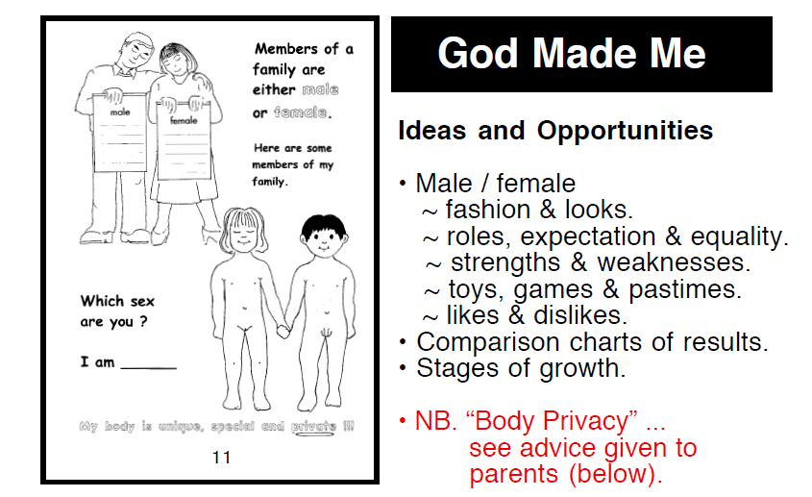
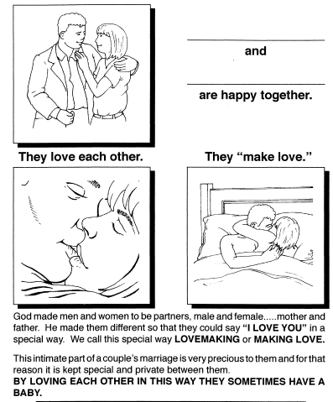
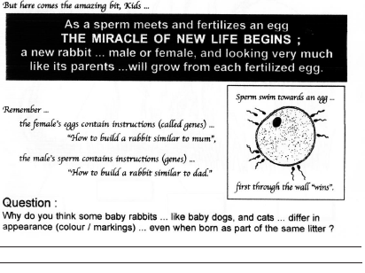
For further details of the ‘In the Beginning’ programme including a selection of work booklets from across the school, please see the documents emailed to you.

Slide 7
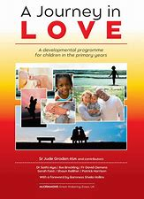
Extracts taken from ‘A Journey in Love’ programme:
A Journey in Love is a resource created by Sister Jude Groden. It has been written as a progressive scheme of work that supports the Religious Education, PSHE and Science curriculum taught within Catholic Primary schools.
As children progress through school, they discover more and more about themselves and the wider world. This thirst for learning new things in all aspects of life is fostered by the school, who attempt to create a safe, stimulating environment for learning; supporting all children in their development. Our mission statement which drives the school, attempts to achieve this goal following the Gospel values of truth and respect, understanding our journey as children of God, both special and unique.
The scheme permeates through all levels of learning throughout the school. It focuses on friendship, family, community, relationships and spirituality; a guide to the children’s development as young Catholics.

Slide 8
As you would expect, not all issues related to personal development are covered by the end of Year 6. The content is age appropriate and is taught with sensitivity, taking into account the children’s level of maturity in regard to the delivery of the lessons.
As with all aspects of learning, children are naturally curious and many will have questions related to their lessons. Opportunities to discuss questions form part of the lessons and again these are treated with care and understanding. ‘A Journey in Love’ highlights the importance of parental input and children will be told to discuss their lessons at home.
An aspect of the mystery of love is taught in each year group; children are encouraged to marvel at the wonder and beauty of God’s creative love. This is reflected through a series of progressive and developmental tasks, activities and reflections which focus on physical, social, emotional, intellectual and spiritual development.

Slide 9
Summary of planned teaching for each year group:
Nursery: Wonder at God’s love
Reception: God loves each of us in our uniqueness
Year One: We meet God’s love in our family
Year Two: We meet God’s love in the community
Year Three: How we live in love
Year Four: God loves us in our differences
Year Five: God loves me in my changing and development
Year Six: The wonder of God’s love in creating new life

Slide 10
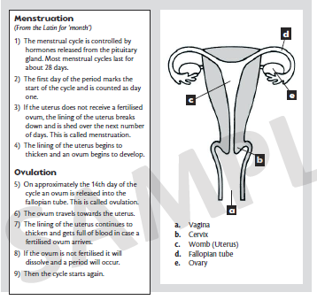
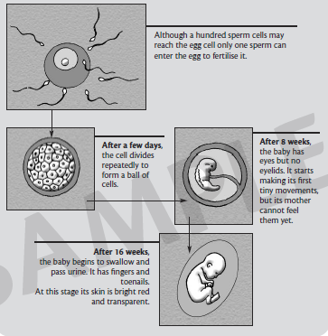
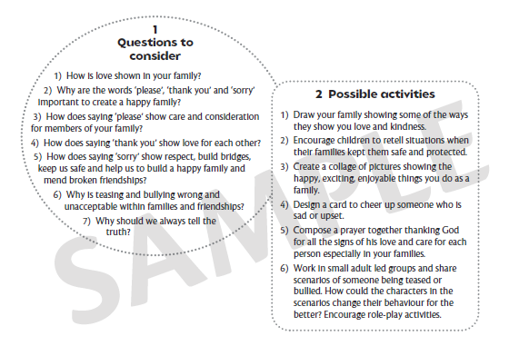
For further details of the ‘A Journey in Love’ programme including a selection of Powerpoints from across the school and a parents guide, please see the documents emailed to you.

Slide 11

Extracts taken from ‘Life to the Full’
programme:
Life to the Full is a fully resourced Scheme of Work in Relationships and Health Education (RHE) for Catholic primary schools which embraces and fulfils the new statutory curriculum.
It has been created by TenTen, an award-winning Catholic educational organisation that is well-respected and very experienced in this field of work.
Life to the Full has been approved for use by Salford Diocese. Furthermore, TenTen have entered into a partnership with the Catholic Education Service and the Department for Education to provide training for teachers and guidance for parents.
Through their programme, TenTen understand the foundational role that parents have in educating and nurturing their children on these matters. Within the programme, they have built in resources which will not only keep you informed about what is being taught in school, but will also give you the opportunity to engage your children in discussion, activity and prayer.

Slide 12
Taught with a spiral approach to learning in which pupils will revisit the same topics at an age-appropriate stage through their school life, the programme includes teaching about personal health, physical and emotional well-being, strong emotions, private parts of the body, personal relationships, family structures, trusted adults, growing bodies, puberty, periods, life cycles, the dangers of social media, where babies come from, an understanding of the Common Good and living in the wider world.
The entire teaching is underpinned with a Christian faith understanding that our deepest identity is as a child of God – created, chosen and loved by God. The programme is fully inclusive of all pupils and their families.
To watch a video about this programme, click here:
https://www.tentenresources.co.uk/life-to-the-full-catholic-landing-page/

Slide 13
Life to the Full is annual subscription platform in Catholic RSE which gives:
A programme of study containing approximately 60 media-rich lessons divided into three learning stages*:
Key Stage One (Years 1 and 2);
Lower Key Stage Two (Years 3 and 4);
Upper Key Stage Two (Years 5 and 6).
2. Assessment Activities to record evidence of success;
3. Training sessions for staff;
4. An online parent portal for links to home.
Scheme of work details can be found here:
https://www.tentenresources.co.uk/life-to-the-full-catholic-landing-page/scheme-of-work-slides/

Slide 14
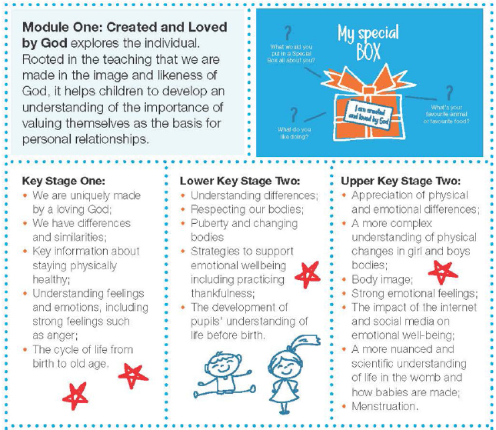
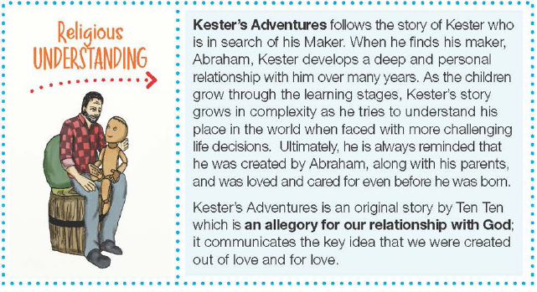

Slide 15
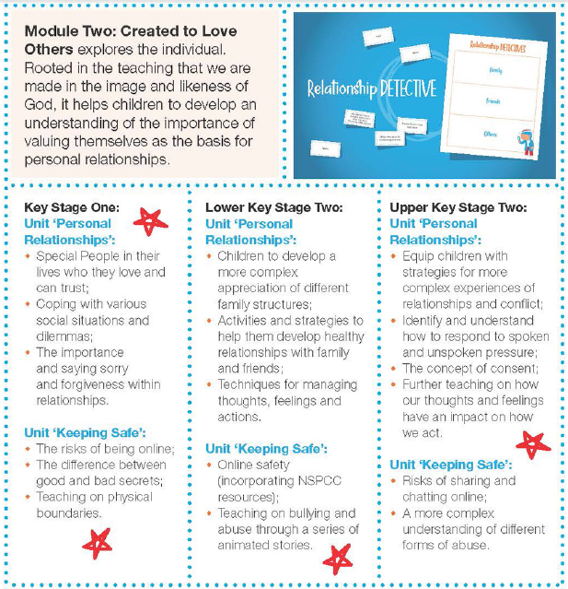
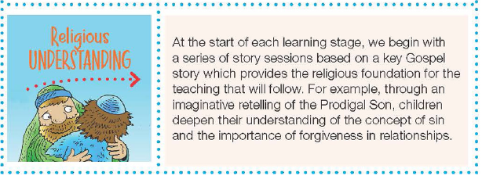

Slide 16
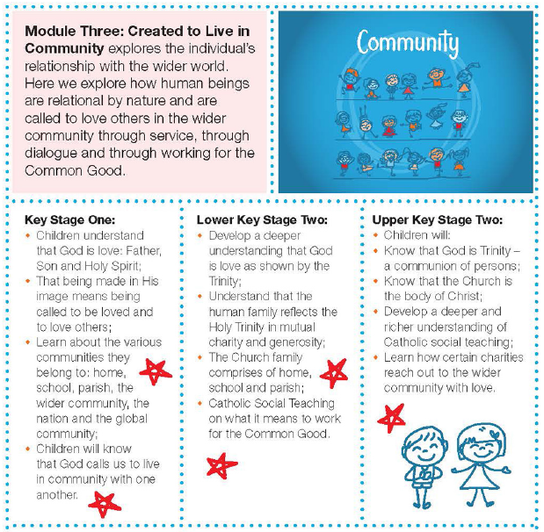
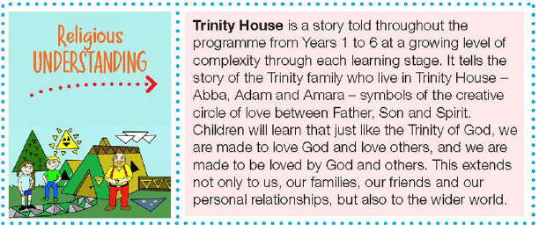

Slide 17
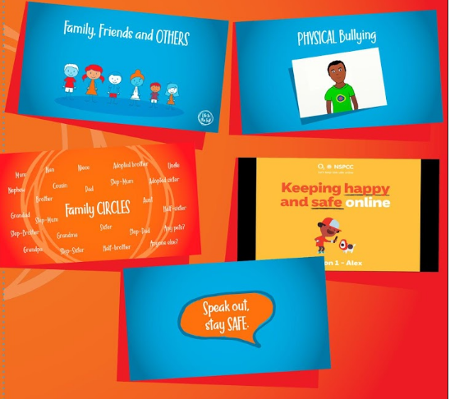
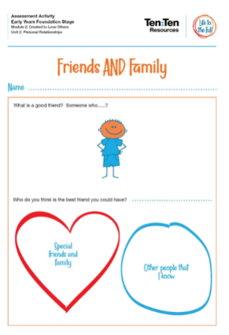
For further details of the ‘Life to the Full’ programme, please see the documents emailed to you.

