Slide 1

Year 5
Parents Meeting
Class Teacher: Mrs Pugh Teaching Assistants: Mrs. Kehoe
Mrs. Bolton

Slide 2
Growing together within God’s loving family, we support, challenge and inspire each other to become the best that we can be.

Slide 3

Spiritual, moral, social and cultural development
Importance of our health and well-being in order to have the capacity to make the right choices and work at our best level
Positive reinforcement policy
Reflection times where needed to support children in understanding appropriate behaviour
Our behaviour policy links to the beatitudes
Mrs Bolton drop in sessions for children and parents

Slide 4



Our Behaviour Policy
Positive
Our reward system links to following the Golden Rules and showing God’s love to one another.
Reward assembly is on a Friday to celebrate the achievements of the week.
Classroom daily rewards - class dojo
Star of the Day
Compliments Sheets
V.I.P table
Phone call home

Slide 5


Celebrating children's work
Sharing of great work in assembly
Showcased on classroom displays
Head teacher awards
Sharing news with parents – phone call home
Website
Twitter
(cathedralschoolstpeterandjohn.com)

Slide 6
Homework and Spellings
Homework will be given out on Friday and returned to school to be marked on Tuesday.
Children will receive spellings on a Wednesday to practice for a spelling test, which will be carried out on the following Wednesday. You can find your children's scores in their home spelling book and incorrect words will be highlighted so they can continue to practice these, alongside their new spellings.
Homework will usually consist of Maths work to be completed in the maths workbooks. The page numbers to be completed will be written in reading record. Some weeks homework may include a literacy or topic based piece of work.
A list of the statutory spellings for year 5 and 6 can be found on the school website.

Slide 7
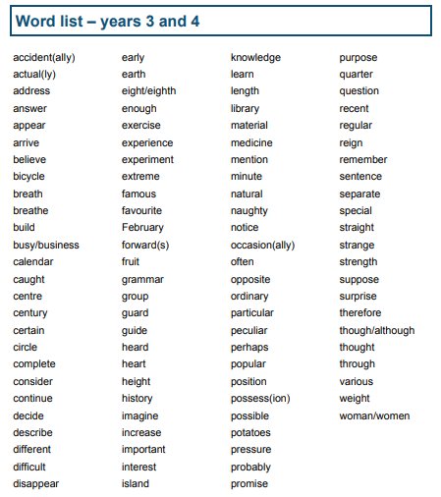
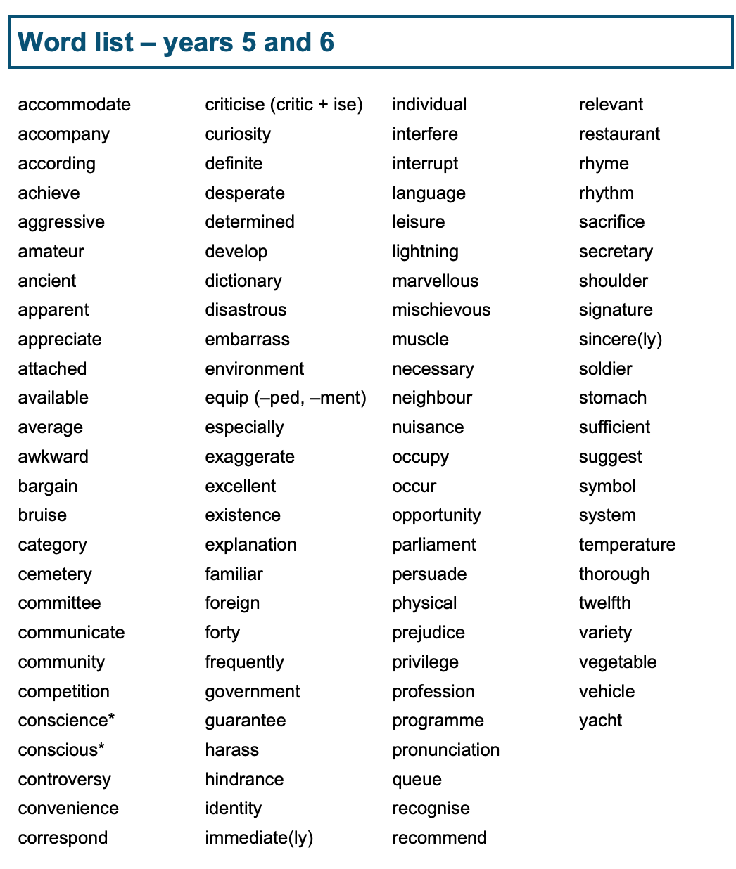


Slide 8
accommodate
accompany
according
achieve
aggressive
amateur
ancient
apparent
appreciate
attached
available
average
awkward
criticise
(critic + ise)
curiosity
definite
desperate
determined
develop
dictionary
disastrous
embarrass
environment
equip
(-ped, -ment)
identity
immediate
(-ly)
individual
interfere
interrupt
language
leisure
lightning
marvellous
mischievous
muscle
necessary
queue
recognise
recommend
relevant
restaurant
rhyme
rhythm
sacrifice
secretary
shoulder
signature
sincere
(-ly)
bargain
bruise
category
cemetery
committee
communicate
community
competition
conscience
conscious
controversy
convenience
correspond
especially
exaggerate
excellent
existence
explanation
familiar
foreign
forty
frequently
government
guarantee
harass
hindrance
neighbour
nuisance
occupy
occur
opportunity
parliament
persuade
physical
prejudice
privilege
profession
programme
pronunciation
soldier
stomach
sufficient
suggest
symbol
system
temperature
thorough
twelfth
variety
vegetable
vehicle
yacht

Slide 9
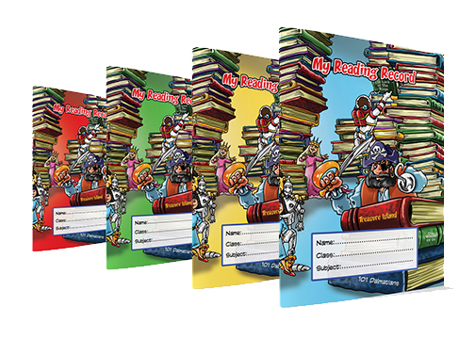



Reading at home
Children are expected to read and have their reading record signed each night. Now they are in Year 5,the children can sign their own reading record.
Children are expected to read at least 20 pages of their book each night.
Reading recommendations – a list of recommended reads can be found in more detail on our website.

Slide 10

A selection of books that are suggested for year 5 children, to build a wide and varied vocabulary.

Slide 11

PE
Children will have Sport every Tuesday
They need to bring plain black shorts a plain white t shirt and trainers or pumps each week.
Alternatively, they can bring their P.E kit and leave it on their peg for the half term.

Slide 12

The curriculum - Religion
Religion is at the heart of our school. We say prayers together and take part in class and whole school worship. We use the Vine and the Branches program which gives pupils the opportunity to explore the mystery of faith through scripture and tradition.
In Year 5 we follow these topics:
Creation and Covenant
Prophecy and Promise
Galilee to Jerusalem
Desert to Garden
To the Ends of the Earth
Dialogue and Encounter
Judaism
https://www.tentenresources.co.uk/life-to-the-full-primary/
Health and relationship curriculum
The entire teaching is underpinned with a Christian faith understanding that our deepest identity is as a child of God – created, chosen and loved by God.

Slide 13

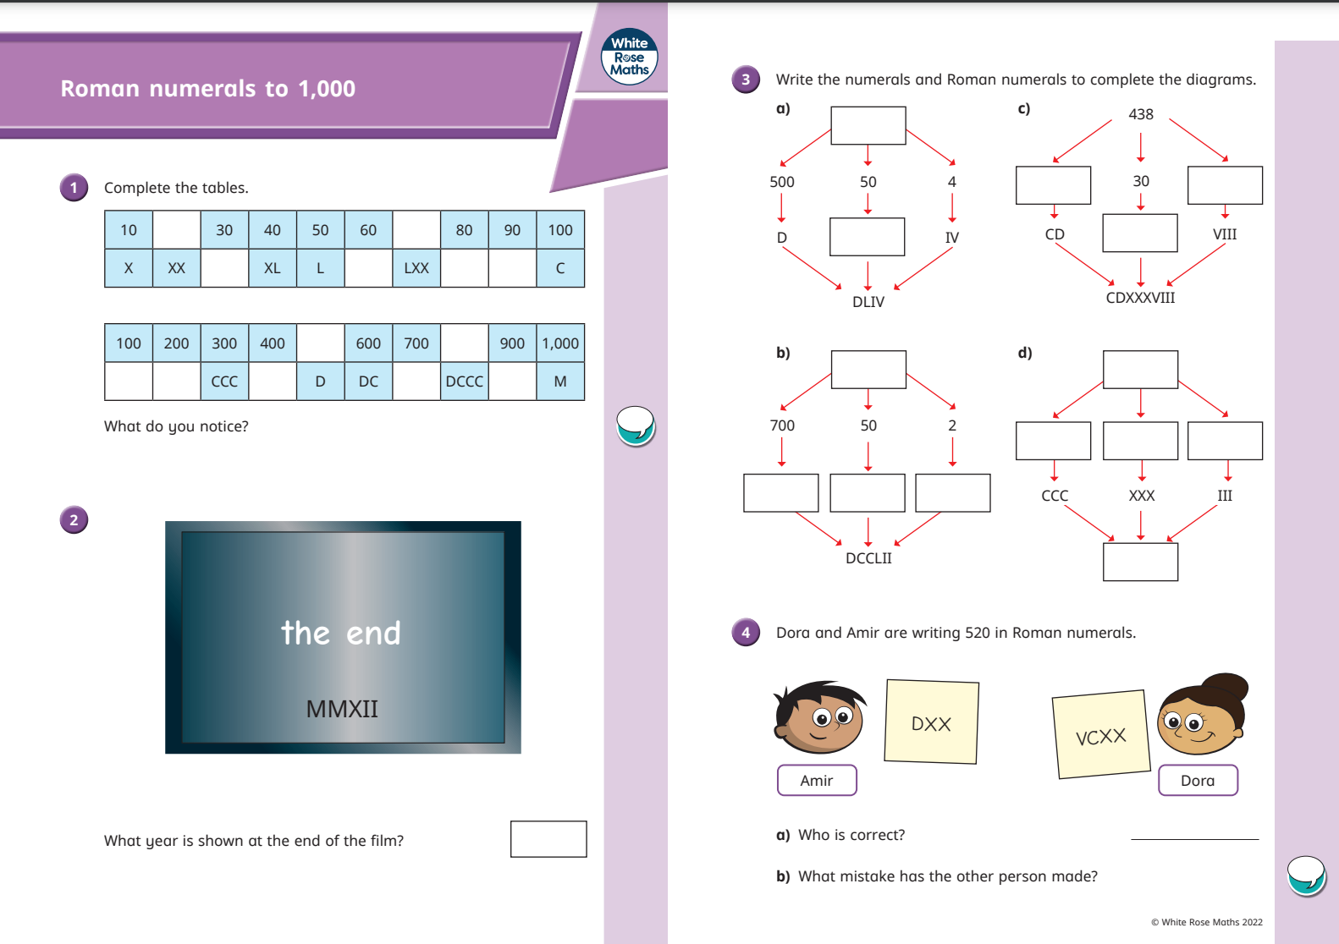
The curriculum - Maths
Maths - White Rose
Lessons and activities are designed to encourage children to become more fluent in their problem- solving and encourage a higher level of thinking in maths in order to deepen understanding and master concepts. Concepts merge from one chapter to the next. Chapters are then broken down into individual lessons.
We use lots of practical resources to support children’s learning and understanding of mathematical concepts. We also use real life problem solving so children can see and use real life contexts.
https://whiterosemaths.com/parent-resources

Slide 14


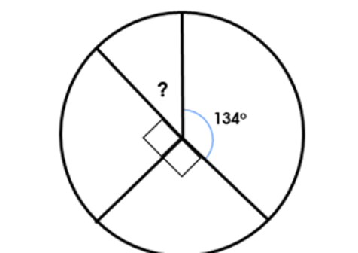
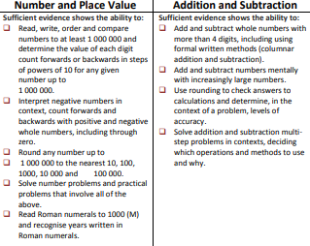
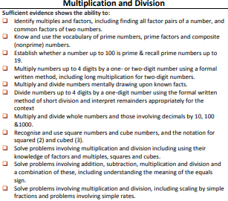
End of year expectations - Maths

Slide 15
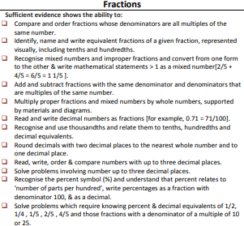
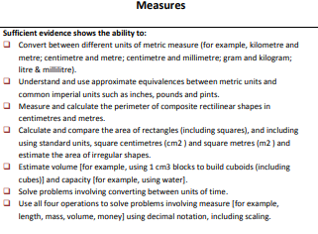
End of year expectations - Maths

Slide 16

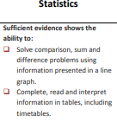
End of year expectations - Maths

Slide 17
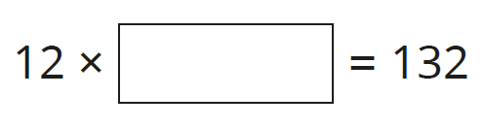
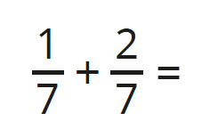
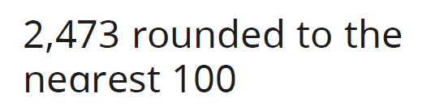
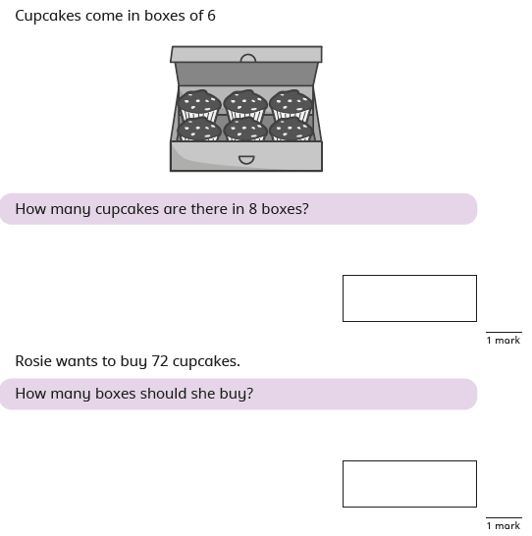
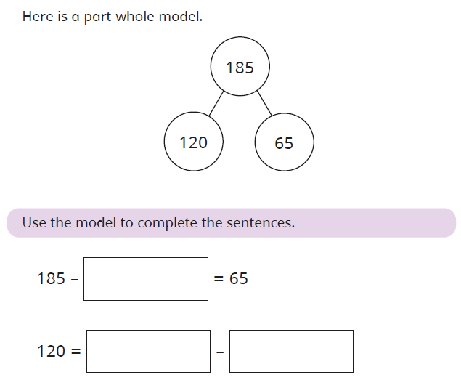

Slide 18



The curriculum - Literacy
In Year 5 children will:
Write for a variety of purposes – diary entries, stories, persuasive letters.
Read and take inspiration from a variety of non-fiction and fiction texts.
Edit and improve their own writing.
Be taught a range of spelling patterns.
https://primarysite-prod-sorted.s3.amazonaws.com/cathedral-school-st-peter-and-st-john/UploadedDocument/888b42f4-c4f2-4272-acc4-d149a6065d37/key-learning-in-writing-1.pdf

Slide 19



End of year expectations - Reading
In Year 5 children will:
Read books at an age appropriate interest level.
Use knowledge of root words to understand meanings of words.
Use suffixes to understand meanings e.g. -ant, -ance, -ancy, - ent, ence, -ency, -ible, -able, -ibly, - ably.
Read and understand words from the Year 5/6 word list
Understand texts they read independently and those which are read to them
Evaluate the impact of the author’s use of language e.g the use of similes and metaphors.
https://primarysite-prod-sorted.s3.amazonaws.com/cathedral-school-st-peter-and-st-john/UploadedDocument/af2bffa8-731e-413d-aa23-0a77458047b4/key-learning-in-reading111.pdf

Slide 20
Year 5 Autumn Overview
Along with other staff members working with our class, I am looking forward to getting to know your children and working with you help your child reach their potential. Mrs Pugh.
Every day your child needs to bring in their reading record (signed by them or a grown up), reading book and their home spelling book.
Tuesday: Bring in sports kit – plain white t-shirt and plain black shorts (can be left in school for the half term) and their completed homework.
Wednesday: Spelling test (results will be sent home, on Thursday) in their home spelling books, along with new spellings for the following week.
Friday: New homework (to be handed in on Tuesday).
Literacy
Working with the text The Lion the Witch and the Wardrobe, the children will write their own innovated stories and create their own mythical creature. They will then explore the Legend of Gellert and Beowolf to devise their own legend.
Maths
Place value - understanding numbers to 1,000,000.
Addition and subtraction – adding and subtracting numbers with up to four digits.
Multiplication and division – multiplying and dividing by 10, 100 and 1,000 and understanding factors , prime, square and cubed numbers.
Fractions – adding and subtracting fractions and finding equivalent fractions.
Religion
Using Bible scripture, the children will know God more clearly to understand His Word and learn how to live out His will and spread the Good News. Exploring Creation and Covenant, they will realise God’s love through His work and agreements with His chosen ones. Prophecy and Promise will cement the children’s understand the work of those chosen by God.

Slide 21
Year 5 Autumn Overview…cont.
History
We will investigate and discover Ancient China and The Shang Dynasty’s legacy, its significance amongst the other Chinese dynasties and the impact that can still be seen in the world today.
Science
The children will get hands on to investigate forces and mechanisms. Learning how gravity, friction, and air and water resistance effect everyday objects, as well as, finding out how we can create a greater effect from smaller effort. We will understand Earth’s movement in relation to the Sun and other planets and recognise the phases of the moon.
Geography
In the topic: Investigating Our World, the children will pick up essential map reading skills and begin to understand time zones through locating the Prime Meridian/Greenwich Mean Time (GMT). They will know the lines of significance and how they dictate climates and environmental regions. Knowing about physical features will assist in understanding settlements and human features, linking to our knowledge of The Shang Dynasty
Music, Sport and Computing
A specialist MAPAS teacher will teach music (rhythm, notation, timbre and dynamics). Also on Tuesdays, a PE coach will train skills for various sports. Computing will focus on on-line safety, digital literacy, information technology and computer science.
Art and DT
Continuing to progress our basic skills, we will work with lines and textures with colour and tone. We will look at the significance of art from Ancient China, specifically the Taotie motif and compare ancient and contemporary carving methods.

Slide 22
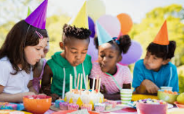
Birthdays in Year 5.
On your child’s birthday, they can come to school in non-uniform and bring in sweets or a cake for their friends, if they would like to.
(please no lollies with sticks)
If you are sending in a cake, please could you provide napkins, also.
If any children are allergic to what has been brought in, I will have some treats that they would be able to have instead of the supplied treat.
If you’re their birthday falls at the weekend, or during the holidays, we will celebrate either the last day in or the first day back.

Slide 23
Any Questions?
Important Dates – Full list available on the website.
Thursday 2nd October: Individual photos
Wednesday 8th October: Year 5 Harvest Festival Celebration
Tuesday 11th November: Poetry and poppies assembly
Thursday 27th November – Jack and the Beanstalk pantomime
Please feel free to ask any questions regarding any issues you may have.
I am always happy to help with anything you may need. You can catch me quickly in the morning, or at pick up, or; if you require more time or privacy, we can arrange a private meeting before or after school.

