Slide 1


Welcome to year 2
2025 - 2026

Slide 2
Our Mission STATEMENT
Growing together within God’s loving family, we support, challenge and inspire each other to become the best that we can be.

Slide 3
Introductions
The Year 2 team:
Mrs Royle - Monday – Wednesday
Mrs Thorpe – Thursday and Friday
Miss Janik – Monday - Friday

Slide 4
General reminders
Doors open at 8.40am for a 8.45am start.
Children must bring a water bottle into school every day. It will be sent home at the end of the day to be washed and refilled.
Toast and milk are payable half termly in advance.
All monies are to be paid using Parent Pay.
The school day ends at 3.15pm – please collect your youngest child first.
Breakfast Club and After School Club are available although are heavily subscribed.

Slide 5
Uniform
School jumpers and cardigans are available from the school office.
Blue sweatshirt or cardigan with school logo
White polo shirt or blouse/shirt
Dark grey/black trousers
Navy/black/grey knee length skirt or pinafore dress
Plain black/white or grey socks/tights
Black shoes (no trainers, boots or open toe sandals)
Jewellery - Small plain studs - one in each ear
All items of clothing should be marked with your child’s name please (including PE kits).
Please make sure you send a coat into school everyday.

Slide 6

PE
PE will be on a Thursday afternoon.
We recommend you leave your child’s PE bag at school for the half term, taking it home to wash in the holidays.
PE kit – white T-shirt, black shorts and trainers.
Please encourage your children to practise getting changed independently at home. It is currently taking a long time for them to change which takes away from their lesson time.

Slide 7

Class Dojo
Children receive dojo points for going ‘above and beyond.’
Children will be rewarded with a prize when they achieve 50 dojo points.

Slide 8
Year 2 Religion
Religion is a core subject. It is taught for two and a half hours each week.
Our religion curriculum is organized into six branches; Creation and Covenant (stewardship and baptism), Prophecy and Promise (Advent and Christmas), Galilee to Jerusalem (Jesus’ life), Desert to Garden (Lent and Easter), Ends of the Earth (The Ascension and Pentecost) , Dialogue and Encounter (The Mass and other religions)
We will attend Mass at whole school mass at key times during the year.
We do daily worship in class and a Key Stage 1 worship once a week.

Slide 9
Year 2 Maths
We follow the White Rose Maths curriculum. Topics include place value, addition and subtraction, shape, money, multiplication and division, space and measure, fractions, time and statistics.
We also have a daily session of Mastering Number which helps the children become increasingly fluent in number.
Making children aware of, and involving them in mathematical problems in real life will be a great help in applying their skills.
Children are expected to know their 2, 3, 5 and 10 times tables (and the related number facts).
Much of this work is still done practically, working on the building blocks from the previous years.

Slide 10
Year 2 Reading
School reading – your child’s book will be changed when they have read it and we feel that they are confident on decoding, fluency and the understanding of that book.
Please make sure your child reads to an adult every night and that the reading record is signed every night.
It is important to ask questions about the text to check the children have understood what they have read.
Your child must bring their reading folder into school every day. Not returning books impacts your child’s learning and the learning of other children too.

Slide 11
Year 2 Weekly activities
Spellings
We will have a spelling test on Wednesdays. New words will be given on a Friday.
Spellings should be practised regularly at home. They will also be on Spelling Frame to practise. The children’s individual log in is in the front of their reading record.
Some words may be those they have already taken home to practise before as they will be words that we discover they have not remembered and are not applying in their written work and so need more practise on.
Some may be words they already know in order to build confidence.

Slide 12

Homework
Homework will be given on a Friday to be returned by Tuesday
There will be English and Maths homework each week.
Spellings will be tested each Tuesday. Children will have access to Spelling Frame to practise the week’s spellings. It is also advised they practise by writing their spellings down and putting them into sentences.
By the end of Year 2, children are expected to know the 2, 3, 5 and 10 times tables to instant recall. We will let you know which times tables we are focusing on and we will have regular tests to assess this.

Slide 13
How can you help?
Support your child with their homework they bring home each week. If they don’t understand something, please come and speak to a member of staff for extra guidance.
Daily reading with your child (around 10 minutes) – asking questions about characters’ actions and feelings, the authors use of language and exploring new vocabulary by discussing what words in the text mean.
Maths number facts – addition, subtraction, multiplication and division. Number problems e.g. I need 18 eggs, they come in boxes of 6, how many boxes will I need?
Practising their weekly spellings and the common exception words sent home.
Sharing stories together, not only their school reading book.

Slide 14
Assessment
SATS in Year 2 are no longer mandatory however all children are regularly assessed using a combination of tests, observations and teacher assessment. This is an ongoing process throughout the year, just as it was in previous years. This information is used to inform and plan the next steps for your child as they progress.

Slide 15
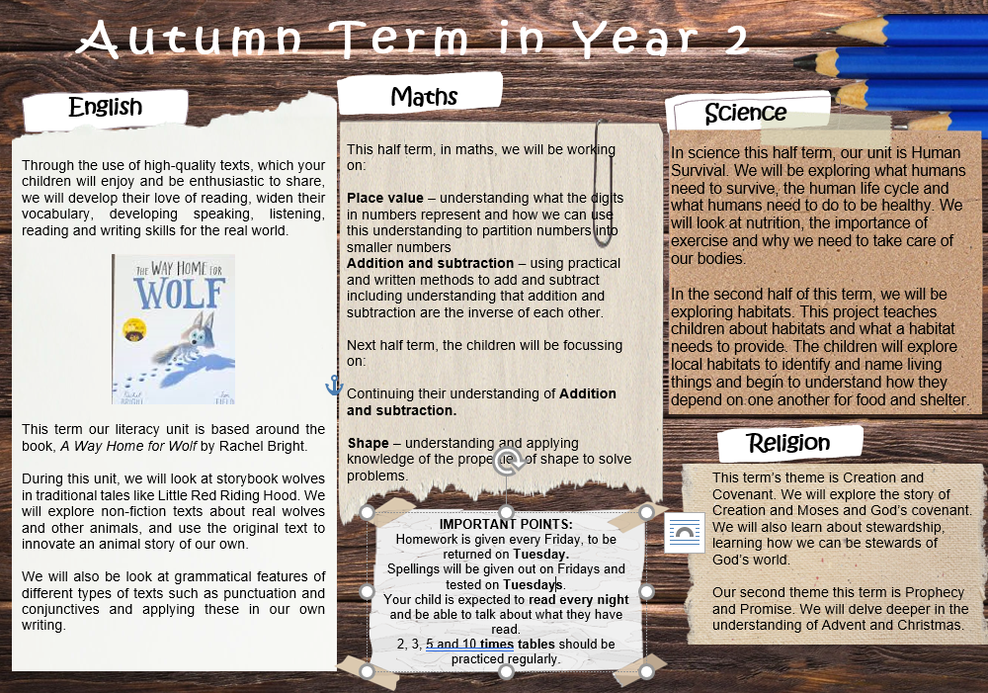

Slide 16
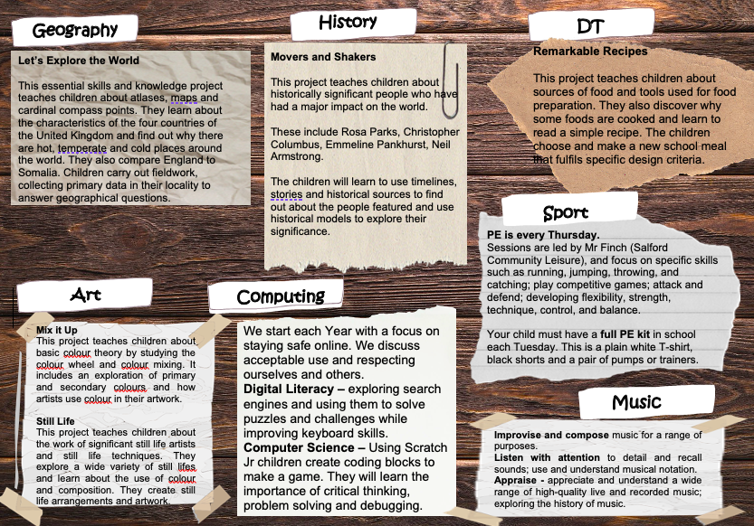

Slide 17
Any questions?

