Slide 1


Welcome to year 1
2022 - 2023

Slide 2
Growing together within God’s loving family, we support, challenge and inspire each other to become the best that we can be.

Slide 3
Introductions
The Year 1 team:
Mrs Mc Fadden
Miss Myers
Mrs Culkin – interventions
Miss Walsh
And of course your wonderful children!

Slide 4
General reminders
Doors open at 8.40am for a 8.45am start.
New water bottles are available from the school office
Toast and milk are payable half termly in advance.
All monies are to be paid using Parent Pay.
The school day ends at 3.15pm – please collect your youngest first.
Breakfast club and After school club are available although are heavily subscribed!

Slide 5
Uniform
School jumpers and cardigans are available from the school office.
Blue sweatshirt or cardigan with school logo
White polo shirt or blouse/shirt
Dark grey/black trousers
Navy/black/grey knee length skirt or pinafore dress
Plain black/white or grey socks/tights
Black shoes (no trainers, boots or open toe sandals)
Please ensure your child comes to school with a coat
Jewellery
Small plain studs-one in each ear
All items of clothing should be marked with your child’s name please!

Slide 6

PE
PE Day is Thursday.
We recommend you leave your child’s PE bag at school for the half term, taking it home to wash in the holidays. Or if you prefer, bring it in to school on a Monday and take it home on a Friday.
PE kit – white T-shirt, black shorts and pumps or trainers.

Slide 7

Class Dojo
Children receive dojo points as a way of promoting positive
behaviour .
Children receive a reward when
they have collected 10 dojo points and for
every multiple of ten thereafter.
FRIDAY- GOLDEN TIME!

Slide 8
Year 1 Phonics AND Reading
Our teaching scheme - Little Wandle Letters and Sounds.
Systematic Teaching of Phonics – Includes teaching spelling and reading skills.
Phonics meeting: Wednesday 12th October 9 am
School reading – your child will read a new book every week at school. They will read this for 3 days to build on decoding, prosody and understanding.
They will bring this home on a Wednesday. They should be able to read this independently or without much support.
Your child will also bring home a book of their choice to read for pleasure. This is a book to share. There is no expectation for them to read it independently.

Slide 9
What is the phonics screening?
The Phonics Screening Check is meant to show how well your child can use the phonics skills they’ve learned up to the end of Year 1, and to identify students who need extra phonics help.
The Department for Education defines the checks as “short, light-touch assessments” that take about four to nine minutes to complete.
The aim of the test is not to see if your child can read but to ensure they have phonic skills they need to read new words in the future.

Slide 10
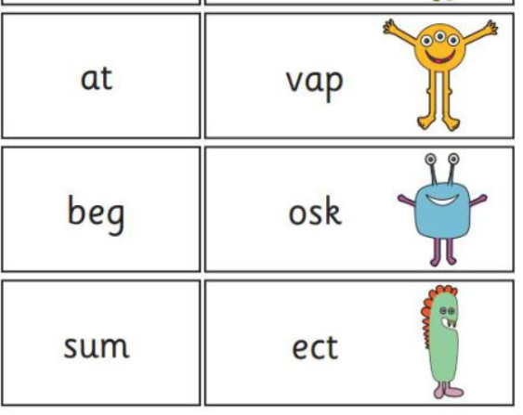
What is on it?
The 40 words in the check are split into sections progressing from simple word structures to trickier words with five or six letters.
The often confusing thing about the screening check
is that 20/40 of the words that children are expected to
read are ‘nonsense words’, alien words that have no
meaning. This really tests a child’s phonic decoding skills
to check they have the appropriate standard.

Slide 11
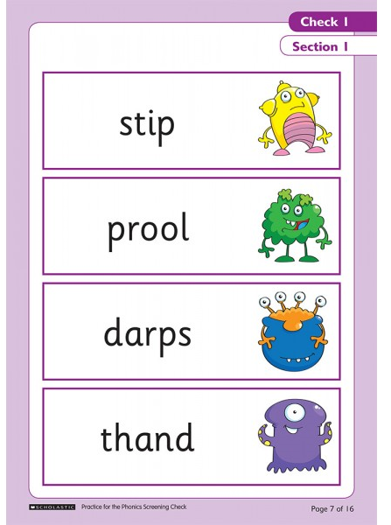
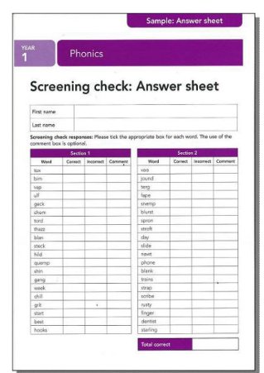
What it looks like

Slide 12
When is it?
Schools will administer the Phonics Screening Check during the Summer 1 Term.
It will be a one to one check and your child will be given some practice words first including nonsense words.

Slide 13
What will my child’s score mean?
The Pass threshold is set at 32/40.
You will be told how your child did, but schools’ results will not be published.
If your child’s score falls below the national standard, we will discuss with you how they will be given extra phonics help.

Slide 14

Spellings
Spellings will be given on a Friday to be returned on Thursday.
This will link to their phonics and statutory requirements in National Curriculum.

Slide 15
HomeworK
Homework will be given on a Friday to be returned on Tuesday.
This will link with something we are learning about in class.
In addition, there will be something set on Google Classrooms.
White Rose Maths. You can download an app which will support your children at home

Slide 16
Any questions?

