Slide 1


Welcome to year 2
2021 - 2022

Slide 2
Growing together within God’s loving family, we support, challenge and inspire each other to become the best that we can be.

Slide 3
Introductions
The Year 2 team:
Mrs Ginns
Miss Smith
Mrs Culkin – interventions
Mrs Campbell - Fridays
And of course your wonderful children

Slide 4
General reminders
Doors open at 8.45am for a 8.55am start.
New water bottles are available from the school office
Toast and milk are payable half termly in advance.
All monies are to be paid using Parent Pay.
The school day ends at 3.15pm – please collect your youngest first.
Breakfast club and After school club are available although are heavily subscribed!

Slide 5
Uniform
School jumpers and cardigans are available from the school office.
Blue sweatshirt or cardigan with school logo
White polo shirt or blouse/shirt
Dark grey/black trousers
Navy/black/grey knee length skirt or pinafore dress
Plain black/white or grey socks/tights
Black shoes
(no trainers, boots or open toe sandals)
Jewellery
Small plain studs-one in each ear
All items of clothing should be marked with your child’s name please!

Slide 6

PE
PE will be on a Thursday.
We recommend you leave your child’s PE bag at school for the half term, taking it home to wash in the holidays. Or if you prefer, bring it in to school on a Monday and take it home on a Friday.
PE kit – white T-shirt, black shorts and trainers.

Slide 7
Good to be green
Our daily reward system for following the Golden Rules and showing God’s love to one another.
Golden Time is on a Friday to celebrate the achievements of the week.

Slide 8

Class Dojo
Children receive dojo points for going ‘above and beyond.’
These can be saved up to claim rewards.

Slide 9
Year 2 Reading
School reading – your child will read a new book every week at school. They will read this for 3 days to build on decoding, prosody and understanding.
They will bring this home on a Wednesday. They should be able to read this independently or without much support.
Your child will also bring home a book of their choice to read for pleasure. This is a book to share. There is no expectation for them to read it independently.

Slide 10
Year 2 Weekly activities
Spellings
We will have a spelling test on a Wednesday. New words will be given on a Thursday.
You should practice your spellings regularly at home.
Some words will be those they have already taken home to practise before as they will be words that we discover they have not remembered and so need more practise on.
Some will be words they already know in order to build confidence but new words will be put into the lists also.

Slide 11

Homework
Homework will be given on a Thursday to be returned by Monday
There will be English and maths homework each week
In addition, there will be something set on Google Classrooms

Slide 12
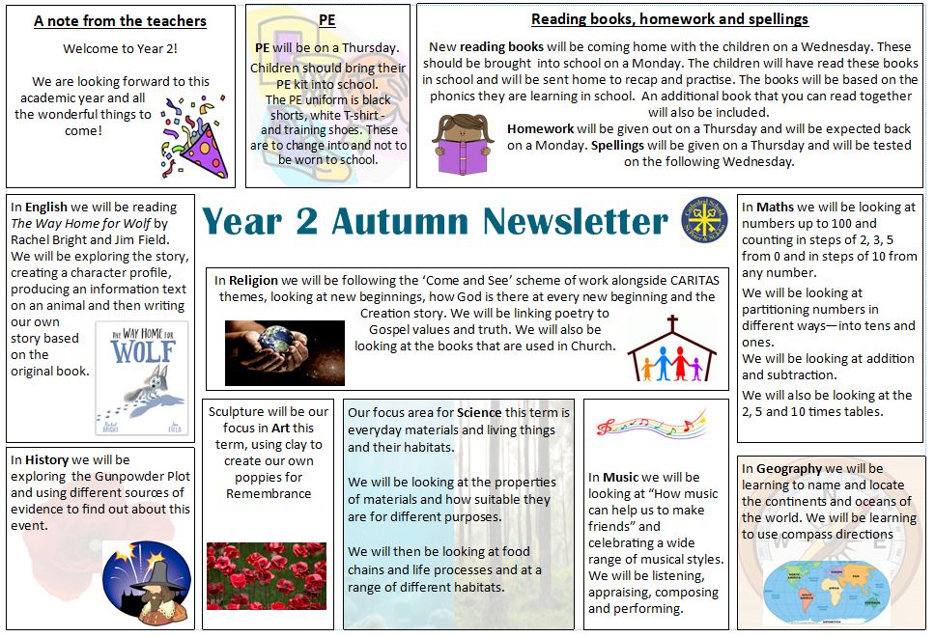

Slide 13
What is the phonics screening?
The Phonics Screening Check is meant to show how well your child can use the phonics skills they’ve learned up to the end of Year 1, and to identify students who need extra phonics help.
Due to school closure your child was not screened at the end of Year 1 and will be screened in the second half of Autumn term of Year 2.
The Department for Education defines the checks as “short, light-touch assessments” that take about four to nine minutes to complete.
The aim of the test is not to see if your child can read but to ensure they have phonic skills they need to read new words in the future.

Slide 14
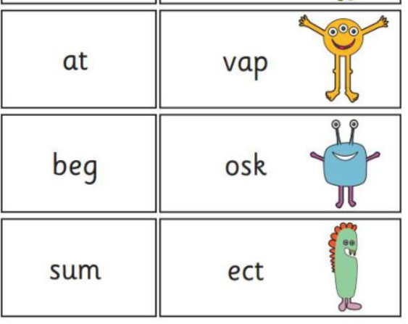
What is on it?
The 40 words in the check are split into sections progressing from simple word structures to trickier words with five or six letters.
The often confusing thing about the screening check
is that 20/40 of the words that children are expected to
read are ‘nonsense words’, alien words that have no
meaning. This really tests a child’s phonic decoding skills
to check they have the appropriate standard.

Slide 15
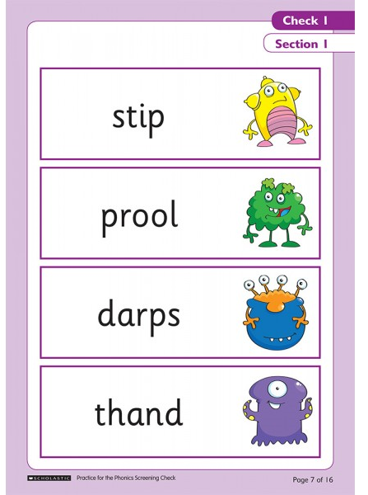
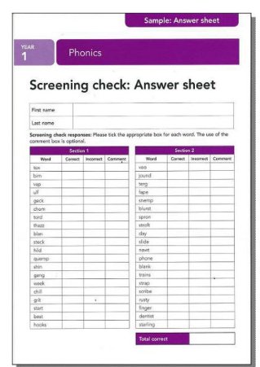
What it looks like

Slide 16
When is it?
Schools will administer the Phonics Screening Check during Autumn 2.
It will be a one to one check and your child will be given some practice words first including nonsense words.

Slide 17
What will my child’s score mean?
The Pass threshold is set at 32/40.
You will be told how your child did, but schools’ results will not be published.
If your child’s score falls below the national standard, we will discuss with you how they will be given extra phonics help.

Slide 18
How can I help my child prepare?
You can help your child prepare for their Phonics Screening Check by going over the phonics they’ve learned to date.
Read new books and stories with them where they will be introduced to new words that they’ll have to sound out, and review the phonics sounds and rules they have learned.
There are past phonics screening checks which can be practised on www.readwithfonics.com - just choose ' Past Phonics Screenings'.
www.phonicsplay.com

Slide 19
Any questions?

