Slide 1





Welcome to
Nursery!
“Growing together within God's loving family, we support, challenge, and inspire each other to become the best that we can be.”
https://www.cathedralschoolstpeterandjohn.com/

Slide 2

The Team
Class Teacher - Miss Doolan
Teaching Assistants - Miss Culkin, Miss Clarke and Miss Deakin

Slide 3
What is EYFS?
The EYFS focuses on supporting children’s learning through play, exploration, and real-life experiences, helping them to build the skills they need for school and beyond.
Within the EYFS, children’s learning is divided into Prime Areas and Specific Areas.
The Prime Areas are the essential foundations for development. This includes Communication and Language, Physical Development, and Personal, Social and Emotional Development.
The Specific Areas are Literacy, Mathematics, Understanding the World, and Expressive Arts and Design. These help children to apply their early skills in more focused ways, such as learning to nursery rhymes, exploring numbers and patterns, discovering the world around them, and expressing creativity through art, music, and role play.
Together, the Prime and Specific Areas ensure that children receive a balanced start to their learning and development.

Slide 4
What is EYFS?
  In nursery, our engaging environment allows your child to move freely between areas and ‘choose their learning’ in areas of the classroom such as role play, construction, creative arts, small world, reading corners, and outdoor play.
  Staff support children by joining in their play, asking questions to spark curiosity, and encouraging independence.
  We plan so that learning and development are implemented through purposeful play and through a mix of adult-led and child-initiated activities.

Slide 5

A Day in the life in Nursery
8:50 - 9 - Welcome, worship, timetable for the day
9:00-10:00 - Continous Provision - indoor and outdoor
10-10.20 - Snack and story
10:20-11.00 - Continous Provision - indoor and outdoor
11:00-11:15 - Phonics - Rhyme Time
11:15-11:25 - Prayers, toilets, wash hands, ready for lunch.
11:30-12:30 - LUNCH
12:30-12:45 - Maths
12:45-1:30 - Continous Provision - indoors
1:30 - 2:30 - Continuous Provision - indoors and outdoors
2:40 - Snack and story
3:00 - Home time

Slide 6




Curriculum
  Our planning ensures we cover all the areas of the curriculum however it is flexible. We always aim to plan to the interests of the children and therefore the overviews should be considered as a working document and can alter slightly as the year progresses.
  We are always looking for ways to enrich our curriculum so if you have any links that you feel might benefit our children, please let us know for example, if you or a member of your family is a key worker, it would be wonderful if you could come in and talk to the children during our ‘People Who Help Us’ unit.
  https://www.cathedralschoolstpeterandjohn.com/nursery-curriculum/

Slide 7


The importance of reading and phonics
  If a child is never read to by the time they are 5 years old, they would have heard 4662 words. If a child is read to daily they will hear 296,660 words!
  If a child knows 8 nursery rhymes by heart by the time they are 4 years old, they are usually among the best readers and spellers in their class by the time they are 8.

Slide 8
Reading and homework in Nursery
  In Nursery, your child will take home a story book of their choice to share with you at home.
  They will also be given a homework learning journal. Inside this, there will be a range of different activities to choose from to complete together and our weekly nursery rhyme to learn.
  All of the home learning is given on a Friday and returned the following Wednesday. This gives the team a chance to change their story book and mark any homework. Please return homework folders with their learning journal and reading book inside.

Slide 9
Little Wandle Phonics
  In Nursery, children follow the Little Wandle Letters and Sounds Revised ‘Foundations for Phonics’ guidance.
  Phase 1 phonics focuses on:
1) speaking and listening
2) Listening to environmental and body sounds
3) Oral segmenting and blending.
During this phase, children are tuning in to sounds, listening and remembering sounds, and talking about sounds. They begin to play with sounds using rhyme, rhythm, alliteration, voice sounds and oral blending and segmenting. We do this through a range of high quality rhymes and stories.
  There is a big focus on learning and remembering nursery rhymes, 20 in total!

Slide 10



Mathematics
  We follow White Rose Maths as a school. The Nursery maths scheme of learning covers the DfE statutory framework of the EYFS.
  It embeds early mathematical skills, thinking and talk.
  Maths in EYFS is all about a hands-on, practical approach to learning.

Slide 11
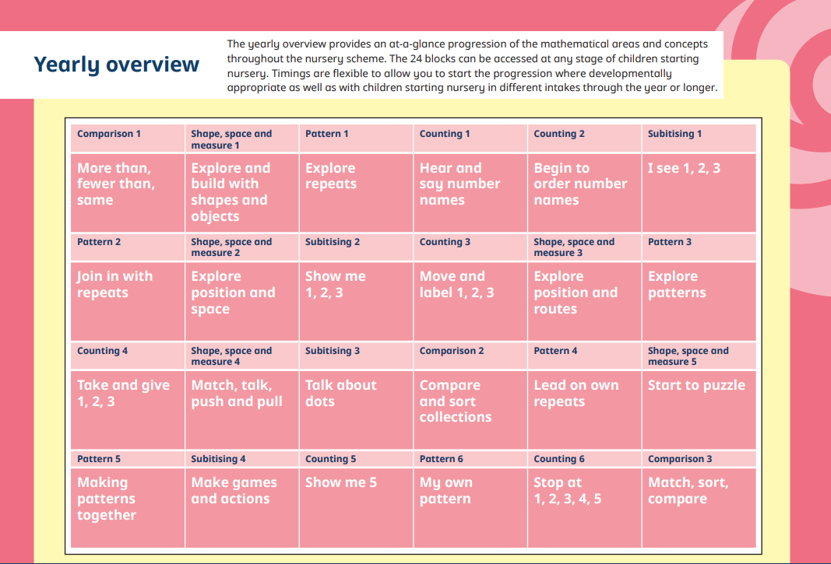

Slide 12
General Reminders...
  Doors open at 8.40 am for a 8.45 am start. The school gates open at 3 pm for pick up.
  Toast and milk are payable half termly in advance.
  School dinners must be ordered on School Grid before 8.50 a.m.
  All money to be paid using Parent Pay.
  Please make sure you send your child in with a water bottle each day and a spare change of clothes.
  Please ensure all clothing is labelled with your child's full name.
  Drawstring bags or book bags only please!
  We are a healthy eating school. Please ensure your child's packed lunch is in line with our healthy eating policy. This includes only water. Other juices are not permitted.
  One of our pupils in Nursery has a severe nut allergy. No nuts or nut-containing products are allowed to be brought into school. If it a birthday, please make sure the cake does not contain nuts.

Slide 13
Uniform
  School jumpers and cardigans are available from the school office.
  Blue sweatshirt or cardigan with school logo
  White polo shirt or blouse/shirt
  Dark grey/black trousers
  Navy/black/grey knee length skirt or pinafore dress
  Plain black/white or grey socks/tights
  Black shoes
  (no trainers, boots or open toe sandals) If you child’s shoes light up, please turn this feature off. We highly encourage for your child to wear trainers with velcro straps.
Jewellery
  Small plain studs-one in each ear, no necklaces and no bracelets.
,

Slide 14

Class Dojo
Children receive dojo points for going ‘above and beyond.’
When the children reach 10 dojo points, they will be able to choose a prize from the prize box.
After they have received their prize, the dojos will be reset to 0, ready for them to start earning their next 10 dojos.

Slide 15
Parental Involvement
  Dialogue between parent’s and teachers is extremely important to us. No one knows your child better than you do!
  We aim to have an open door policy and will always make time to speak to you. If you need to speak to us at the end of the day, please appreciate you will need to wait until the other children have been dismissed for safety reasons. Alternatively, we can speak over the phone or make an appointment.
  We will also have the opportunity to speak at pupil progress meetings that we have three times each year. You will be given written achievements and targets prior to pupil progress meetings.
  You can also see all the wonderful things your children have been doing on the school website and the school twitter page.

Slide 16


Any questions?

