Slide 1


Welcome to Reception
2025 - 2026

Slide 2
Mission Statement
Growing together within God’s loving family, we support, challenge and inspire each other to become the best that we can be.

Slide 3
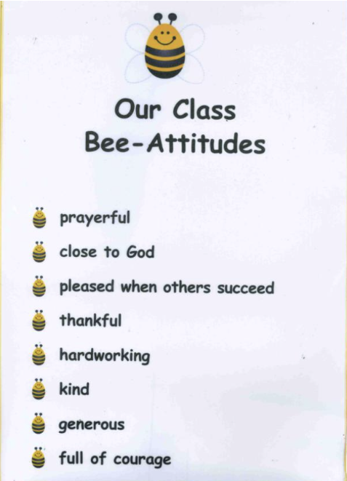
Bee- Attitudes
In Reception the children are developing their understanding of Gospel values, they are promoted through Bee-Attitudes which is consistent throughout the school. The children are encouraged to follow the values of Jesus.

Slide 4

Class Dojo
Children receive dojo points for going ‘above and beyond.’
When the children reach 10 dojo points, they will be able to choose a prize from the prize box.
After they have received their prize, the dojos will be reset to 0, ready for them to start earning their next 10 dojos.
You will be sent messages through the Dojo website when your child receives points.

Slide 5
Website
Home | The Cathedral School of St Peter and St John Primary (cathedralschoolstpeterandjohn.com)

Slide 6
The EYFS TEAM
Mrs Mc Fadden- Early Years Lead and Reception Teacher
Mrs Culkin- Higher Level Teaching Assistant
Mrs Clarke – Teaching Assistant
Miss Poll – Teaching Assistant

Slide 7
What is EYFS?
The Early Years Foundation Stage is a statutory framework that sets out standards for the learning, development and the care of children from birth to five years
The framework ensures children are safe, healthy, and well-prepared for future learning by outlining legal requirements for safeguarding, welfare, learning, and development, all centered around a play-based approach to education
The framework emphasizes that children learn best through play and active exploration.

Slide 8
Key Areas of Learning
Key areas:
Prime areas:
Communication and Language
Personal Social and Emotional Development
Physical Development
Literacy
Mathematics
Understanding of the World
Expressive Arts and Design

Slide 9
Reception is more structured than nursery. The children are expected to concentrate for longer periods of time and complete increasingly challenging tasks, such as writing short sentences or solving problems in maths. The structure helps to prepare the children for Year 1.

Slide 10
Supervised Teeth brushing programme
Consent forms will be provided if you would like your child to take part.
Your child will be helped to brush their teeth each day and will be closely supervised to ensure they are doing it efficiently

Slide 11
Reception Baseline
Every child is assessed at the beginning of Reception. This allows us to track your child’s progress as they move through the school.
These assessments are completed in class with the teacher. They take about 20 minutes.
Every child in the country will complete the same assessments.

Slide 12
General reminders
Doors open at 8.40 am for a 8.45 am start.
School meal orders can be placed a week in advance or on the day, before 8.30am.
Packed lunches: We promote healthy eating, water available in the dinner hall.
Toast and milk are payable half termly in advance.
All monies are to be paid using Parent Pay.
The school gates open at 3 pm and the day ends at 3.10 pm.

Slide 13
Uniform
Blue sweatshirt or cardigan with school logo.
White polo shirt
Dark grey/black trousers
Navy/black/grey knee length skirt or pinafore dress
Plain black/white or grey socks/tights
Black shoes (no trainers, boots or open toe sandals) Velcro promotes independence.
Please ensure your child comes to school with a coat, British weather is unpredictable
Draw string bags for coat pegs: Please provide spare clothes (doesn’t need to be a uniform).
Reading bags: To be kept in the boxes under the coat trolley
Sweatshirt’s/Cardigan’s, book/drawstring bags available to order at the office
Small plain studs. No bracelets or necklaces to be worn
All items of clothing should be marked with your child’s name please!

Slide 14
Curriculum
Our planning is a basic outline to ensure we cover all the areas of the curriculum however it is flexible. We always aim to plan to the interests of the children and therefore the overviews should be considered as a working document and can alter slightly.
We are always looking for ways to enrich our curriculum so if you have any links that you feel might benefit our children, please let us know for example, if you or a member of your family is a key worker, it would be wonderful if you could come in and talk to the children.
In addition to our curriculum, we are also involved in the whole school super learning days, for example, the Inspirational Women in History, Black History month, Science day and much more.

Slide 15
Educational visits
Peel Park
RHS Bridewater
Salford Museum and Art Gallery: Visit to the Victorian Street Lark Hill Place
Southport beach

Slide 16
Reception Phonics AND Reading
Our teaching scheme - Little Wandle Letters and Sounds.
Systematic Synthetic Phonics – it is an approach to recognise letters and their associated sounds. We break the words down into the smallest units of sound and blend them together to read the words
In Reception, your child will read a new book every week at school. They will read this for 3 days to build on decoding, prosody (reading with expression) and understanding.
They will bring this home on a Wednesday, it must be returned each day as your child may be asked to read with a member of staff. They should be able to read this independently or without much support.
Your child will also bring home a book of their choice to read for pleasure. This is a book to share. There is no expectation for them to read it independently.

Slide 17
Reading books
Wordless books
Can establish a reading routine without the pressure of reading a book.
Focus on discussing the illustrations and story.
Questioning.
Extend vocabulary- adding describing words, alternative words (a big tree, an enormous tree).
Phonological awareness (I spy ‘s’ for..)
Comprehension (What might the character be feeling?)
Structure (Beginning, middle and end).
Retelling and Imagination (remembering the beginning, middle and end as well as acting out the story).
SO MUCH LEARNING FROM WORDLESS BOOKS!
Reading books match the children’s level of phonic understanding (identifying phonemes and blending).
Phonics assessments are completed to ensure the children are given the correct level of reading book.
To begin with your child may be given a wordless book because they are still developing their understanding.

Slide 18
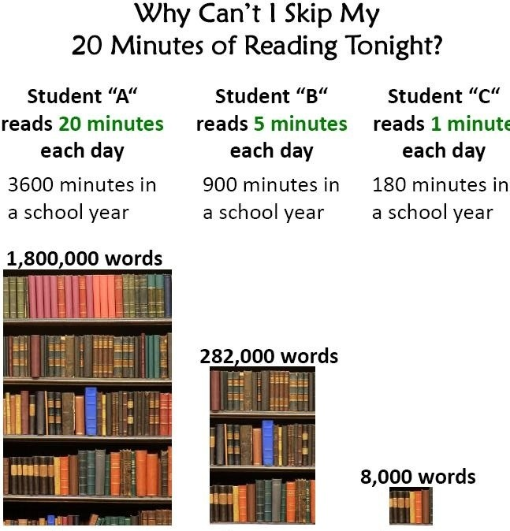
How can I help my child at home?
Talking to your child is the most fundamental way you can help your child in Early Years. Communication is key to so many areas of a child’s development.
Reading stories together is not only educational but what a lovely time to spend together!
Listening to and supporting your child with their reading book. Please comment on anything you notice in their reading record – your opinion and comments can really help us to help them.

Slide 19
Mathematics
Reception look at numbers to 10 and beyond. We use many resources, including 10s frames and part, part whole frames to deepen the children’s understanding of number.
There are many ways children can develop their understanding of numbers for example, counting whilst climbing the stairs, numbers in the environment such as numbers on front doors, on a bus or a clock.

Slide 20
HomeWork Book
This will be given on a Friday to be returned on Tuesday.
This will link with something we are learning about in class.

Slide 21

PE
PE Day is a Wednesday
Pumps or a pair of trainers must be provided- please ensure they are slip on or Velcro fastening
We recommend you leave your child’s pumps/trainers in their drawstring bag

Slide 22
Parental Involvement
Communication between parents and teachers is extremely important to us. No one knows your child better than you do!
We aim to have an open door policy and will always make time to speak to you. If you need to speak to us at the end of the day, to ensure the safety of the children we ask you to wait until the other children have left the classroom. Alternatively, we can speak over the phone or make an appointment.
We will also have the opportunity to speak at pupil progress meetings that we have three times each year. You will be given written achievements and targets prior to pupil progress meetings.
You can also see all the wonderful things your children have been doing on the school website, on the school twitter page and in our termly newspaper.

Slide 23
Any questions?

