Slide 1

Welcome to year 5
2018-19

Slide 2
Growing together within God’s loving family, we support, challenge and inspire each other to become the best that we can be.

Slide 3
Introductions
The Year 5 team:
Mrs McDermott (Class Teacher)
Mr Boardman
And of course your wonderful children

Slide 4
General reminders
Doors open at 8.45am for a 8.55am start.
New water bottles are available from the school office for £2.00
Toast and milk are payable half termly – speak to the office if you wish your child to have this (toast is 50p a week).
All monies are to be paid using Parent Pay.
The school day ends at 3.15pm – please collect your youngest first.
Breakfast club and After school club are available although are heavily subscribed!
After school clubs

Slide 5
Uniform
School jumpers and cardigans are available from the school office.
Blue sweatshirt or cardigan with school logo
White polo shirt or blouse/shirt
Dark grey/black trousers
Navy/black/grey knee length skirt or pinafore dress
Plain black/white or grey socks/tights
Black shoes
(no trainers, boots or open toe sandals)
Jewellery
Small plain studs-one in each ear
Black or blue hair bobbles and headbands only
All items of clothing should be marked with your child’s name please!

Slide 6

PE
PE will be on Thursdays.
(In Spring there will be an extra sports session on Tuesdays.)
Lunchtime sports session on Mondays – trainers required.
PE kit – white T-shirt, black shorts and PE pumps.
After school clubs – Tuesday Multi-skills
- Wednesday Spanish or computing for girls.
- Thursday Multi-skills

Slide 7

Class Dojo
Our daily reward system for following the Golden Rules and showing God’s love to one another, through the Gospel Values in action.
Class Dojos are awarded for following class rules, helping one another, teamwork and working hard.
When each child reaches 50 dojos they get a prize and are also able to personalise their avatar.
Golden Time is on a Friday to celebrate the achievements
of the week.

Slide 8

Year 5 Weekly activities
Home reading – it is still incredibly important to listen to your child read, and more importantly to talk to them about what they have read. This will develop fluency, understanding and comprehension of texts.
Reading every night builds a love of reading.
Children need to experience the importance of reading in wider contexts- enjoy sharing appropriate newspaper articles and information leaflets to enhance their vocabulary.

Slide 9
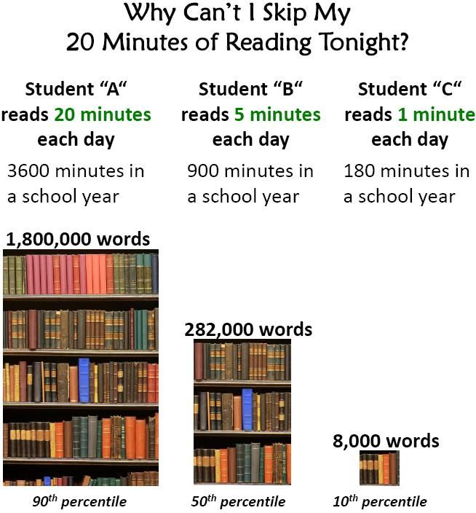

Slide 10
Year 5 Weekly activities
Times Tables
Children are required to know times tables and linking division facts by Year 4. They unlock all avenues in all Mathematics areas.
We have started to use 'Super movers' to practice our times tables in school.
Times Tables Rock Stars.....coming soon.
Spellings
New words will be given weekly on a Friday to be tested the following Friday.
We have lessons and opportunities to practice spellings in school but its is also important for children to practice their spellings regularly at home.

Slide 11
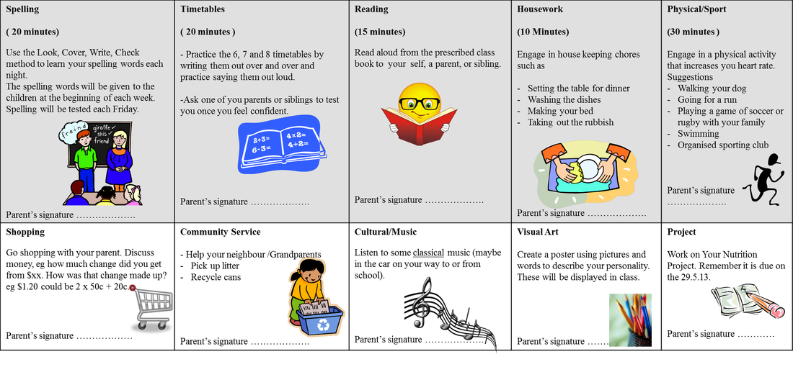
Homework
Homework
Homework is given on Thursdays and due in the following Tuesday.
This allows time for children to ask for any help on Fridays and Mondays.
We will be moving to a new grid system for homework. Homework will be set for the term and will be based on the topics that we are covering in class.
Children can choose a piece of homework to complete each week.

Slide 12
Maths No Problem
Incorporating the use of resources, problem solving and group work, Maths No Problem is child-centred and fun to teach and was assessed by the DfE’s expert panel, which judged that it met the core criteria for a high-quality textbook to support teaching for mastery.
Based on the evidence-based approach developed in Singapore
Fully aligned with the 2014 English National Curriculum for maths
Complies with the UK’s High Quality Textbook guidance published by the National Centre for Excellence in Teaching Mathematics (NCETM)
The Maths — No Problem! Primary Series was assessed by the DfE’s expert panel, which judged that it met the core criteria for a high quality textbook to support teaching for mastery.

Slide 13
Maths No Problem

Slide 14
End of Year expectations
Reading
Use meaning-seeking strategies to explore the meaning of words in context. •
Use meaning – seeking strategies to explore the meaning of idiomatic and figurative language
Identify and comment on writer’s use of language for effect.
Identify grammatical features used by writers.•
Draw inferences such as inferring characters' feelings, thoughts and motives from their actions. •
Make predictions from what has been read. •
Identify how language, structure and presentation contribute to the meaning of a text. •
Become familiar with and talk about a wide range of books,.
Read non-fiction texts and identify purpose and structures and grammatical features and evaluate how effective they are •
Prepare poems and plays to read aloud and to perform, . •
Express a personal point of view about a text, giving reasons. •
Make connections between other similar texts, prior knowledge and experience. •
Listen to and build on others’ ideas and opinions about a text •
Present an oral overview or summary of a text and author’s viewpoint of a text
Writing
Know the audience for and purpose of the writing. •
Use the features and structures of text types taught so far •
Use grammatical features and vocabulary appropriate for the text types taught so far •
Start sentences in different ways. •
Use sentence starters to highlight the main idea. •
Develop characters through action and dialogue. •
Establish viewpoint as the writer through commenting on characters or events. •
Show how grammar and vocabulary choices create impact on the reader. •
Choose vocabulary to engage and impact on the reader. •
Use stylistic devices to create effects in writing, for example, simile, metaphor, personification. •
Add well-chosen detail to interest the reader. •
Summarise a paragraph or event. •
Organise writing into paragraphs to show different information or events

Slide 15
Any questions?
I am available most days should you wish to discuss anything – the door is always open.

