Slide 1
Year 6
End of Key Stage 2 SATs

Slide 2
At the end of Year 6, children sit tests in:
Reading
Maths
Spelling, punctuation and grammar
These tests are both set and marked externally.
Your child’s marks will be used in conjunction with teacher assessment to give a broader picture of their attainment.

Slide 3
Week beginning 13th may 2019
Monday 13 May 2019
English grammar, punctuation and spelling Paper 1: questions
English grammar, punctuation and spelling Paper 2: spelling
Tuesday 14 May 2019
English reading
Wednesday 15 May 2019
Mathematics Paper 1: arithmetic
Mathematics Paper 2: reasoning
Thursday 16 May 2019
Mathematics Paper 3: reasoning

Slide 4
Year 6 SATs
Maths
Children sit three papers in maths:
Paper 1: arithmetic, 30 minutes – marked out of 40
Papers 2 and 3: reasoning, 40 minutes per paper – marked out of 35 each
110 marks available overall

Slide 5
Paper 1 will consist of fixed response questions, where children have to give the correct answer to calculations, including long multiplication and division.
Papers 2 and 3 will involve a number of question types, including:
Multiple choice
True or false
Constrained questions, e.g. giving the answer to a calculation, drawing a shape or completing a table or chart
Less constrained questions, where children will have to explain their approach for solving a problem

Slide 6
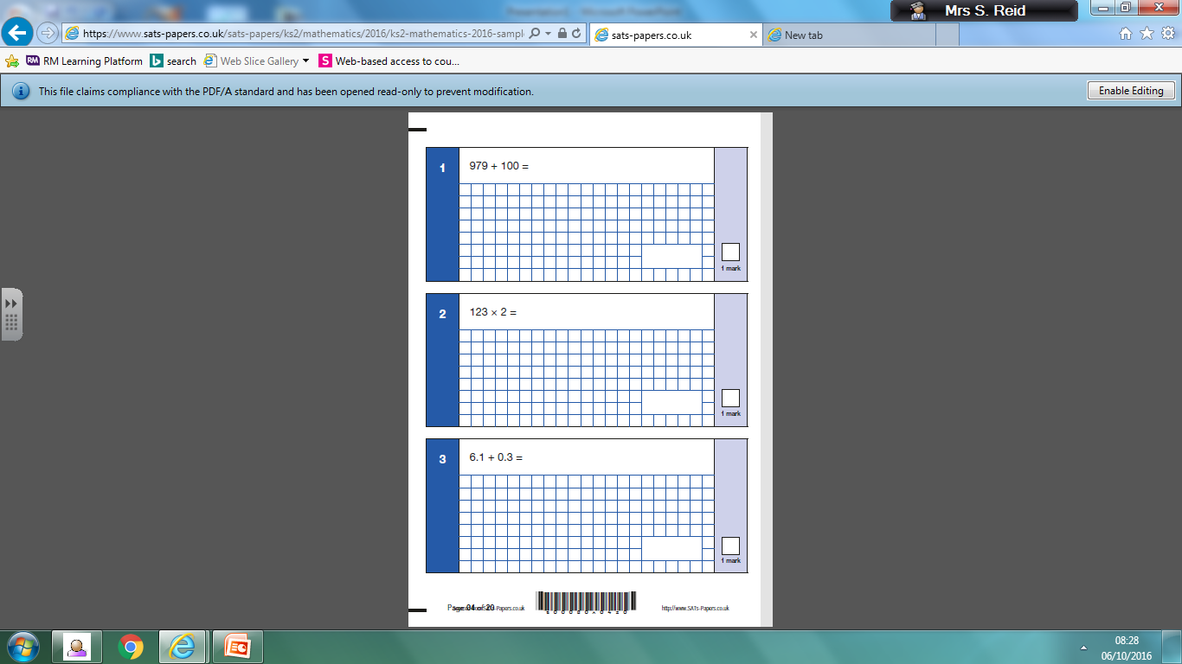

Slide 7
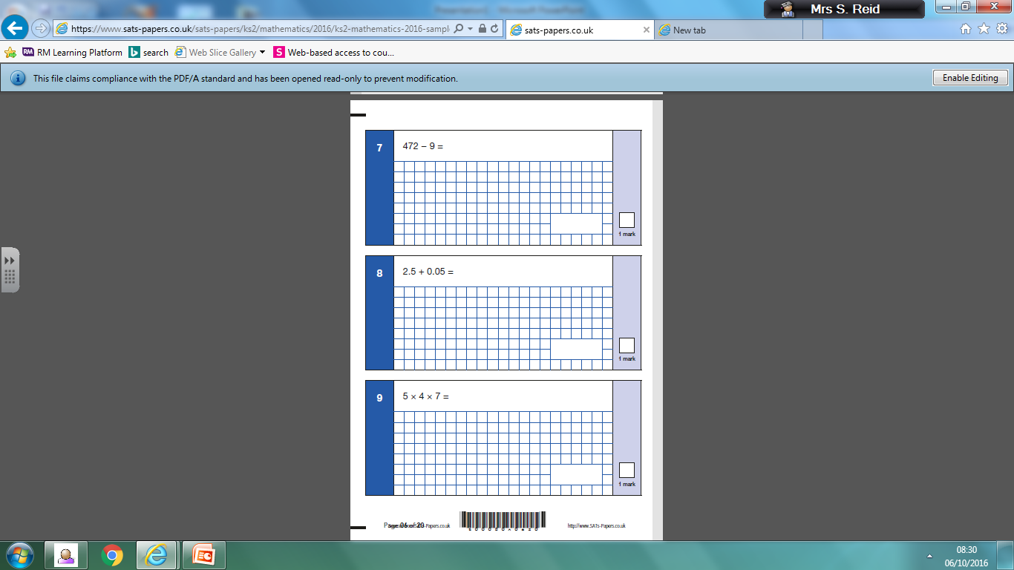

Slide 8
Reading Paper
The reading test is a single paper with questions based on three passages of text
60 minutes to complete, including reading time, to complete the test

Slide 9
Question types:
Ranking/ordering, e.g. ‘Number the events below to show the order in which they happen in the story’
Labelling, e.g. ‘Label the text to show the title of the story’
Find and copy, e.g. ‘Find and copy one word that suggests what the weather is like in the story’
Short constructed response, e.g. ‘What does the bear eat?’
Open-ended response, e.g. ‘Look at the sentence that begins Once upon a time. How does the writer increase the tension throughout this paragraph? Explain fully, referring to the text in your answer.’

Slide 10
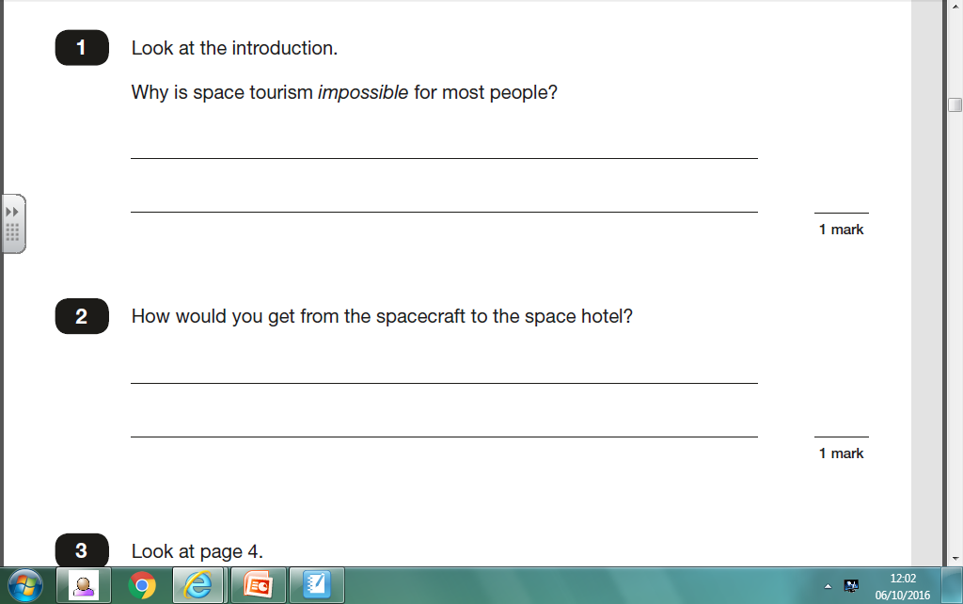

Slide 11
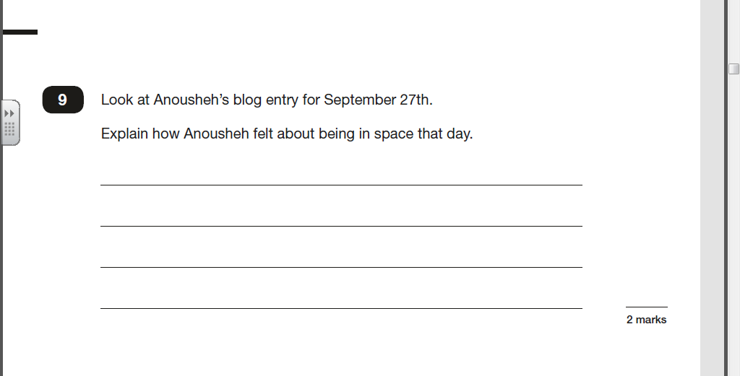

Slide 12
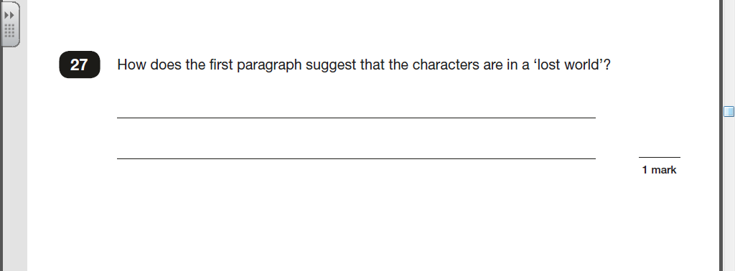

Slide 13
Grammar, Punctuation and Spelling Paper
The grammar, punctuation and spelling test consists of two parts: a grammar and punctuation paper requiring short answers, lasting 45 minutes, and an aural spelling test of 20 words, lasting around 15 minutes.
The grammar and punctuation test will include two sub-types of questions:
Selected response, e.g. ‘Identify the adjectives in the sentence below’
Constructed response, e.g. ‘Correct/complete/rewrite the sentence below,’ or, ‘The sentence below has an apostrophe missing. Explain why it needs an apostrophe.’

Slide 14
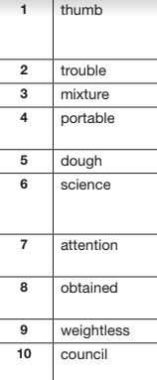
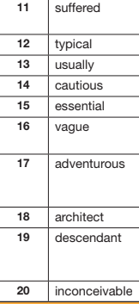

Slide 15
You will be given your child’s scaled score
The range of scaled scores available for each KS2 test is:
80 (the lowest scaled score that can be awarded)
120 (the highest scaled score)
The expected standard for each test is a scaled score of 100 or more. If a child is awarded a scaled score of 99 or less they won't have achieved the expected standard in the test
Scaled Scores
Practise
papers

