Slide 1
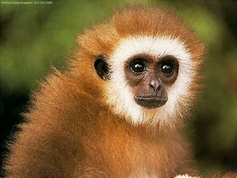
Welcome to charnley zoo
As you go in there is the monkeys

Slide 2
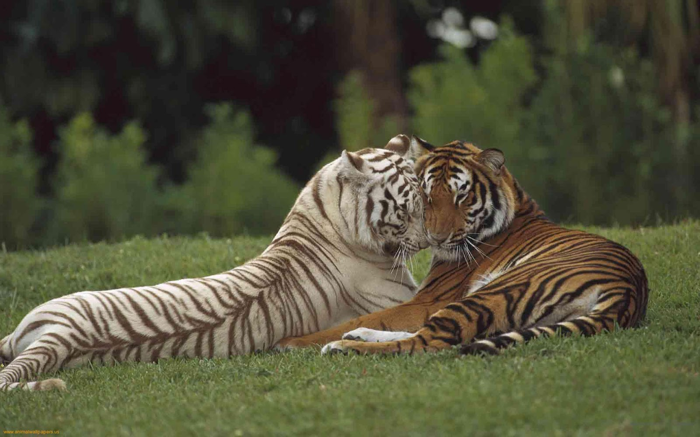
As you go a head there is tigers

Slide 3
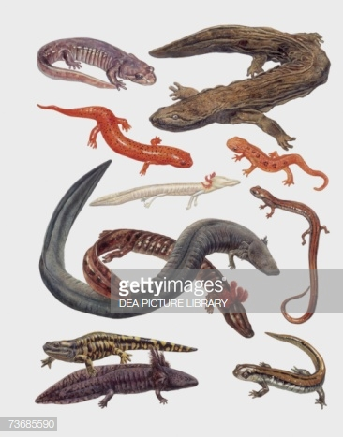
The repties

Slide 4
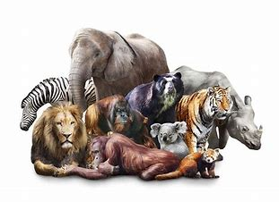
Name this animals

Slide 5
Any questions?

Slide 6

Thank you for waching

