Slide 1
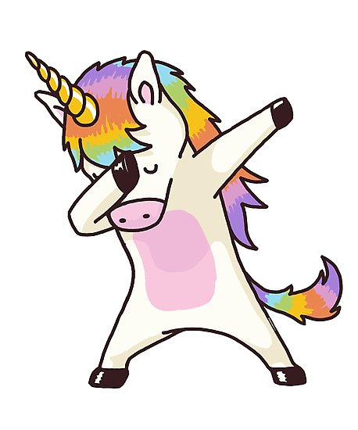

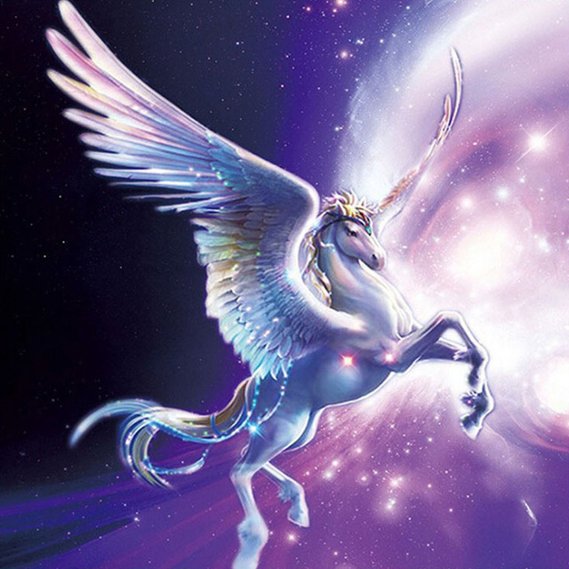
land of the mysteries

Slide 2
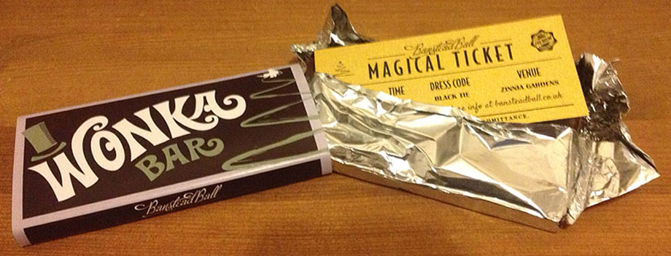
Welcome to the land of mysteries before we enter please make sure you have got your ticket.

Slide 3
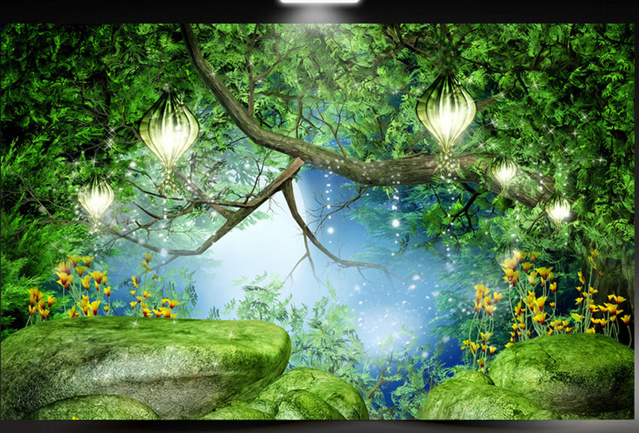
First it is our fantasy forest section. Let’s begin…

Slide 4

e

Slide 5


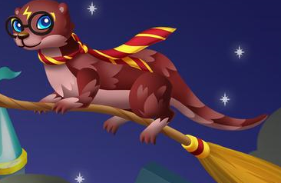
Name: harry otter likes: playing with ron weasel dislikes: professor scrape

Slide 6



Name: dumble dog likes: learning new tricks dislikes: professor scrape

Slide 7


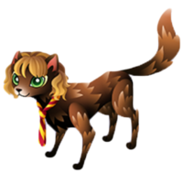
Name: felione likes: magic dislikes: being teased

Slide 8
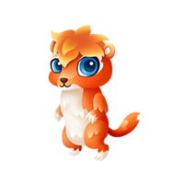
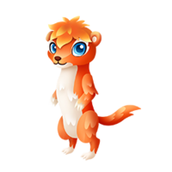
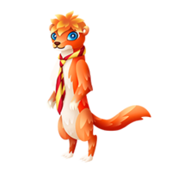
Name: ron weasel likes: harry otter dislikes: getting in trouble

Slide 9
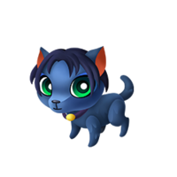
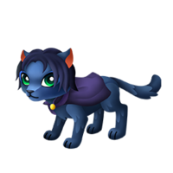
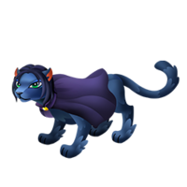
Name: professor scrape likes: being sly dislikes: harry otter

Slide 10
That is the end of our fantasy forest section we’ve got loads more animals like…..

Slide 11
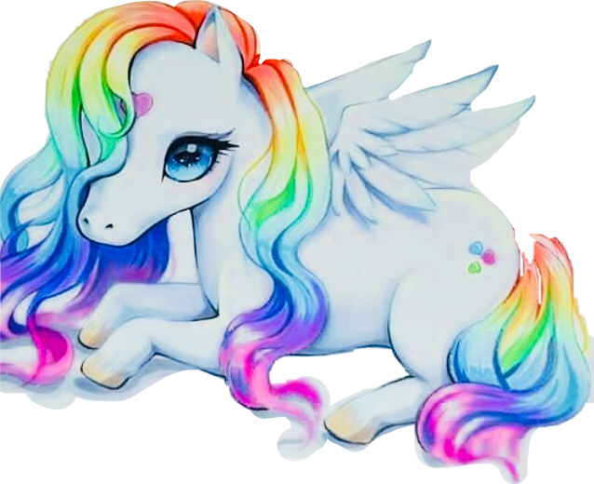
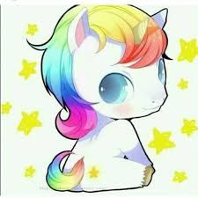

Unicorns likes: being cute dislikes : not having their hair brushed

Slide 12
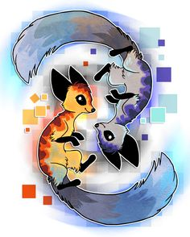
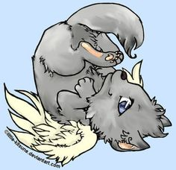
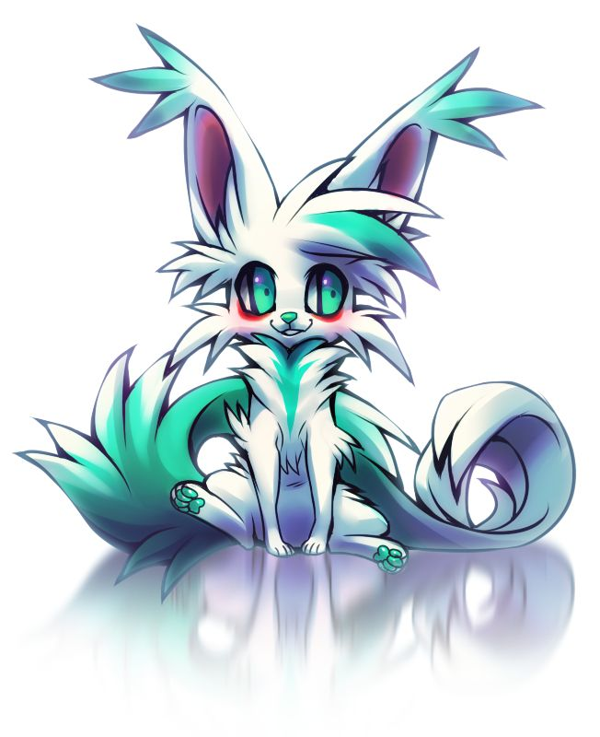
Hybrids likes: being different dislikes: having to be normal

Slide 13


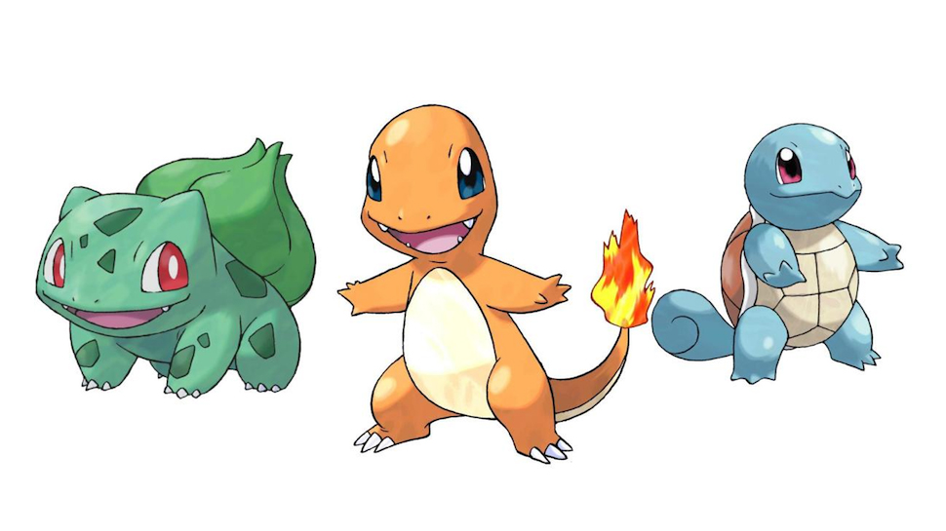
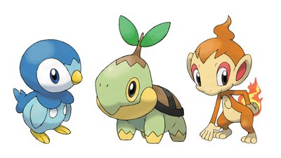
Pokemon likes: ash dislikes: bad guys

Slide 14
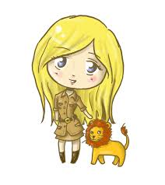
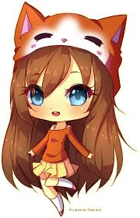
Now that that’s done time to meet our workers. For the fantasy forest workers.
Tasha kate

Slide 15
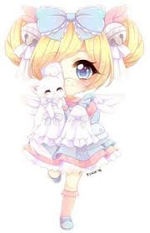
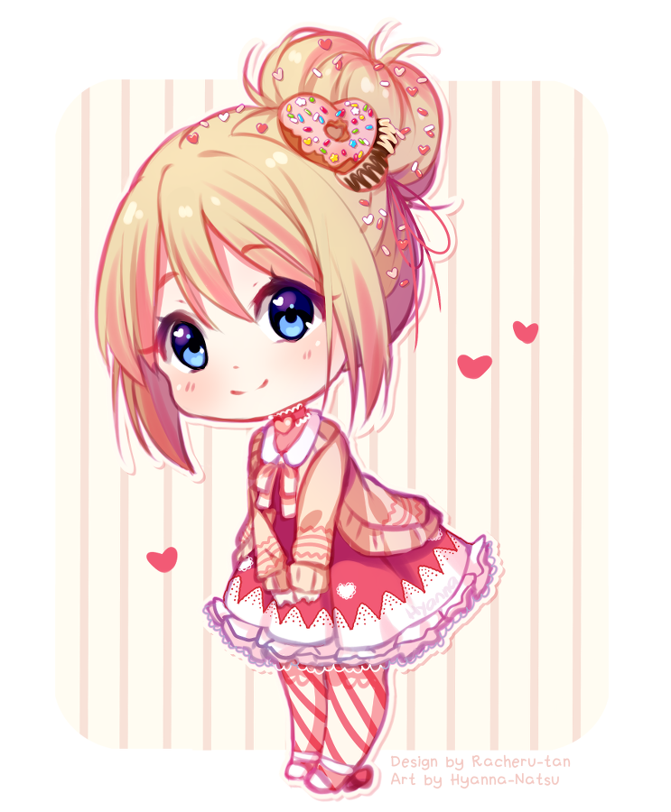
Unicorns candy cathy

Slide 16
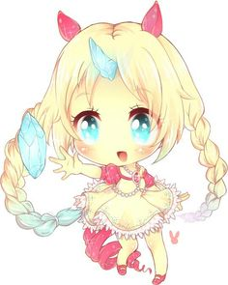
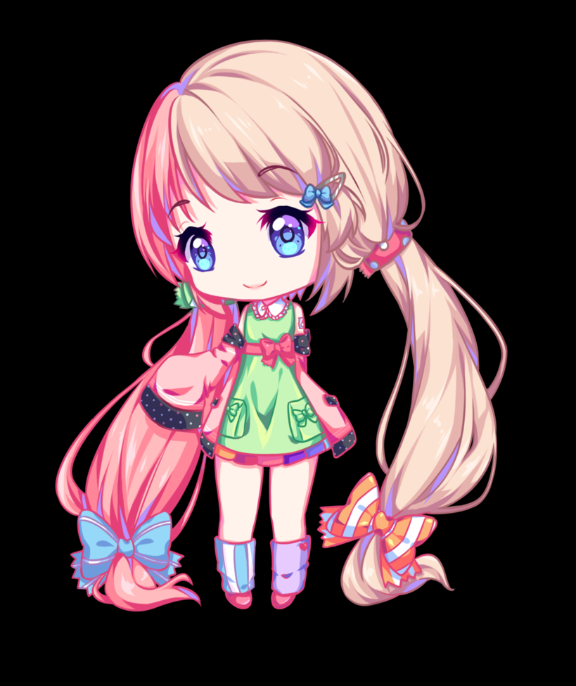
Hybrids lily sandy

Slide 17
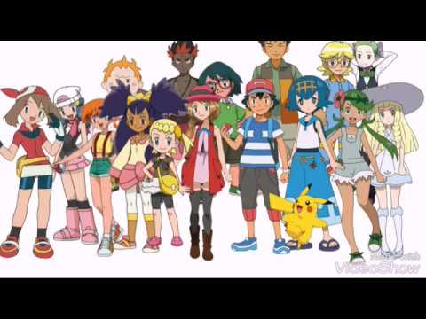
Pokemon the population of pokemon is many so …..

Slide 18


The food huts

Slide 19
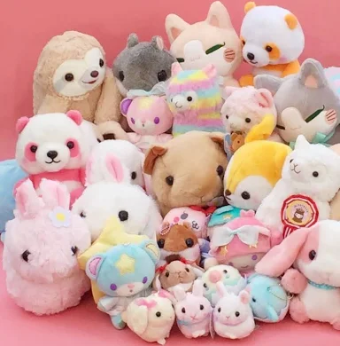
Souvenir shop

Slide 20
I hope you enjoy your day in our zoo any questions ?

