Slide 1



‘’The ZOO of Wonders’’

Slide 2






1. DO NOT FEED THE ANIMALS! (if not allowed)
2. DO NOT ENTER THE CAGE (if not allowed)
3. DO NOT USULT ANY ANIMALS (they do have feelings)
4. DO NOT LITTER (that does ruin the environment)
5. ALWAYS HOLD YOUR CHILDS HAND!! (if you have one)

Slide 3
6. DO NOT EAT OR DRINK OUTSIDE OF THE CAFITEARA.
7. PLEASE DO NOT DISRESPECT OUR MYSTIC WORKERS.
8. ENJOY YOUR STAY AT MYSTIC MEADOWS!

Slide 4
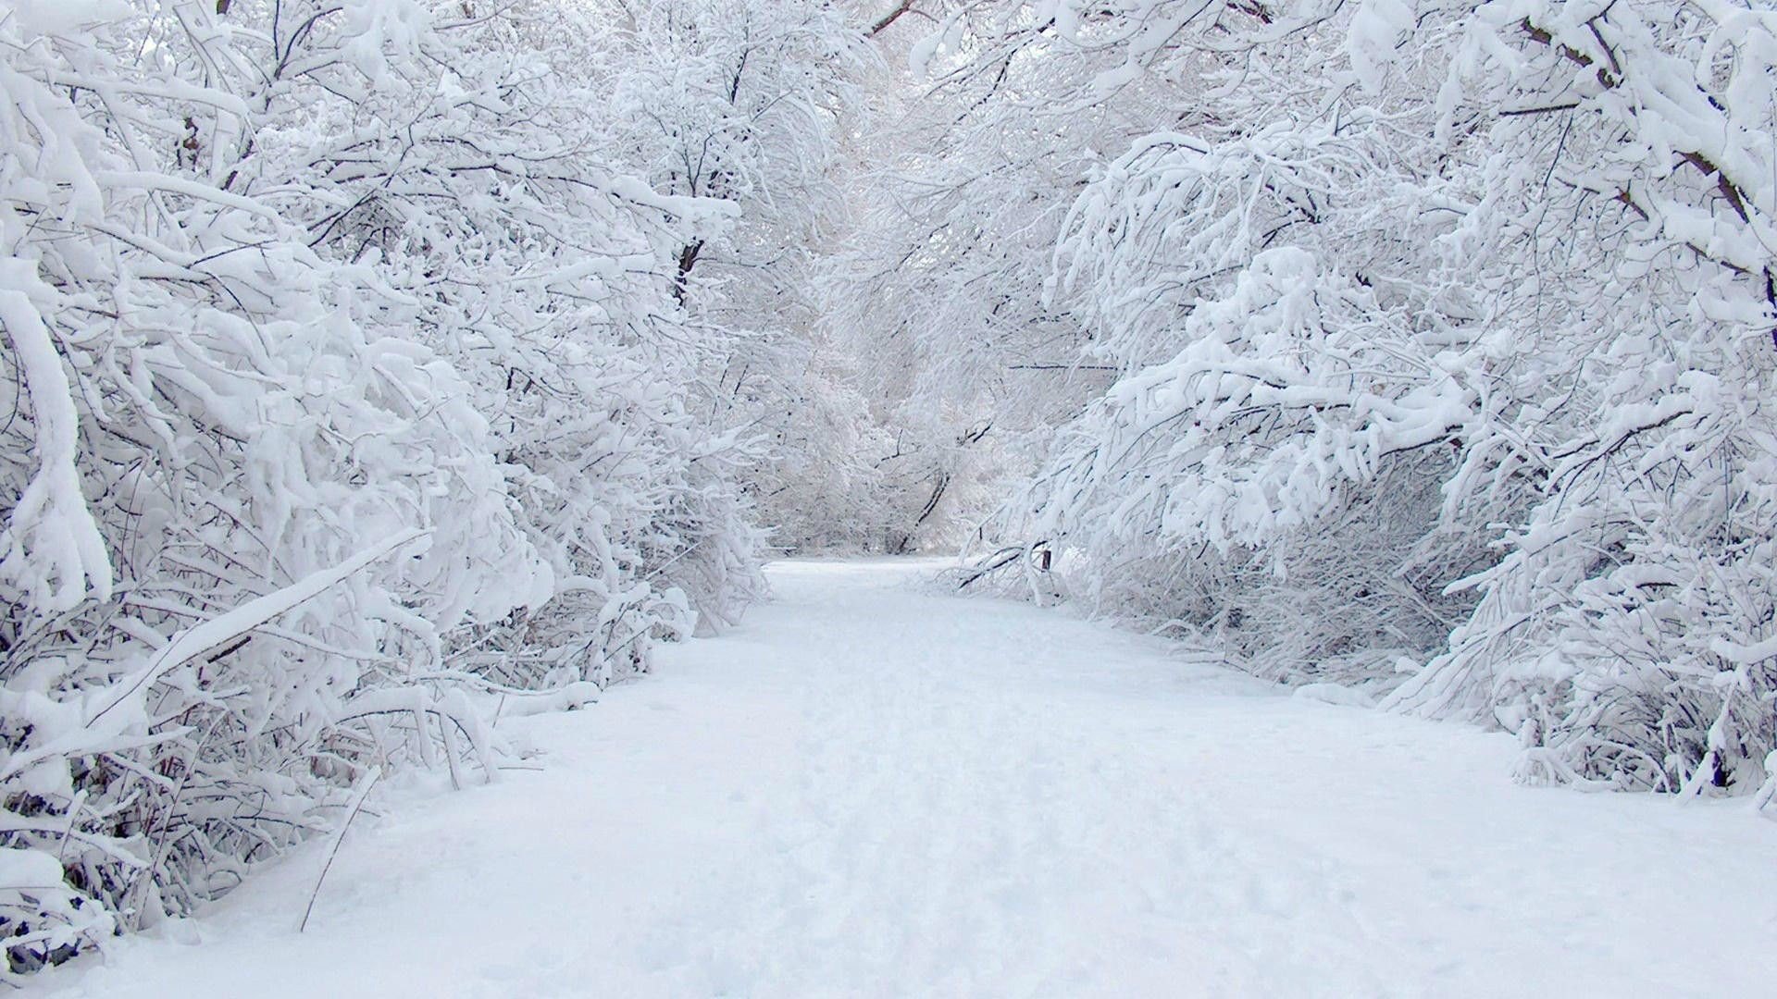
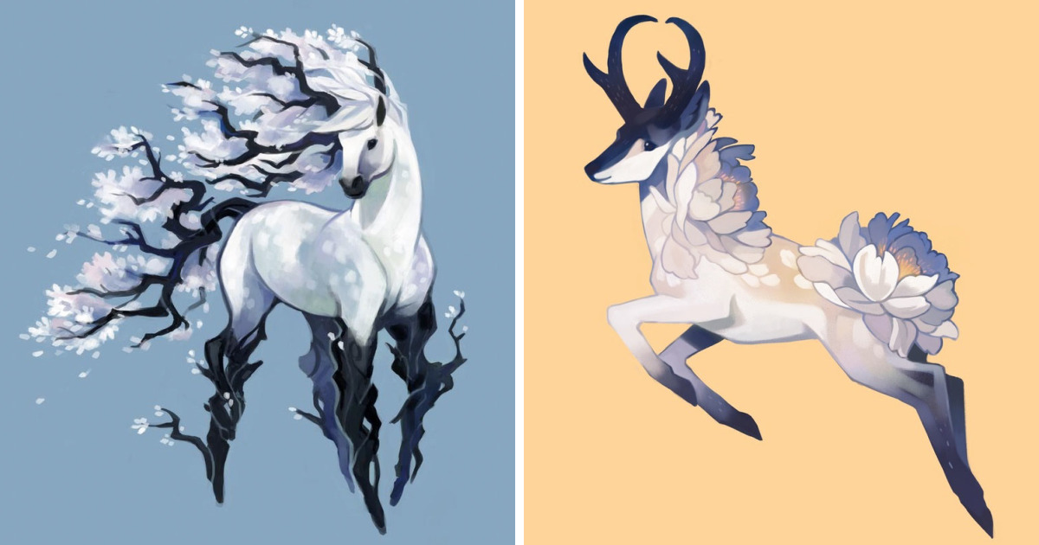
Likes: Cold Temperatures
Dislikes: Branches getting touched
Interests: Playing in snow
Skill: Can jump 21 meters high.
Type: Snow Creature
Rarity: Rare
Flaked-Tree Horse

Slide 5

Horned Dloom
Likes: Exploring forests
Dislikes: Having to stay still
Interests: Playing in leaves
Skill: Can scene if a predator is near
From 36 miles away.
Type: Floral creature
Rarity: ULTRA RARE!!!!!

Slide 6


Slide 7


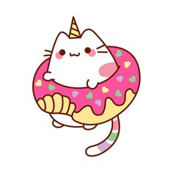
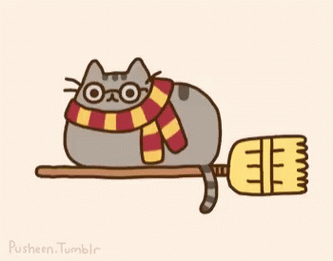
.
Last night is has been brought to Mystic Meadows attention that their ONLY unicorn cat AND pusheen the harry potter cat have escaped.
MISSING!!!
If found, Please return to Mystic Meadows (the zoo) for a reward!
&

Slide 8
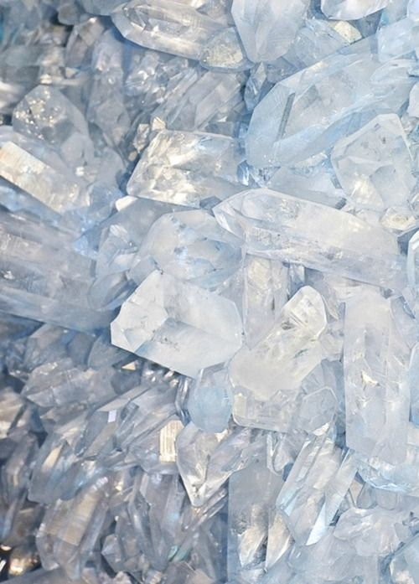

Crystal
Likes: Shining in the sun
Dislikes: Having to stay in a Glass
Cupboard.
Interests: People staring
Skill: Can blind someone if sun
Shines on to it.
Type: MORE INVESTIGATION NEEDED!
Rarity: ULTRA RARE!!!

Slide 9
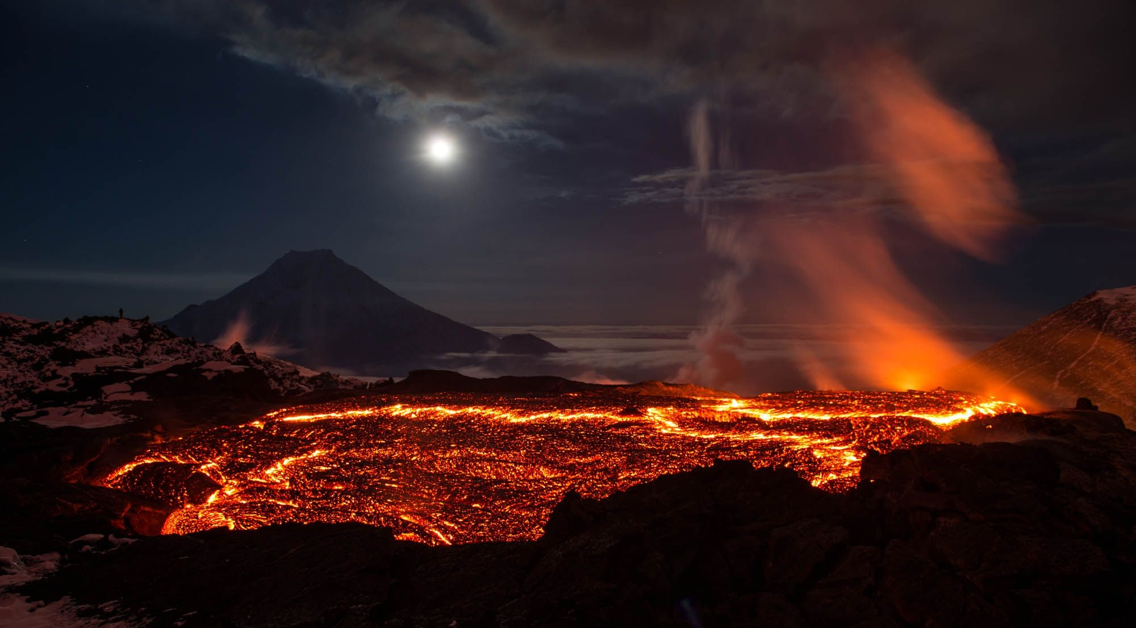
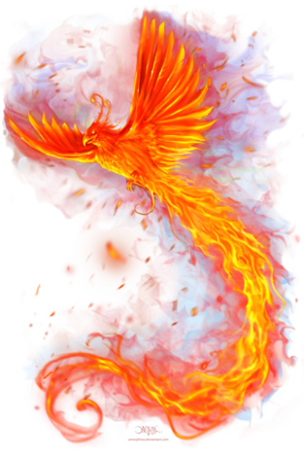
Phoenix
Likes: Being near volcanoes
Dislikes: Winter, Cold days
Interests: Playing with fire
Skill: Wings warm up to 136 degrees
Celsius if predator is near.
Type: Fire Creature
Rarity: Rare

Slide 10






Slide 11



1. What was the phoenix's skill?

Slide 12
Answer: Wings warm up to 136 degrees
Celsius if predator is near.

Slide 13
1. What animals went missing?

Slide 14
Answer: Harry Potter cat & unicorn cat.

Slide 15
1. What does the crystal dislike?

Slide 16
Answer: Having to stay in the glass cupboard.

Slide 17
1. How rare is the Horned Dloom and why?

Slide 18
Answer: ULTRA RARE, because it’s horned and there aren’t many of them around the world.

Slide 19






