Slide 1
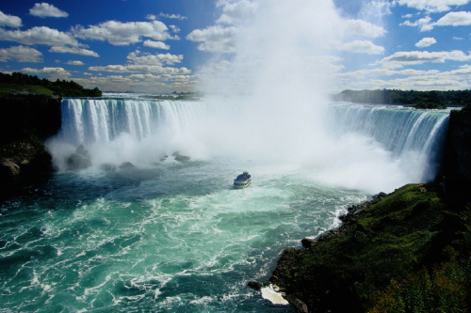
Niagra falls

Slide 2
niagra falls is one of america‘s most famous natural landmrks just like the grand canyon the falls were made by god or as some people say mother nature

Slide 3
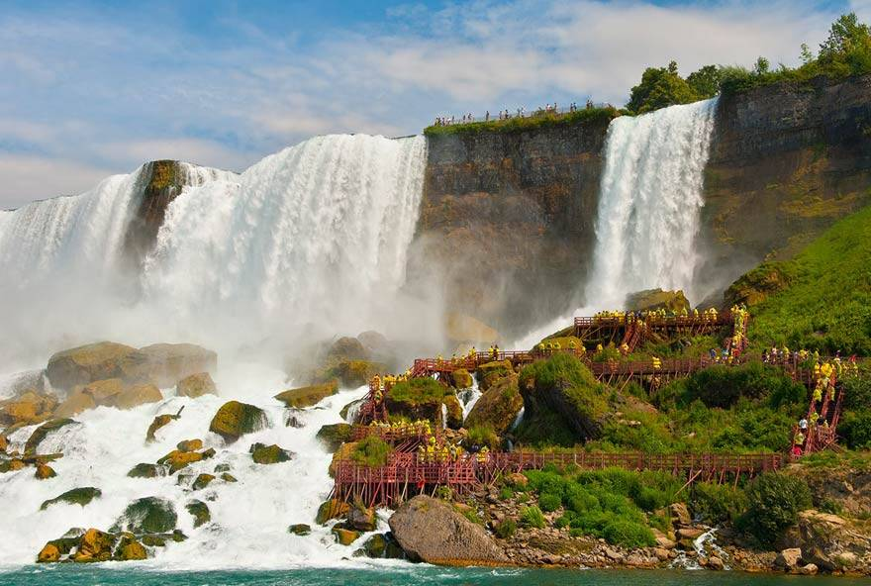
Niagra falls is in Ontario Canada.

Slide 4
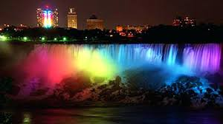
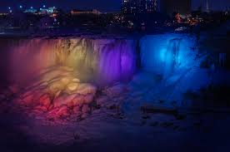
iF you’re a tourist you will especially enjoy our light show

Slide 5
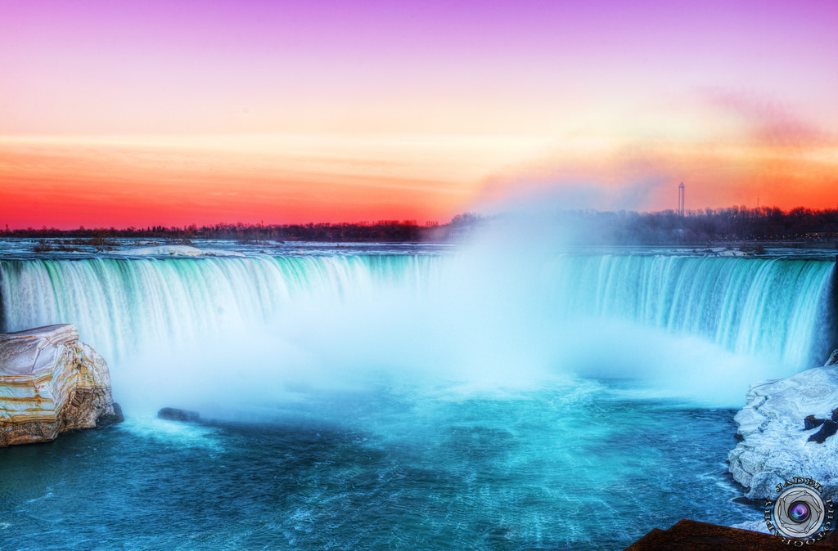
And our sunsets

Slide 6
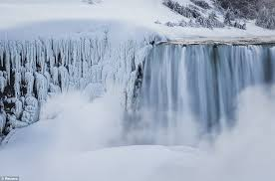
winter

Slide 7
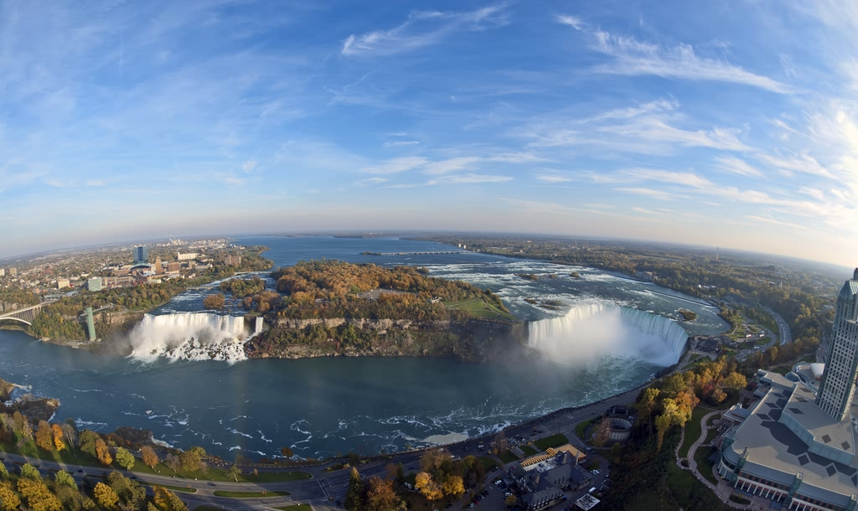
Did you knows

Slide 8
The majesty of Niagara Falls is something that’s difficult to describe in words. The three falls — Horseshoe Falls, the American Falls and the Bridal Veil Falls — overlap the border between Canada and the United States. On one side of the falls is Niagara Falls, Ontario, and on the other is Niagara Falls, N.Y. The two cities with the same name overlook one of the world’s most famous attractions.

Slide 9
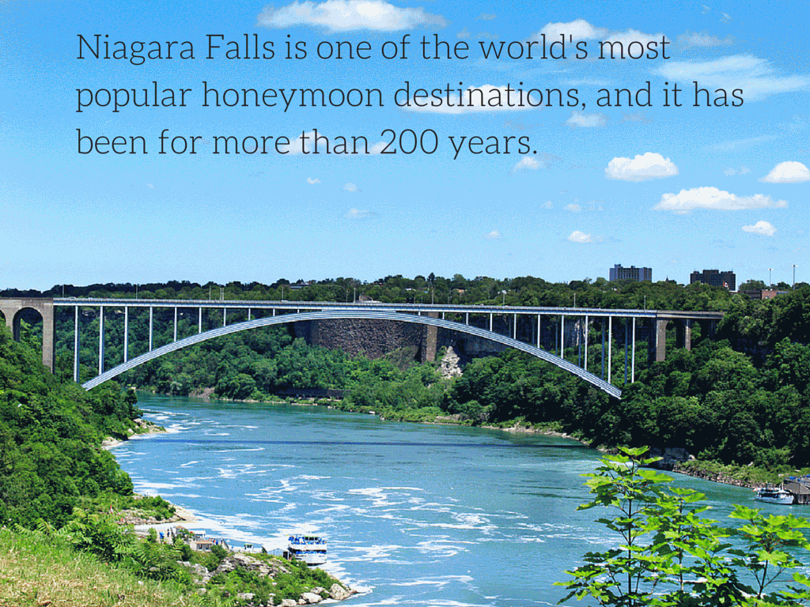

Slide 10
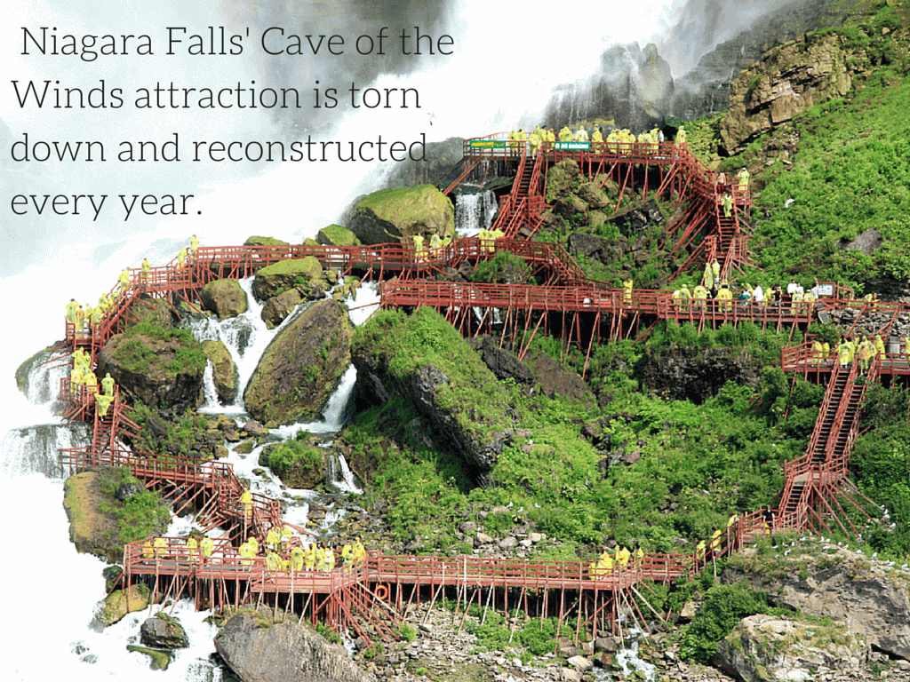

Slide 11
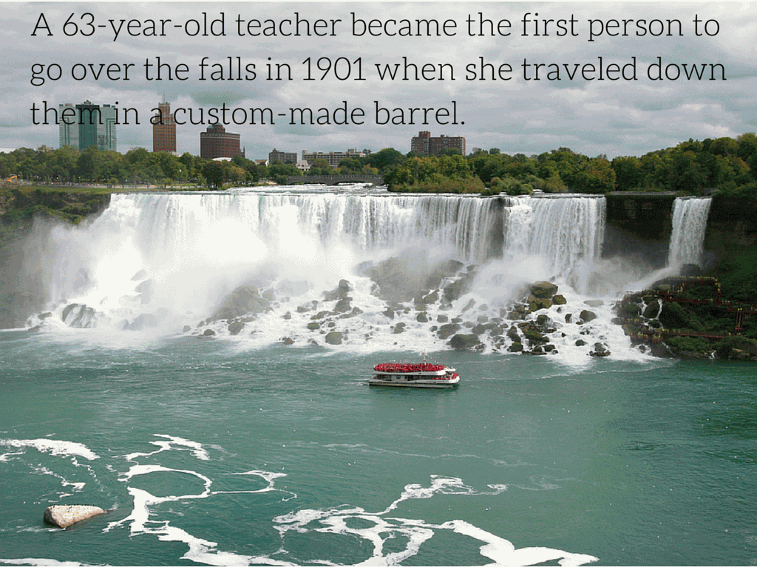

Slide 12
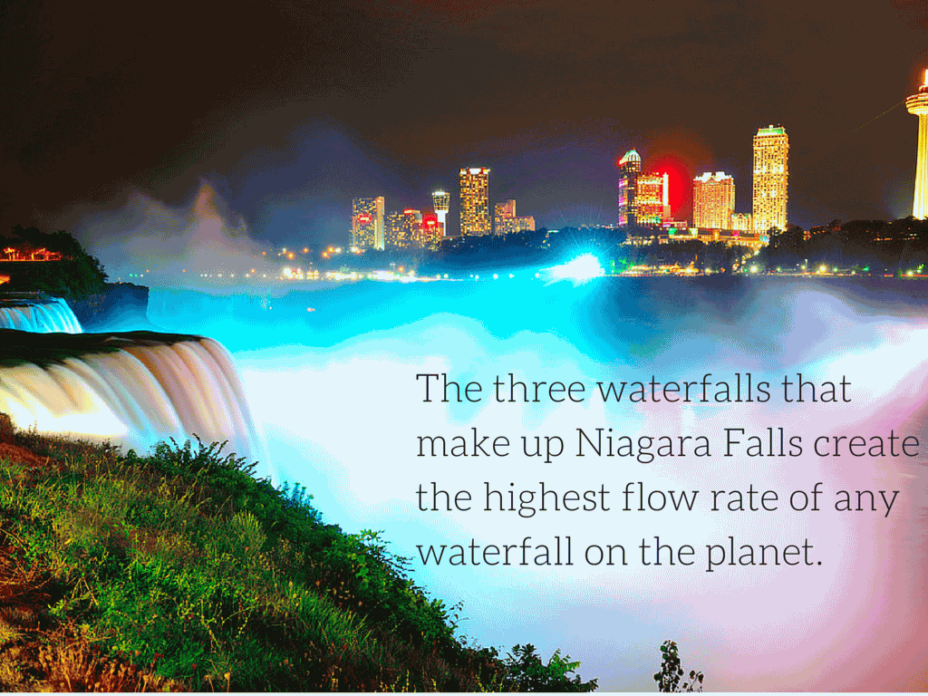

Slide 13
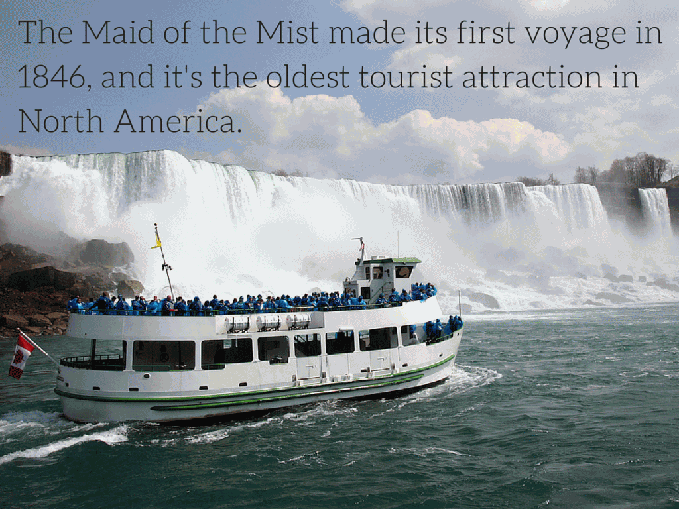

Slide 14
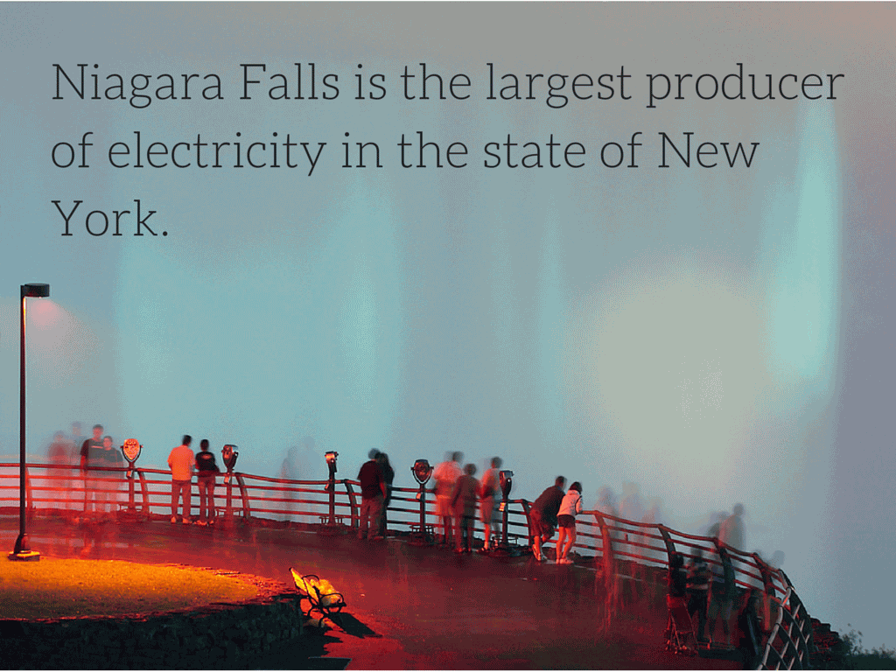

Slide 15
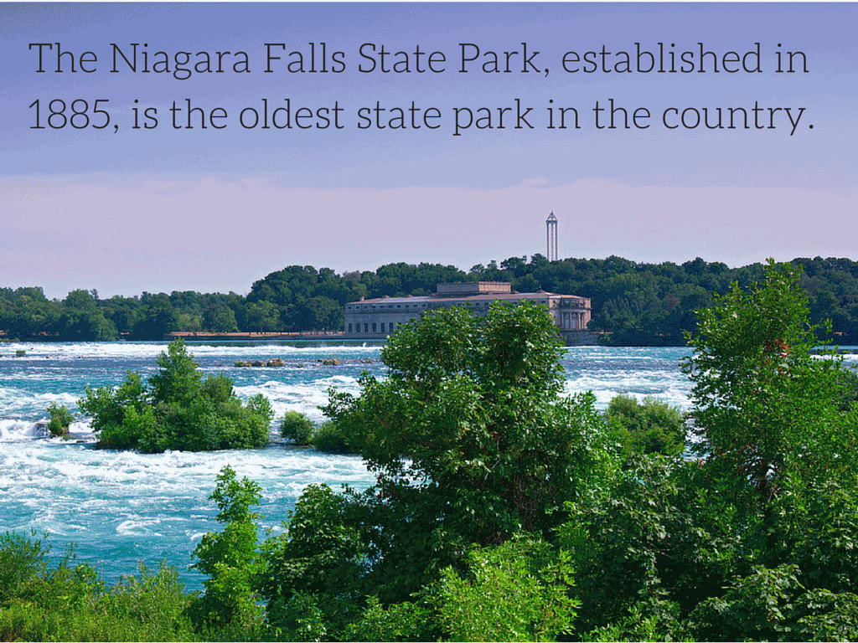

Slide 16

Quiz time

Slide 17
How long has niagra falls been here？
a] more than 1000 years
B] more than 200 years
C] forever

Slide 18
What was the ship called ?

Slide 19
Can you name one of the 3 waterfalls that make niagra falls?

Slide 20
Which two cities are on each side of the falls?

Slide 21
In america,Niagra falls is the largest producer of what ?

Slide 22

Thanks for listening and I hope you visit soon .please grab a leaflet on the way out.

