Slide 1

THIS is bbc zoo news
MONTH20XX
WELCOME
by Oscar and LULU and credit it to Tuguldor and Sasha for helping

Slide 2
POKEMON! TAKE OVER THE ZOO’S
It has been recently brought to my attention that pokemon have been taking the animals out of zoo’s.
Here is the PROOF!

Slide 3
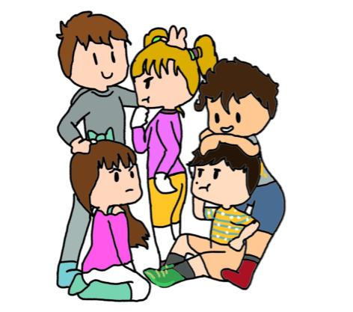
THE DAY
This was the day the animals broke out of there cage. They were behind metal bars so we have no idea how they escaped some speculate that these weird creatures have broke them out but who
.

Slide 4
TIPS+RULES
TIPS HOW TO NOT DIE | NEVER EVER GO INTO DANGERIOS PLACES AKA A ZOO | DON’T FALL IN A ZOO | DON’T DROWN IN A ZOO
NEVER | TOUCH | A | ANIMAL
U | DONT | KNOW | ESPECIALLY
 | IN | THE | ZOO
 | LI | ST | EN
 | TO | THE | M
REMEMBER WHAT HAS BEEN SAID

Slide 5
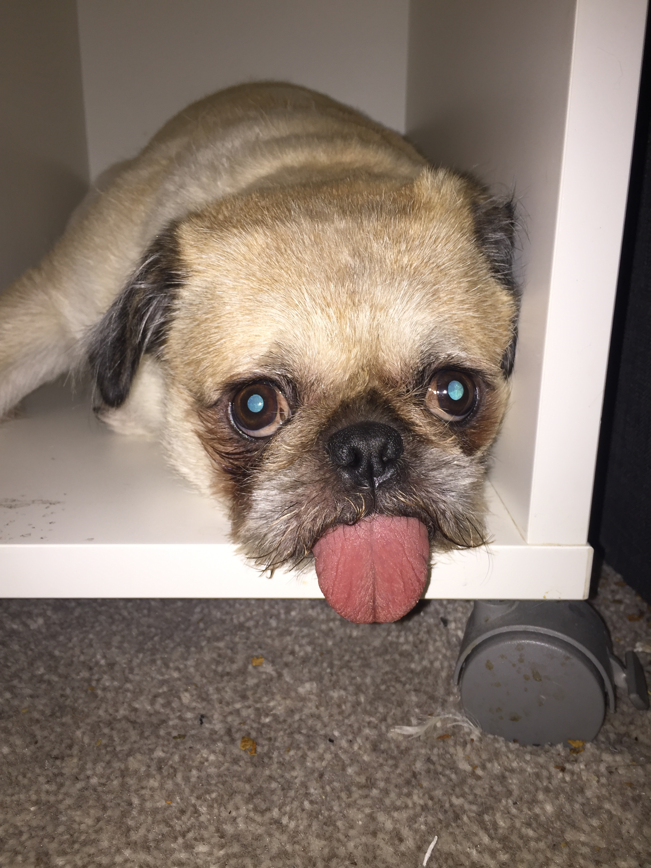
IS A SCHOOLL LIKE A ZOO
If u really think about it a school is kinda like a zoo u have to do as your told. And it is a crucial you are there and if u do not do as your told you get a punishment.

Slide 6

Zoos are quite dangerous if u make them. For example if u keep punching or tapping on the glass even if its strong eventually it will break SO BECARFULL .

Slide 7

ANIMALS might look cute at first glance but if u really actually went up close to some they would probably kill u. EVEN IF THEY LOOK CUTE THEY CAN BE EVIL.
CUTE BUT DEADLY

Slide 8


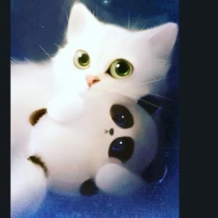


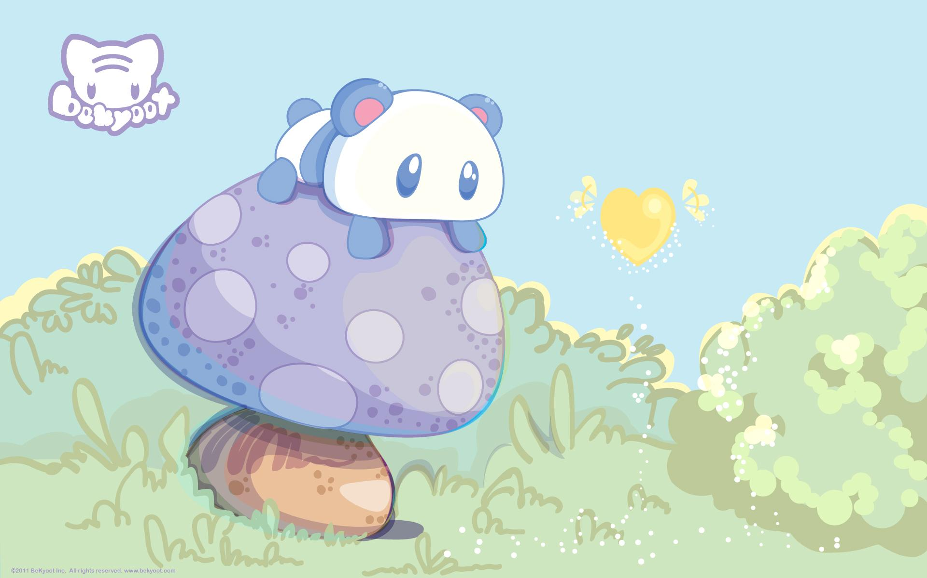
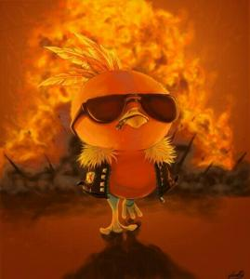



Customize this Template
THANK U FOR LISTINING credit to sasha,tug for helping

