Slide 1
Kaziranga National Park
It’s a World of Adventures

Slide 2
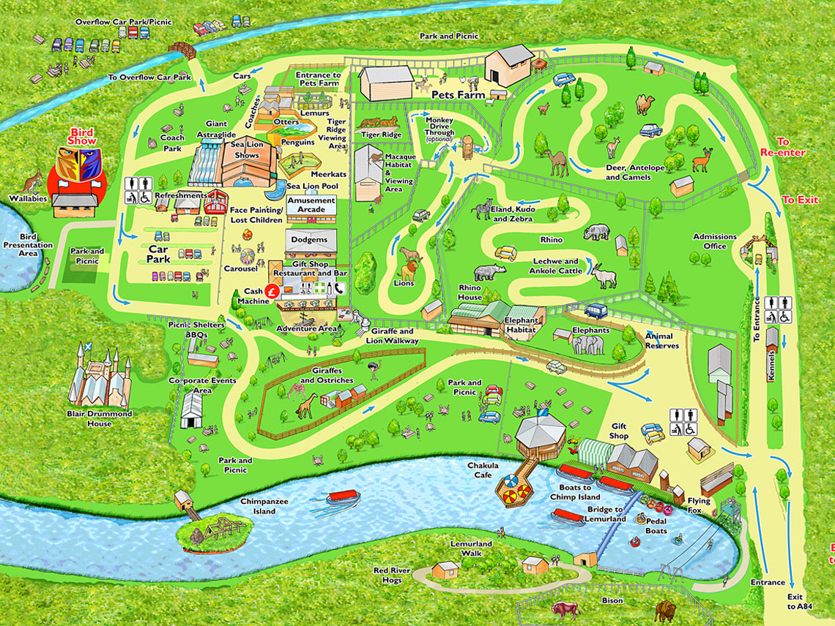

Slide 3
Spanning across 429.69 square kilometers, the Kaziranga National Park is a home to largest population of One Horned Rhinoceros in the world. Apart from the rhinos, elephants, bears, panthers and various pretty birds traverse the landscape of the park.

Slide 4
50% discount
Adult £25, Kids below 10 years free entry
£15 for Children above 10 years

Slide 5


