Slide 1

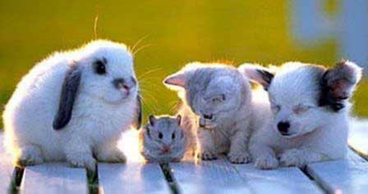
WELCOME TO MY MYTHICAL ZOO
HOPE YOU INJOY and any ways my name is Beheshteh.

Slide 2

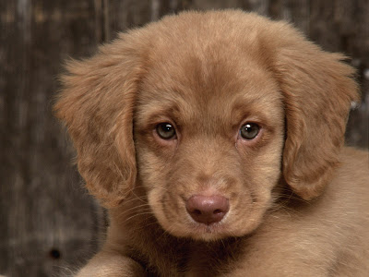
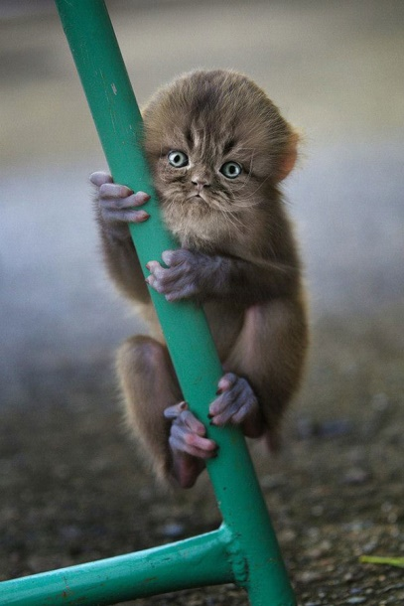
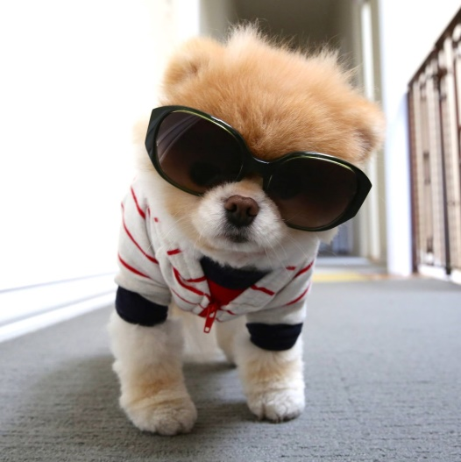
In the entrance you’ll get a map which shows every thing , and the adults have to give fifty pounds because the other things are free for them which I’m going to tell you later and its free for children

Slide 3
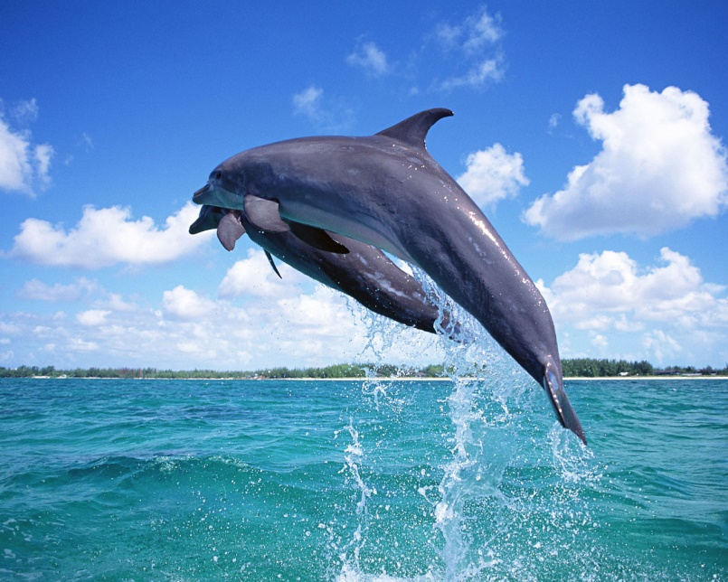
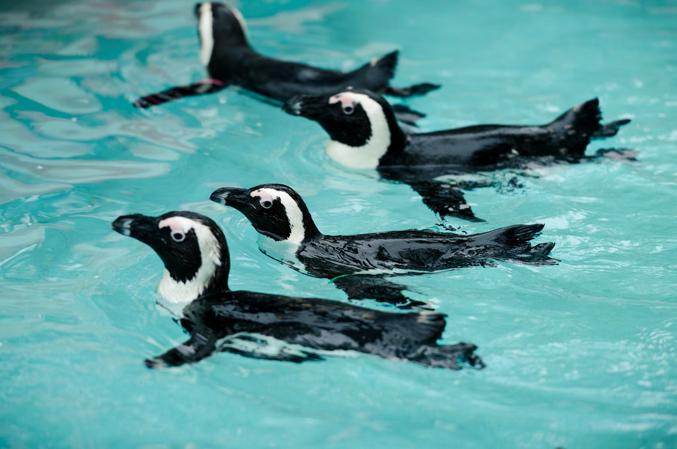
There is a chillout place for you and a coffee shop and the chillout place is going to be swimming with dolphin and penguins[the the suit will be provied]

Slide 4
The rulse your should fallow:
1,don’t be so loud
2,be sensible when your feeding the animal which you are allow

Slide 5
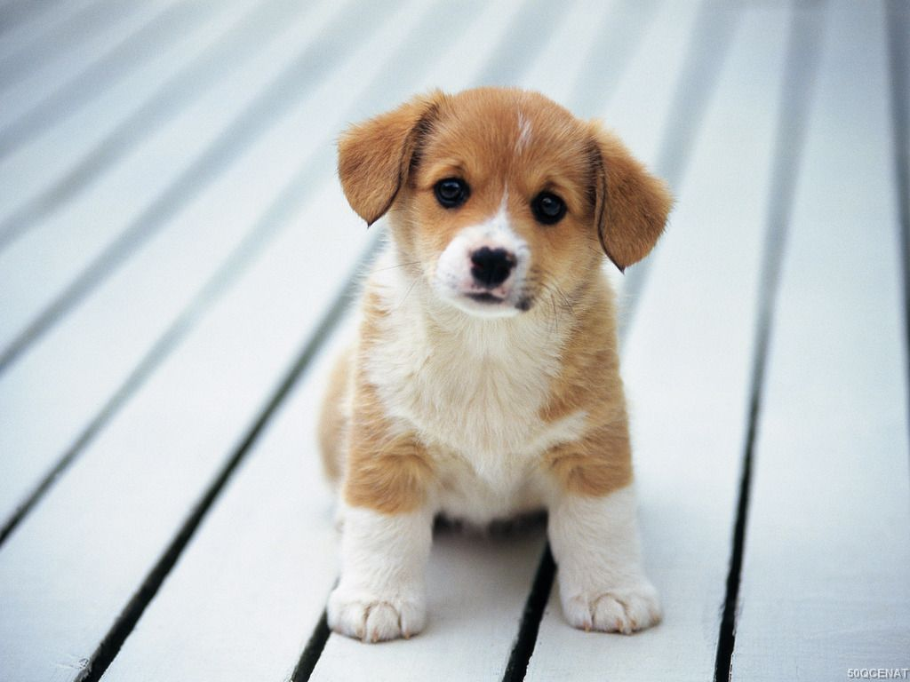
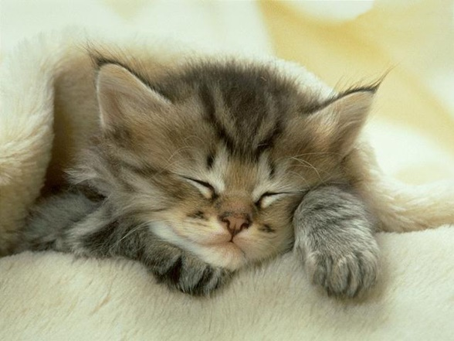
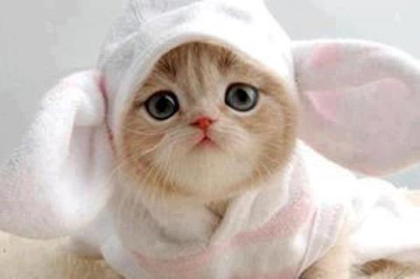
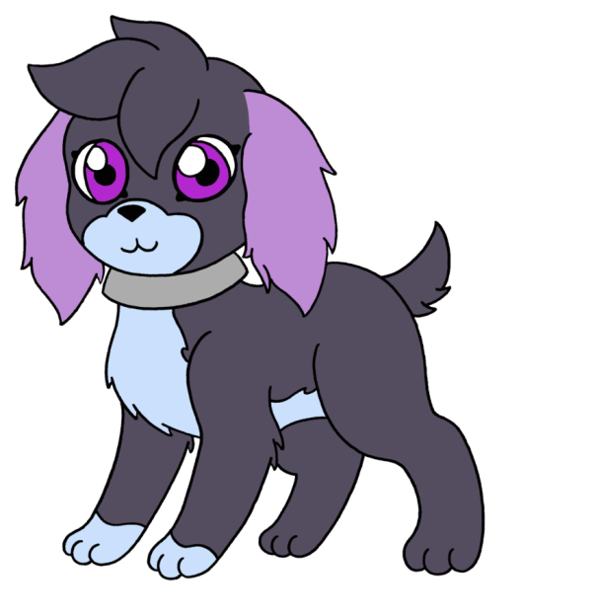
The animals in the zoo are:
CAT
DOG

Slide 6
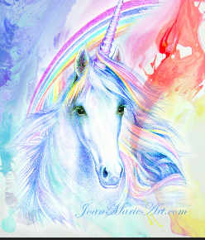
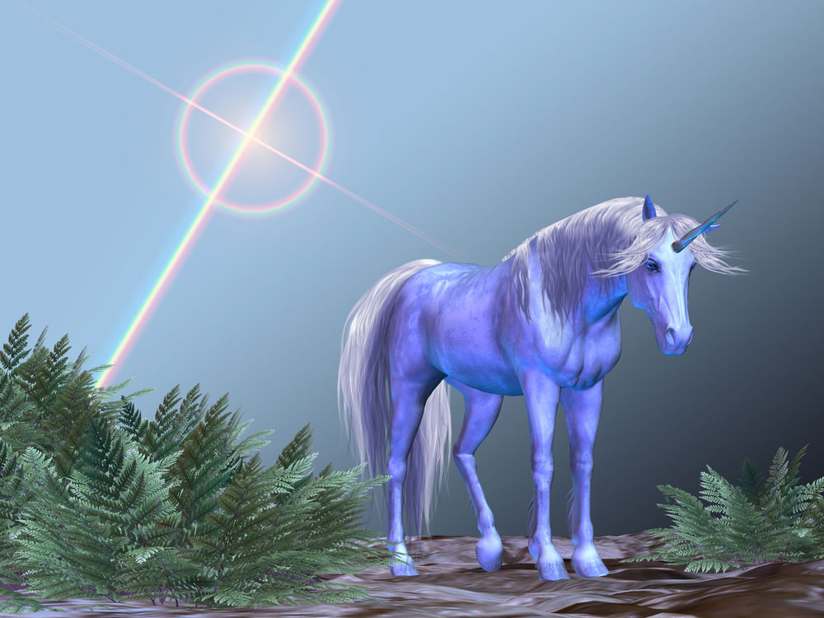


UNICORN
Butterfly

Slide 7
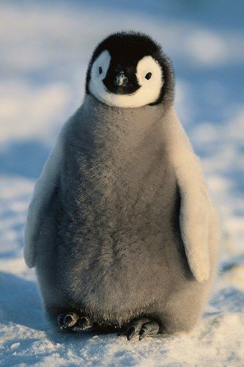
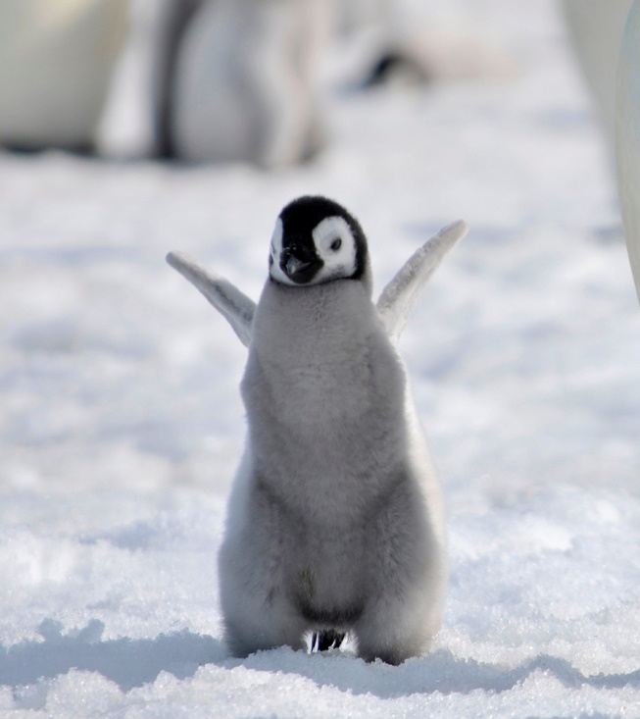

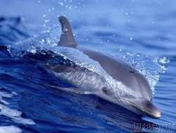
penguins
dolphins

Slide 8
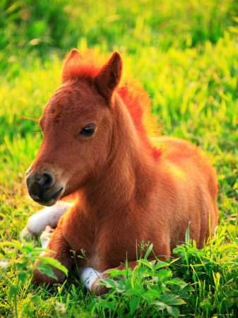
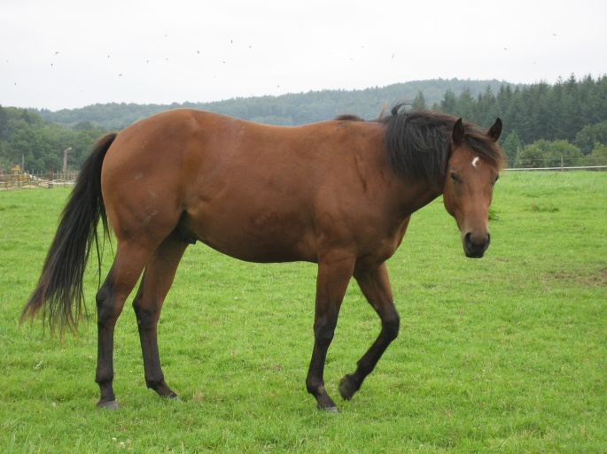

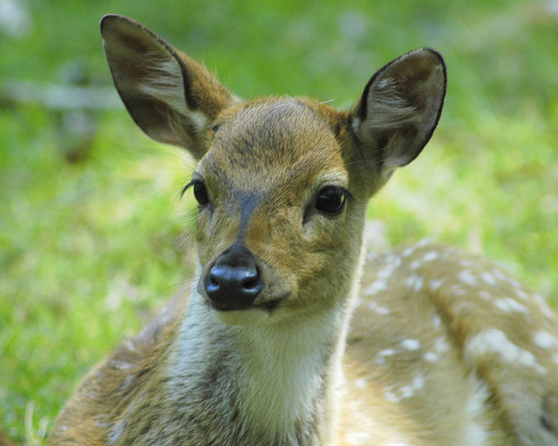
HORSE
DEER

Slide 9

Thank you for listening

