Slide 1

Year 6’s Journey through the Jubilee Year

Slide 2
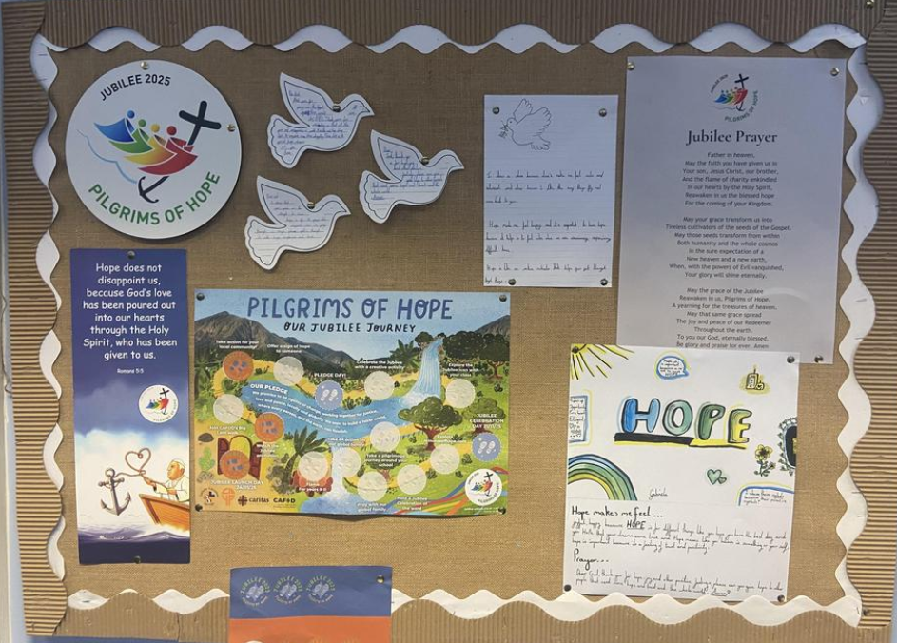
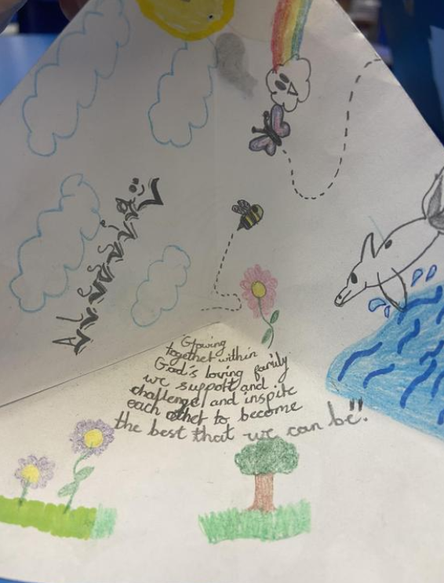
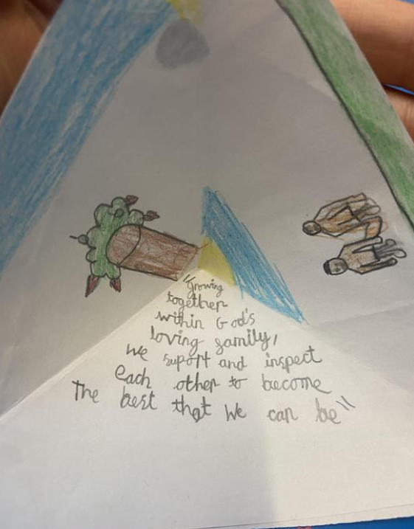
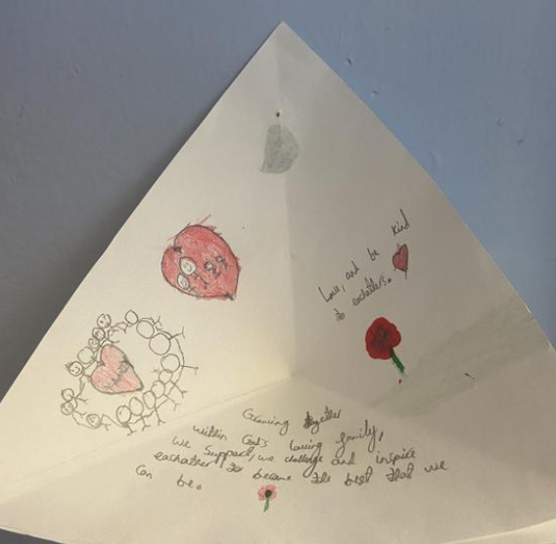
Our journey began in Year 5. We discussed the meaning of hope and how it linked to our school mission statement:
Growing together within God’s loving family, we support, challenge and inspire each other, to become the best that we can be.
We used this to focus our mission on supporting God’s family.

Slide 3

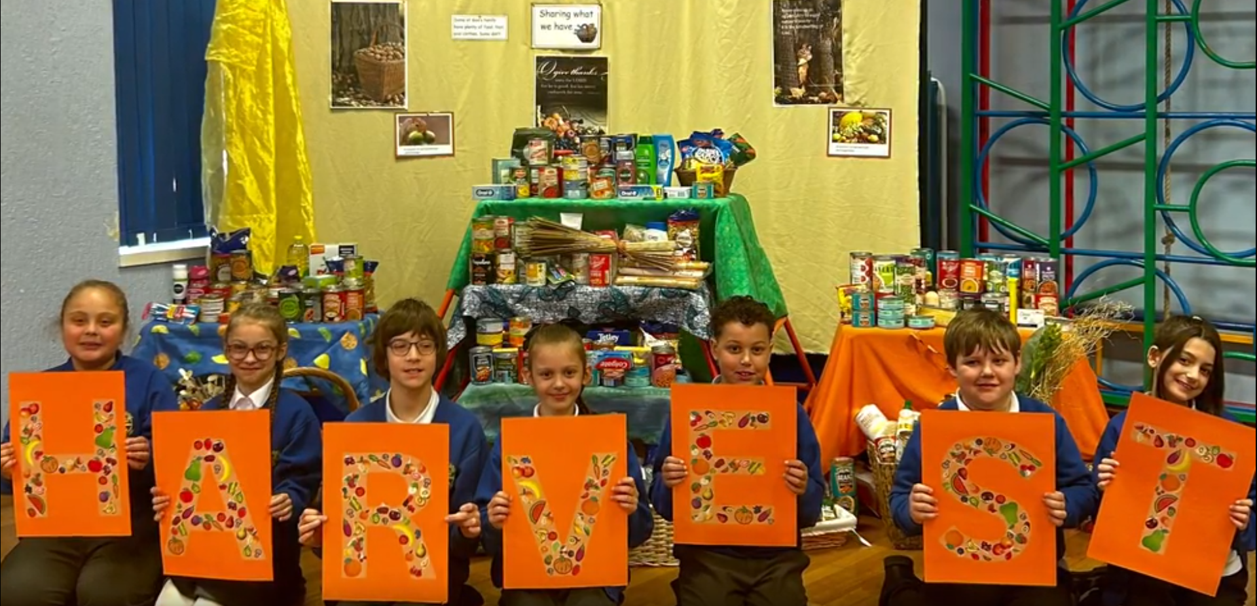

We spread the important message of sharing what we can with those in need in our harvest assembly. The donations we received were sent to Salford Loaves and Fishes.
Harvest Assembly

Slide 4
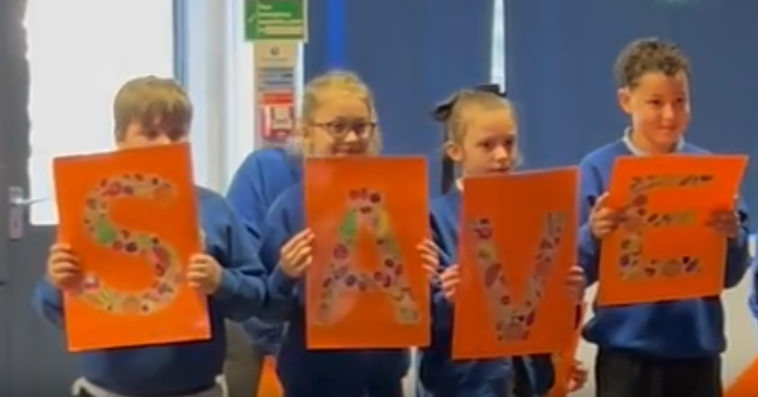
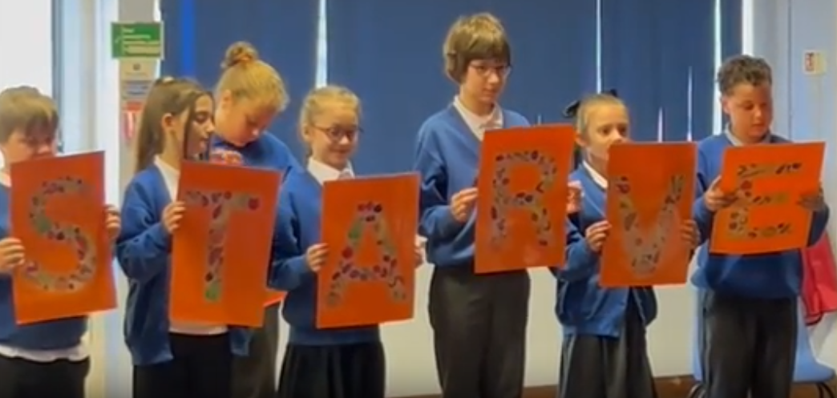
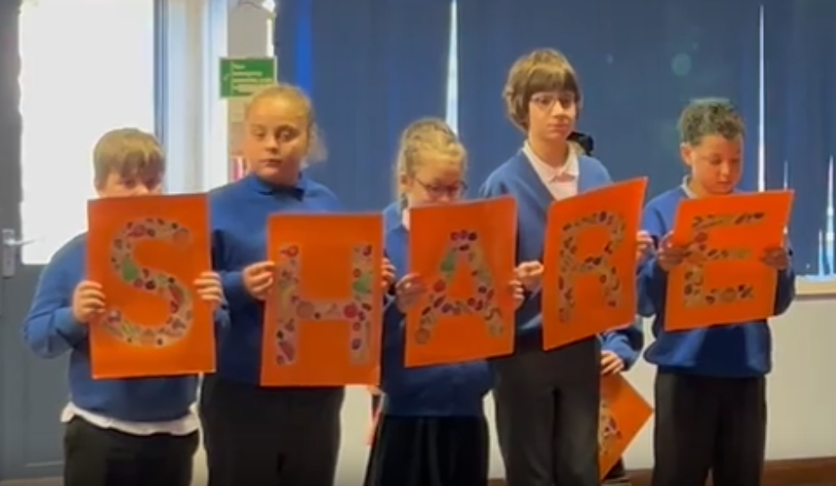
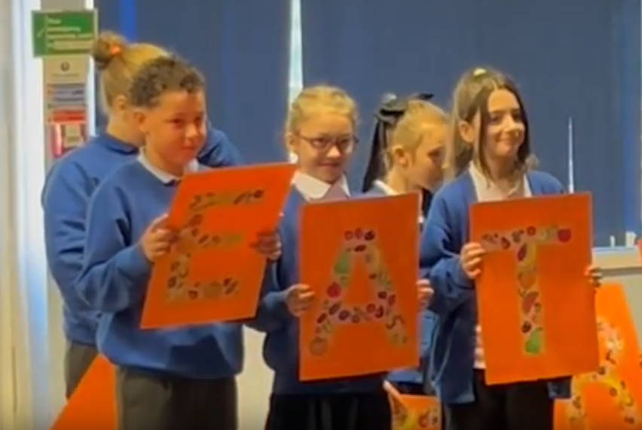
Our message was that we should save others who starve and share what we have so everyone can eat.

Slide 5


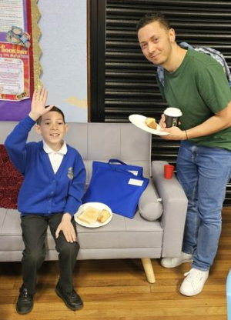
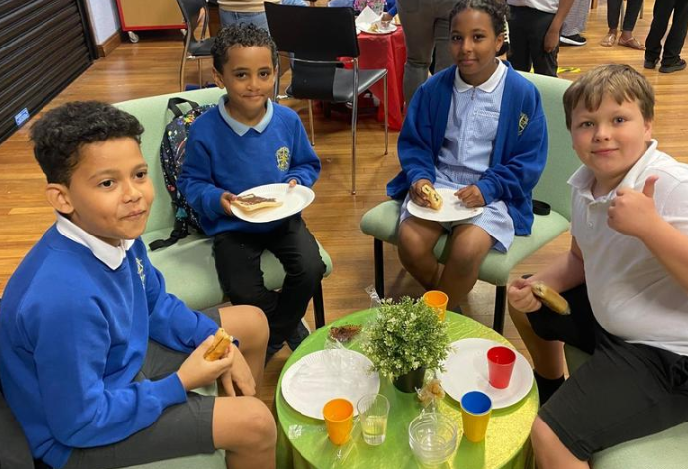
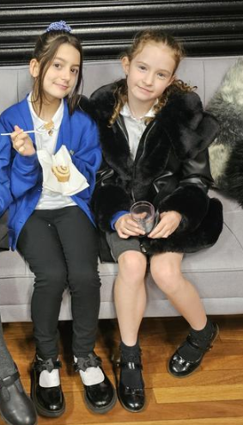
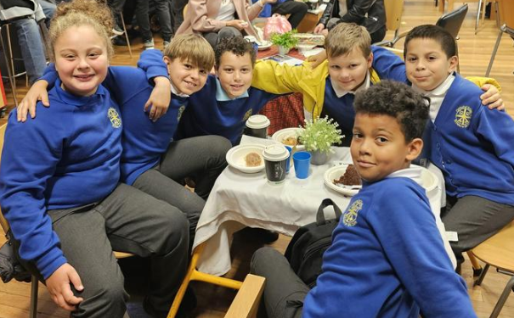
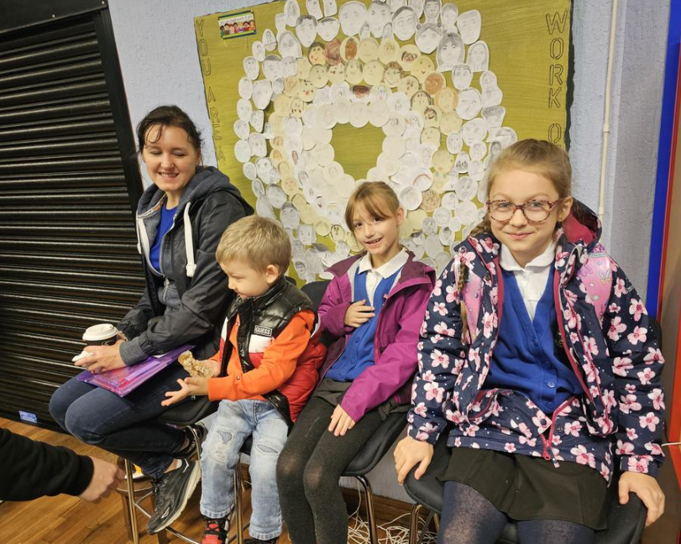
We continued living out this message by supporting Macmillan Coffee Morning and Mary’s Meals. We came together as a school community to raise money and help others.

Slide 6


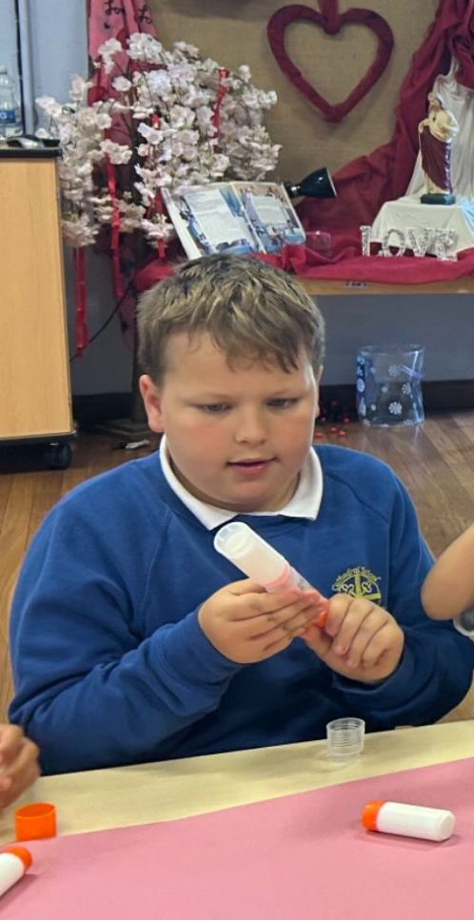
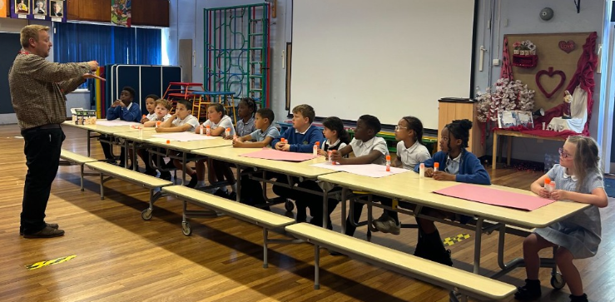
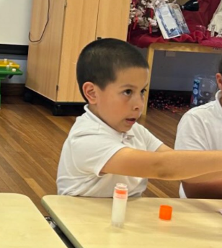
We also know how important it is to take care of our common home. We now use eco-friendly glue sticks to save unnecessary plastic waste.

Slide 7

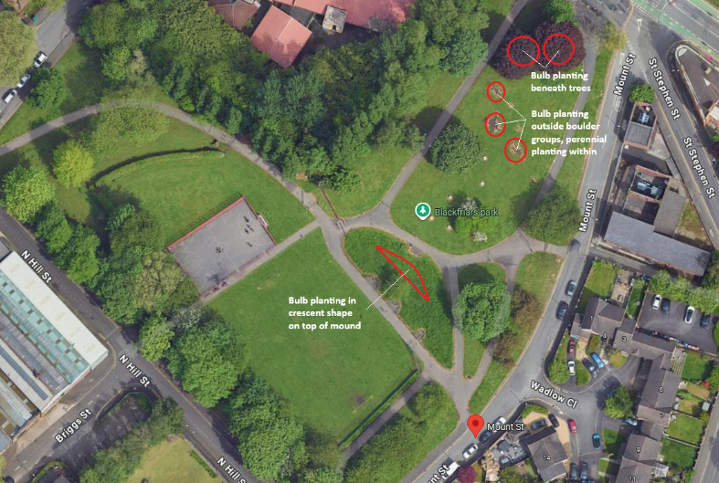
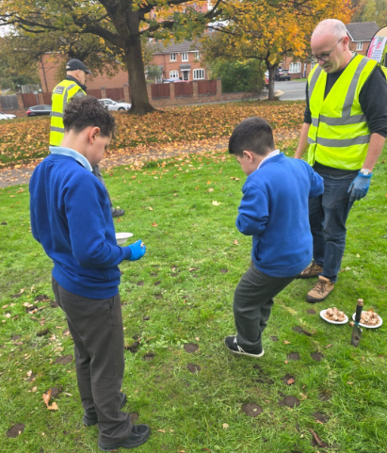
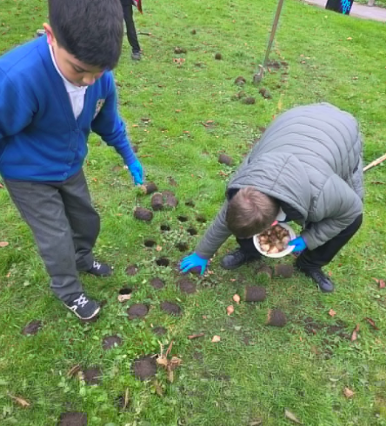
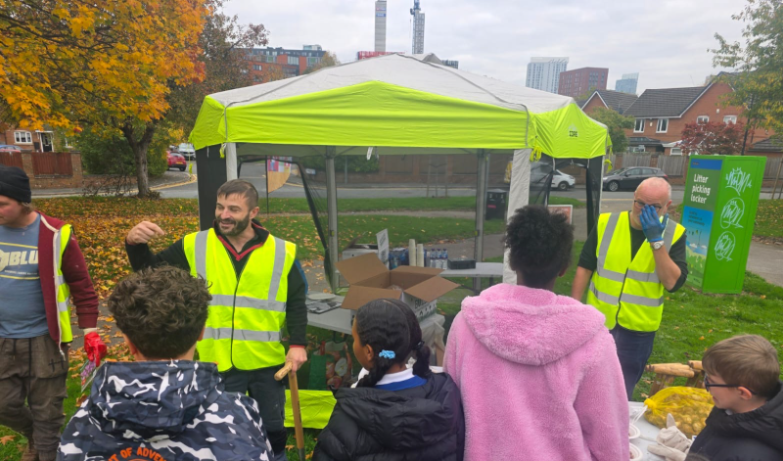
We also have cared for our local community by planting bulbs which people can enjoy in the coming spring.

Slide 8

A Prayer for Our Journey as Pilgrims of Hope
Loving God,
as we travel through this Pilgrimage of Hope,
walk beside us each day.
Help us to keep our hearts open,
our minds ready to learn,
and our words kind and encouraging.
When the path is easy, remind us to be thankful.
When the path is difficult, give us courage and strength.
When we feel unsure, guide us with your light.
May we bring hope to others
by the way we act, share, and care.
Help us to see the good in everyone
and to make choices that lead to peace.
Bless our Year 6 journey—
our learning, our friendships, and our growing—
so that we may walk forward with joy
as true Pilgrims of Hope.
Amen
This has been our journey so far but we know there is more to do and we pray for God’s support and love to help us along the way.

