Slide 1


Slide 2


Slide 3
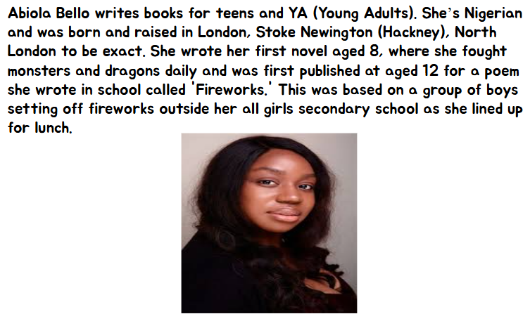

Slide 4
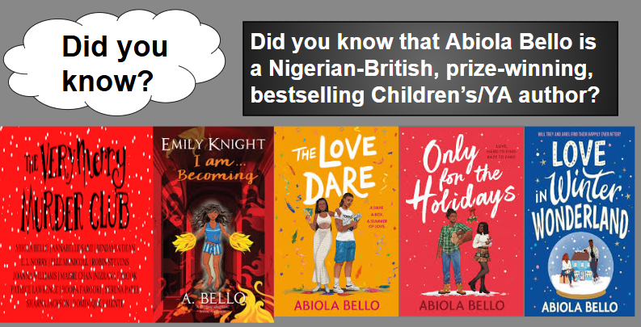

Slide 5


Slide 6
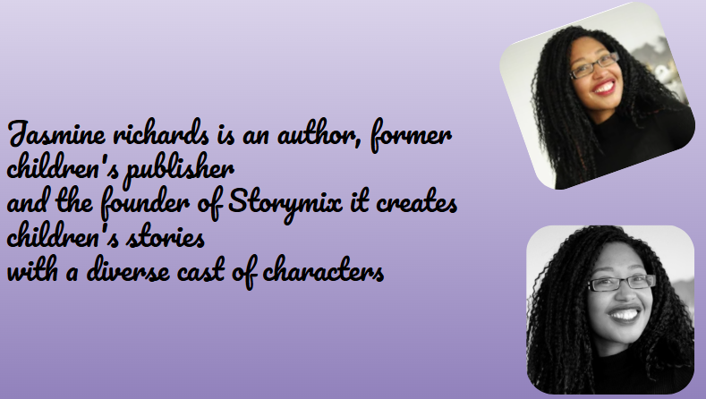

Slide 7
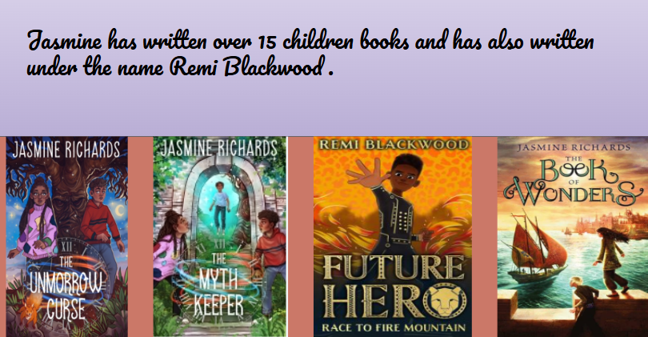

Slide 8
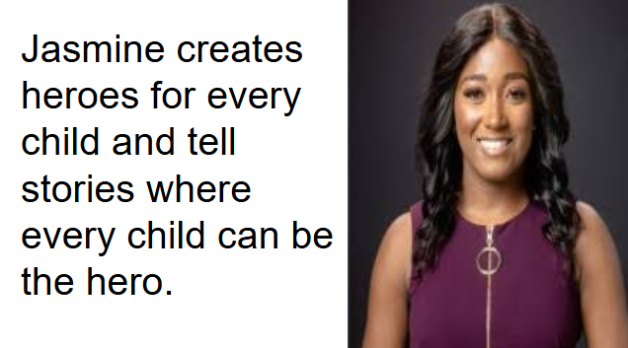

Slide 9
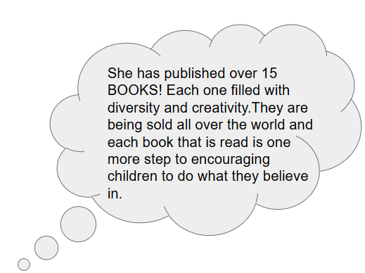

Slide 10
Abiola Bello and Jasmine Richards deserve the spotlight as two inspiring Black British authors whose work is transforming children’s literature. Both writers are powerful voices for showing young readers that stories can reflect a wide range of experiences and cultures.
Together, Bello and Richards are shaping the future of children’s and young adult fiction. They remind us that stories have the power to inspire empathy, pride, and possibility—and that everyone deserves to see themselves as the hero of a story.

