Slide 1

Welcome to year 6

Slide 2
Growing together within God’s loving family, we support, challenge and inspire each other to become the best that we can be.

Slide 3
Spiritual, moral, social and cultural development
Importance of our health and well-being in order to have the capacity to make the right choices and work at our best level
Positive reinforcement policy
Reflection times where needed to support children in understanding appropriate behaviour
Our behaviour links to the beatitudes
Mrs Bolton drop in sessions for children and parents

Slide 4
Our rewards:
Our daily reward system for following the Golden Rules and showing God’s love to one another.
Reward assembly on a Friday to celebrate the achievements of the week.
Classroom daily rewards – Class Dojo points leading to bingo tickets
Star of the Day
Classopoly for attendance

Slide 5
Sharing the fantastic work of your children
Sharing of great work in assembly
Work for the working walls
Wall of Fame
Head teacher awards
Sharing news with parents – phone call home
Website
Twitter (X)

Slide 6
Year 6 Weekly Homework
Spellings each Friday - Spelling words will be a mix of words from the year 5/6 spelling list and spelling rules
Reading every night (between 20 and 25 pages) – reading records to be signed each night by either the parent or child
Homework – given Friday and returned on Tuesday – in either homework book or Google Classroom
Reinforces the learning from the week

Slide 7
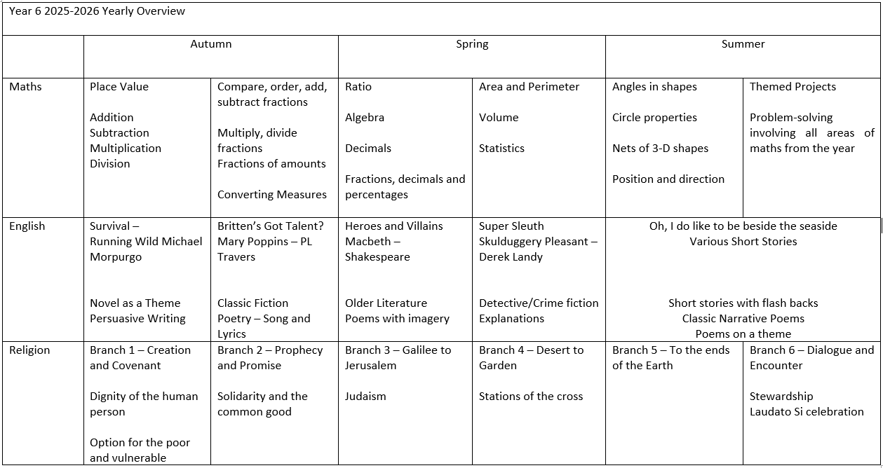

Slide 8
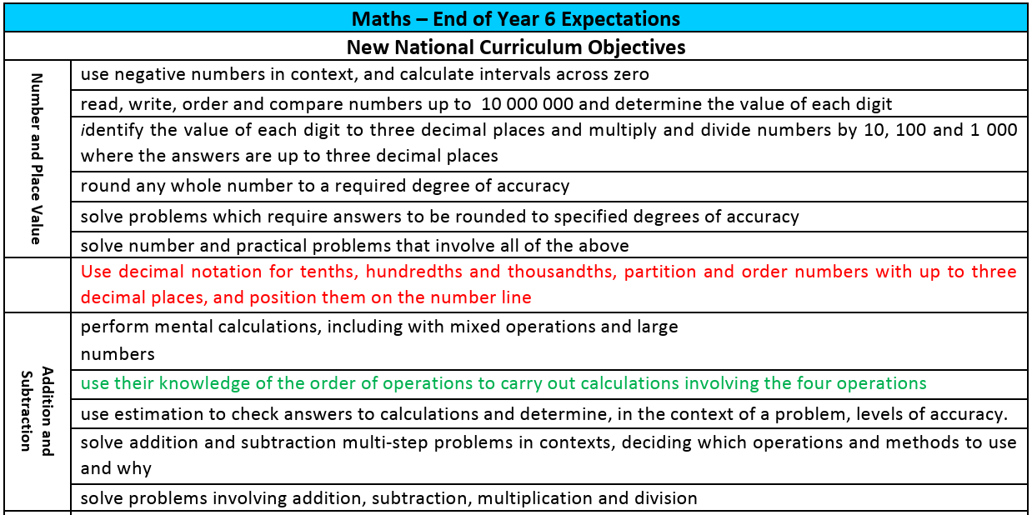
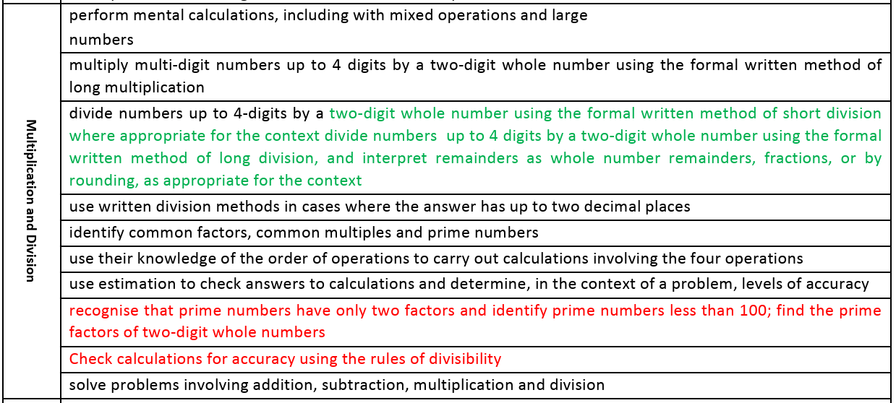
Year 6 Maths Expectations

Slide 9
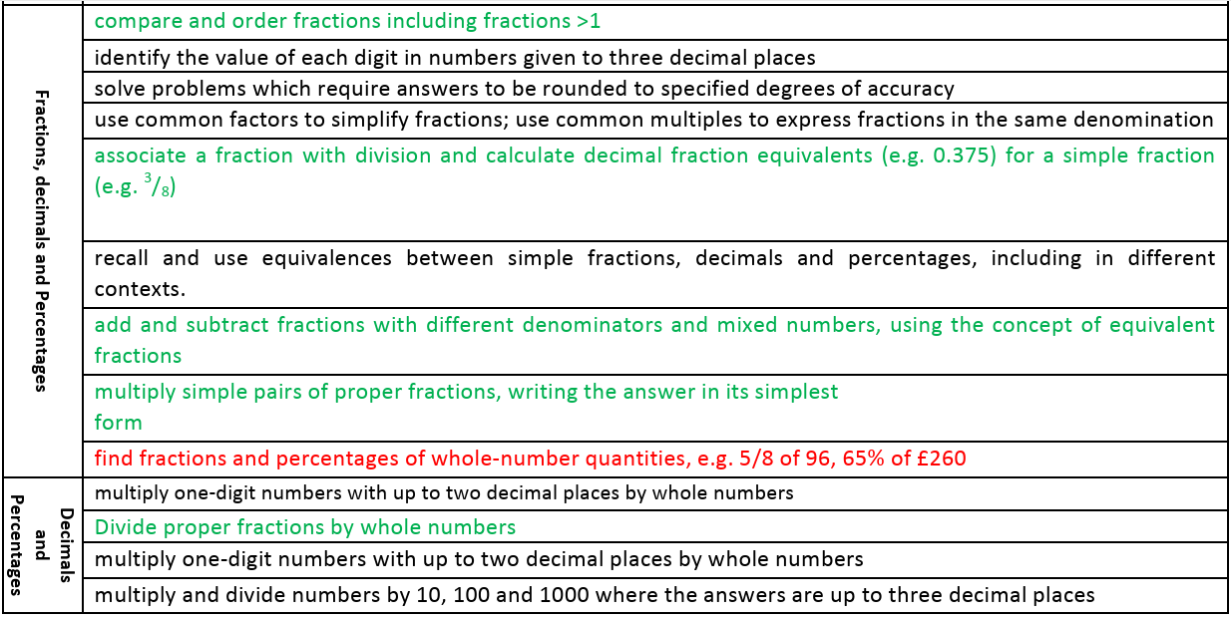
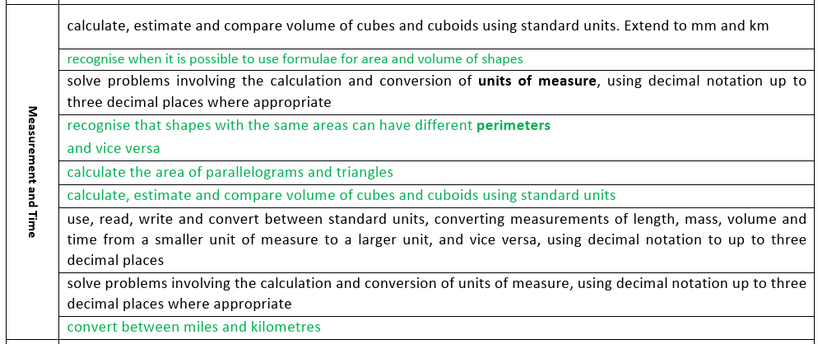
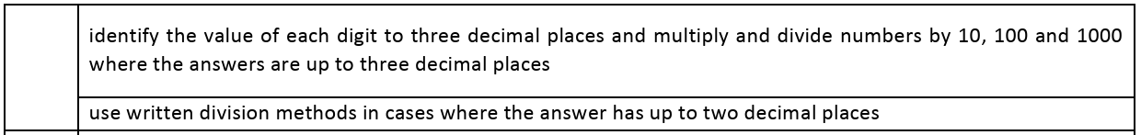
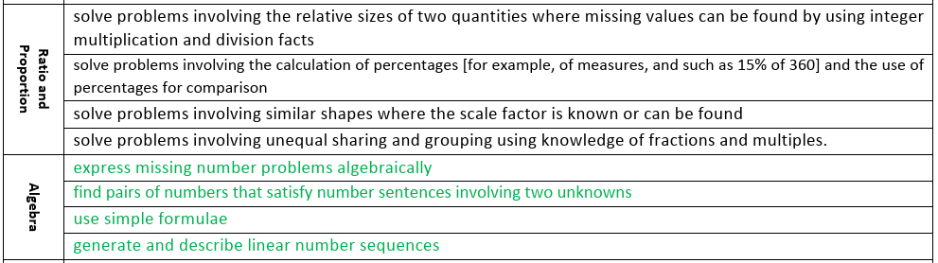

Slide 10
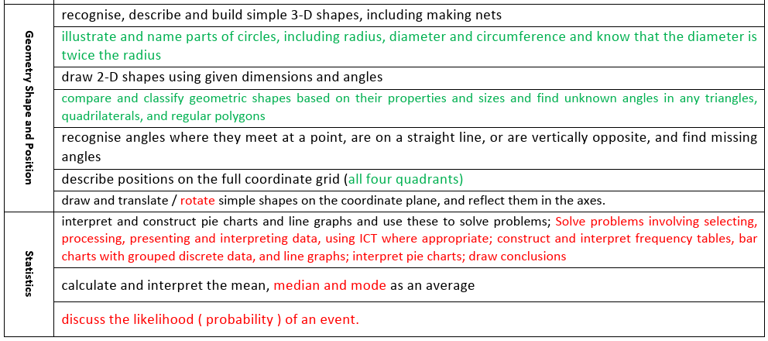

Slide 11
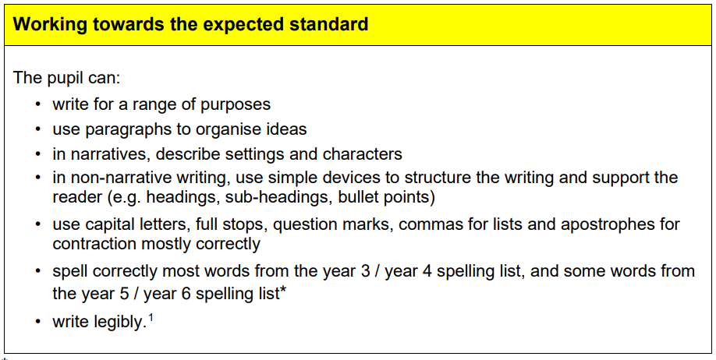
Year 6 Writing Expectations

Slide 12
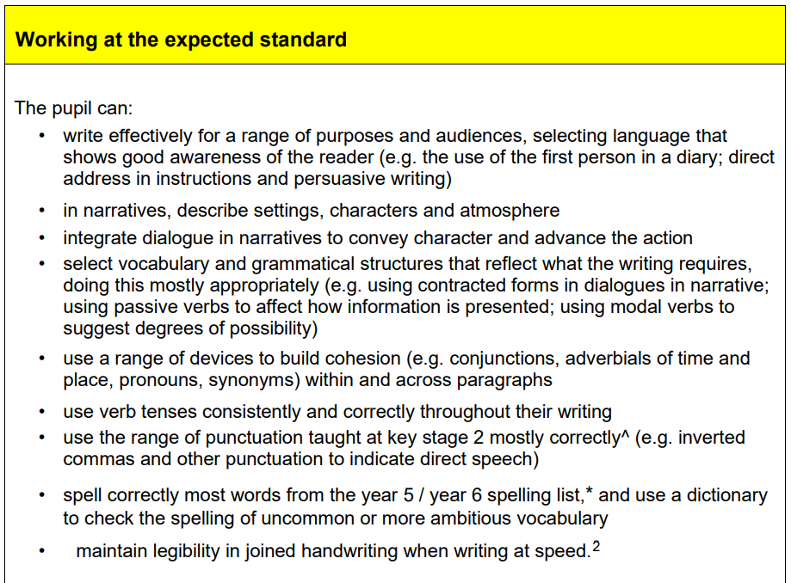

Slide 13
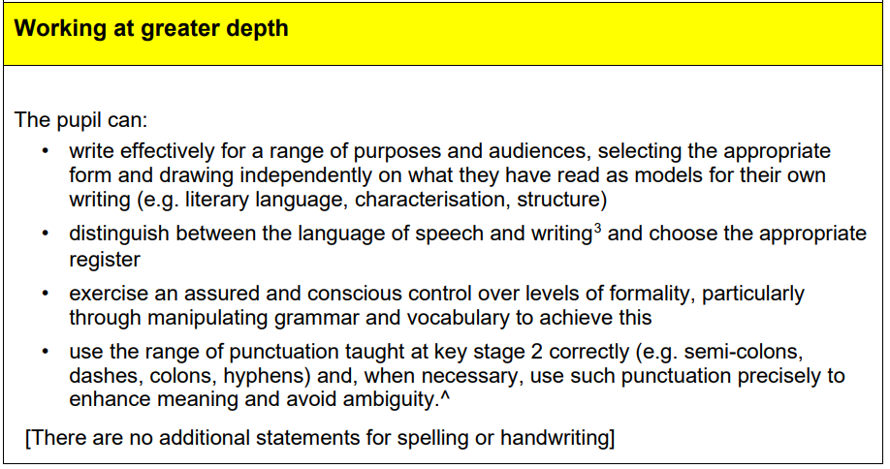

Slide 14
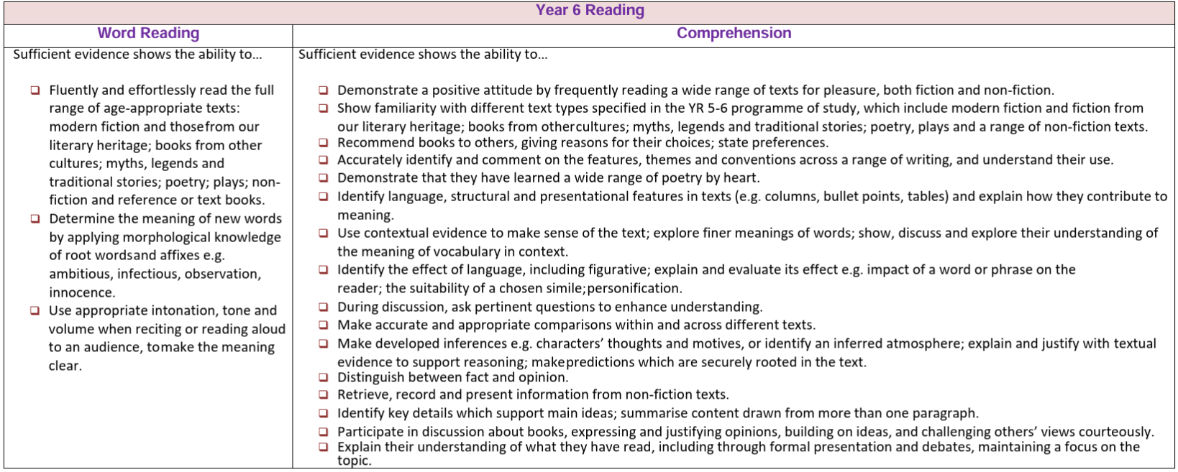
Year 6 Reading Expectations

Slide 15









Year 6 Recommended Reads

Slide 16
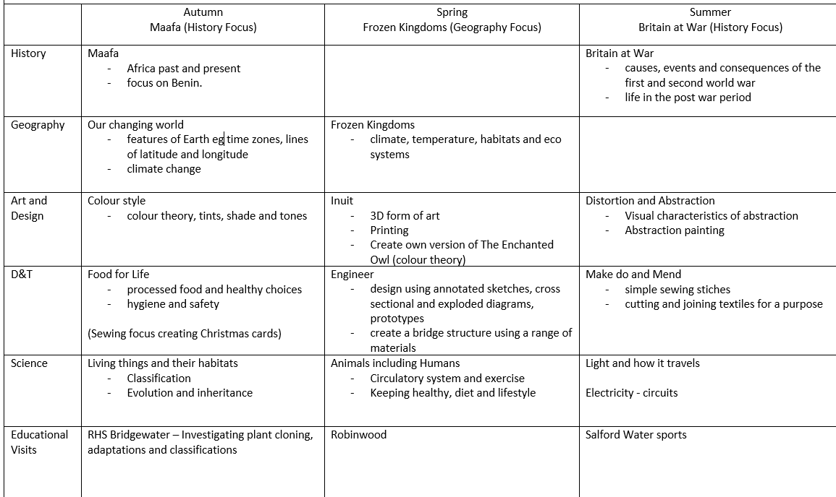

Slide 17
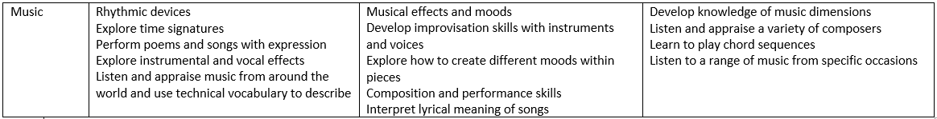

Slide 18
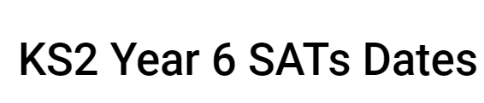
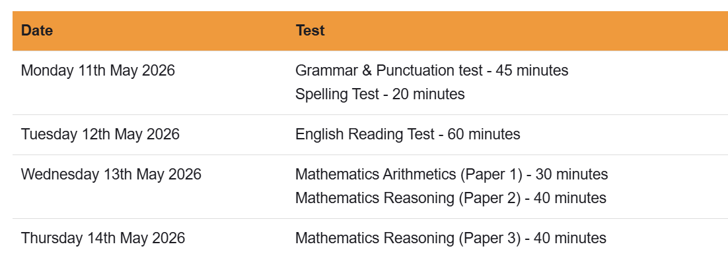
SATs

Slide 19
Useful websites:
https://www.bbc.co.uk/bitesize/articles/zrybvk7
BBC Bitesize
https://www.cgpbooks.co.uk/resources/ks2-sats-online-10-minute-tests?srsltid=AfmBOopEiyGW76VIqN5ZQlRwRbeUACz0XhFvFZMqbQZqDoq_-bcSdKRq
CGP 10 minute tests
https://www.satstestsonline.co.uk/pupils/practice/maths/maths_practice.aspx
Maths SATs Practise
https://www.topmarks.co.uk/Search.aspx?AgeGroup=3
Topmarks Maths Practise

Slide 20
Any questions?

