Slide 1

Welcome to Nursery
2018-19

Slide 2
Growing together within God’s loving family, we support, challenge and inspire each other to become the best that we can be.

Slide 3
Introductions
The Nursery team:
Miss Fletcher (class teacher)
Miss O’Connor (teaching assistant)
Mrs Warsop (teaching assistant)
Miss Kensik (teaching assistant)

Slide 4
General reminders
Doors open at 8.45 am and children should be in school before 8.55 am.
New water bottles are available from the school office for £2.00
All children are offered milk in school under the age of 5
Money for toast is paid half termly – speak to the office if you would like your child to have this (toast is 50p a week).
All monies are to be paid using Parent Pay.
All children in Foundation Stage are offered milk every morning and fruit every afternoon as a healthy snack.
Our doors open at 3pm so that younger children can be collected before older siblings.
Breakfast Club and After School Club are available although are heavily subscribed!
PE is every Thursday and the children will need to bring pumps to change into.

Slide 5
Uniform
Blue sweatshirt or cardigan with school logo. These are available at the school office.
White polo shirt or blouse/shirt
Dark grey/black trousers
Navy/black/grey knee length skirt or pinafore dress
Plain black/white or grey socks/tights
Black shoes
(no trainers, boots or open toe sandals)
Jewellery
Small plain studs-one in each ear
Black or blue hair bobbles and headbands only
All items of clothing should be marked with your child’s name please.

Slide 6

Reward System
The reward system for the Foundation Stage works on the children earning bows on their kites for good work and behaviour.
Children who earn three bows in the week are rewarded with a special golden time on Friday.
If children receive a fourth bow (a golden bow), they choose a special treat out of the golden basket.

Slide 7
Development Matters
Development Matters is an Early Years Foundation Stage planning and assessment document which nurseries and schools use to see what your child’s strengths are and what they need support with.
There are seven areas of development including:
Personal, Social and Emotional Development
Physical Development
Communication and Language
Literacy
Mathematics
Understanding the World
Expressive Arts and Design
The first three are ‘prime areas of development’ because these are critical for the other areas of learning to be possible.

Slide 8
Phonics
Phonics is a way of teaching children to read quickly and skilfully. They are taught:
- how to recognise the sounds that each individual letter makes
-identify the sounds that different combinations of letters make. - such as ‘sh’ or ‘oo’
- how to blend these sounds together from left to right to make a word.
We will start off with listening for sounds in the environment and building an understanding of what a sound is.
Children will have daily phonics lessons until they are in Year 2.

Slide 9

At home
Home reading – Learning to read can be very difficult for young children.
Reading every night builds a love of reading.
Children need to experience the fun of reading - enjoy sharing a story and see you enjoying the story too, one they can escape into a fantasy world, while snuggled up with family.

Slide 10
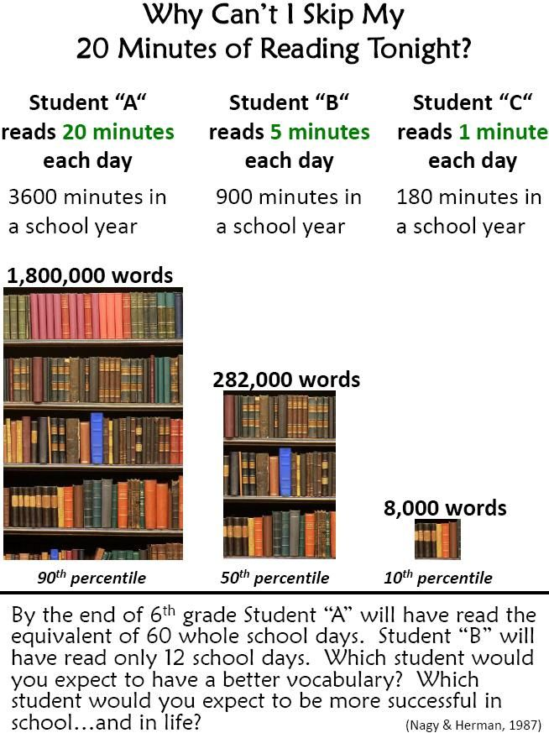
The importance of reading

Slide 11

Education City
EducationCity is an educational resource for children aged 3-12. It allows your child to access online resources to support their learning at home. It’s in a format that will be familiar to them because they will also have opportunities to use it in school.
Your child has a username and log in which you will be given at the end of this meeting.

Slide 12
The term ahead
Heaton Park Educational Visit – we will be going on the school minibus to Heaton Park. As we will be going in small groups, we will let you know in advance what day your child will be going. It will be during the first week of the second half term.
Pupil Progress Meetings – Wednesday 7th November (appointments will be available throughout the day)
Foundation Stage Nativity – Wednesday 12th December at 10 am and Thursday 13th December at 10 am.

Slide 13
Any questions?
Please feel free to come and speak to me if you have a query or concern.

