Slide 1


Welcome to Reception
2023 - 2024

Slide 2
Website
Home | The Cathedral School of St Peter and St John Primary (cathedralschoolstpeterandjohn.com)

Slide 3
The EYFS TEAM
Mrs Mc Fadden- Class teacher
Mrs Culkin- HLTA
Miss Dent –Nursery teacher (Tues-Fri)
Mrs Royle (Miss Fletcher: Mon & Tues)
Mrs Holmes- Teaching Assistant

Slide 4
What is EYFS?
The Early Years Foundation Stage is all about learning through play!
Reception is more structured than nursery. The children are expected to concentrate for longer periods of time and complete increasingly challenging tasks such as writing sentences or solving problems in maths. The structure helps to prepare the children for Key Stage One.

Slide 5
Key Areas of Learning
We follow the Early Years Foundation Stage Statutory Framework (2021)
Key areas:
Prime areas:
Communication and Learning
Personal Social and Emotional Development
Physical Development
Literacy
Mathematics
Understanding of the World
Expressive Arts and Design

Slide 6
Reception Baseline
Every child is assessed at the beginning of Reception. This allows us to track your child’s progress as they move through the school.
These assessments are completed in class with the teacher. They take about 20 minutes.
Every child in the country will complete the same assessments.

Slide 7
General reminders
Doors open at 8.40 am for a 8.45 am start.
Packed lunches to be placed on the designated area outside the classroom.
Toast and milk are payable half termly in advance.
All monies are to be paid using Parent Pay.
The school gates open at 3 pm and the day ends at 3.10 pm.

Slide 8
Uniform
School jumpers and cardigans are available from the school office.
Blue sweatshirt or cardigan with school logo
White polo shirt or blouse/shirt
Dark grey/black trousers
Navy/black/grey knee length skirt or pinafore dress
Plain black/white or grey socks/tights
Black shoes (no trainers, boots or open toe sandals)
Please ensure your child comes to school with a coat
Jewellery
Small plain studs
All items of clothing should be marked with your child’s name please!

Slide 9
Growing together within God’s loving family, we support, challenge and inspire each other to become the best that we can be.

Slide 10
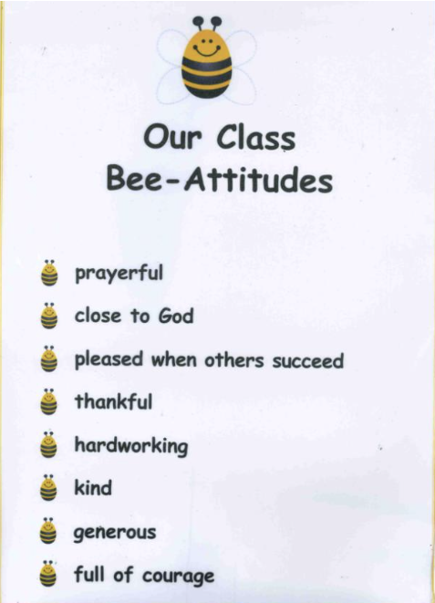
Bee- Attitudes
In Reception the children are developing their understanding of Gospel values, they are promoted through Bee-Attitudes which is consistent throughout the school. The children are encouraged to follow the values of Jesus.

Slide 11

Class Dojo
Children receive dojo points for going ‘above and beyond.’
When the children reach 10 dojo points, they will be able to choose a prize from the prize box.
After they have received their prize, the dojos will be reset to 0, ready for them to start earning their next 10 dojos.
You will be sent messages through the Dojo website when your child receives points.

Slide 12
Curriculum
You will receive half termly newsletters outlining what your children will be learning, this will be available on the website.
Our planning is a basic outline to ensure we cover all the areas of the curriculum however it is flexible. We always aim to plan to the interests of the children and therefore the overviews should be considered as a working document and can alter slightly.
We are always looking for ways to enrich our curriculum so if you have any links that you feel might benefit our children, please let us know for example, if you or a member of your family is a key worker, it would be wonderful if you could come in and talk to the children during our ‘People Who Help Us’ unit.
In addition to our curriculum, we are also involved in the whole school super learning days, for example, the Inspirational Women in History, Black History month and much more.

Slide 13
Reception Phonics AND Reading
Our teaching scheme - Little Wandle Letters and Sounds.
Systematic Synthetic Phonics – it is an approach to recognise letters and their associated sounds. We break the words down into the smallest units of sound and blend them together to read the words
In Reception, your child will read a new book every week at school. They will read this for 3 days to build on decoding, prosody (reading with expression) and understanding.
They will bring this home on a Wednesday, it must be returned on the following Mon. They should be able to read this independently or without much support.
Your child will also bring home a book of their choice to read for pleasure. This is a book to share. There is no expectation for them to read it independently.

Slide 14
Reading books
Wordless books
Can establish a reading routine without the pressure of reading a book.
Focus on discussing the illustrations and story.
Questioning.
Extend vocabulary- adding describing words, alternative words (a big tree, an enormous tree).
Phonological awareness (I spy ‘s’ for..)
Comprehension (What might the character be feeling?)
Structure (Beginning, middle and end).
Retelling and Imagination (remembering the beginning, middle and end as well as acting out the story).
SO MUCH LEARNING FROM WORDLESS BOOKS!
Reading books match the children’s level of phonic understanding (identifying phonemes and blending).
Phonics assessments are completed to ensure the children are given the correct level of reading book.
To begin with your child may be given a wordless book because they are still developing their understanding.

Slide 15
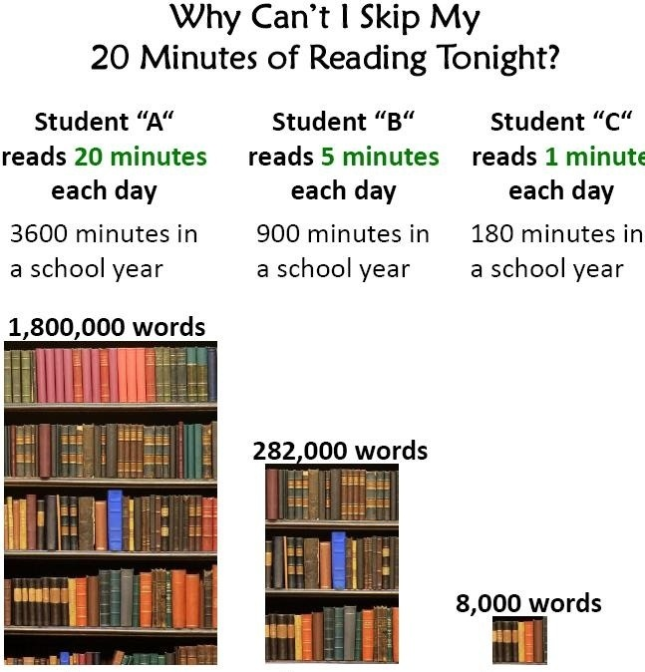
How can I help my child at home?
Talking to your child is the most fundamental way you can help your child in Early Years. Communication is key to so many areas of a child’s development.
Reading stories together is not only educational but what a lovely time to spend together!
Listening to and supporting your child with their reading book. Please comment on anything you notice in their reading record – your opinion and comments can really help us to help them.

Slide 16
Mathematics
Reception look at numbers to 10 and beyond. We use many resources, including 10s frames and part, part whole frames to deepen the children’s understanding of number.
There are many ways children can develop their understanding of numbers for example, counting whilst climbing the stairs, numbers in the environment such as numbers on front doors, on a bus or a clock.

Slide 17
Home Learning Book
This will be given on a Friday to be returned on Tuesday.
This will link with something we are learning about in class.

Slide 18

PE
PE Day is Tuesday: Beginning Autumn 2.
Pumps only, to begin with.
PE kit – white T-shirt, black shorts and pumps or trainers.
We recommend you leave your child’s PE bag at school for the half term, taking it home to wash in the holidays.

Slide 19
Parental Involvement
Communication between parents and teachers is extremely important to us. No one knows your child better than you do!
We aim to have an open door policy and will always make time to speak to you. If you need to speak to us at the end of the day, to ensure the safety of the children we ask you to wait until the other children have left the classroom. Alternatively, we can speak over the phone or make an appointment.
We will also have the opportunity to speak at pupil progress meetings that we have three times each year. You will be given written achievements and targets prior to pupil progress meetings.
You can also see all the wonderful things your children have been doing on the school website, on the school twitter page and in our termly newspaper.

Slide 20
Any questions?

