Slide 1
Year 6
End of Key Stage 2 SATs

Slide 2
Year 6, children sit tests in:
Reading
Maths
Spelling, punctuation and grammar
These tests are both set and marked externally.

Slide 3
Week beginning 13th may 2024
Monday 13th May 2024
English grammar, punctuation and spelling Paper 1: questions
English grammar, punctuation and spelling Paper 2: spelling
Tuesday 14th May 2024
English reading
Wednesday 15th May 2024
Mathematics Paper 1: arithmetic
Mathematics Paper 2: reasoning
Thursday 16th May 2024
Mathematics Paper 3: reasoning

Slide 4
Year 6 SATs
Maths
Children sit three papers in maths:
Paper 1: Arithmetic, 30 minutes – marked out of 40
Papers 2 and 3: Reasoning, 40 minutes per paper – marked out of 35 each
110 marks available overall

Slide 5
Maths
Paper 1 will consist of arithmetic questions, where children have to give the correct answer to calculations, including addition, subtraction multiplication, division, fractions and percentages.
Papers 2 and 3 will involve a number of question types, including:
Multiple choice
True or false
Calculating the answer to a worded problem, drawing a shape or completing a table or chart
Explaining a strategy to solving a problem

Slide 6
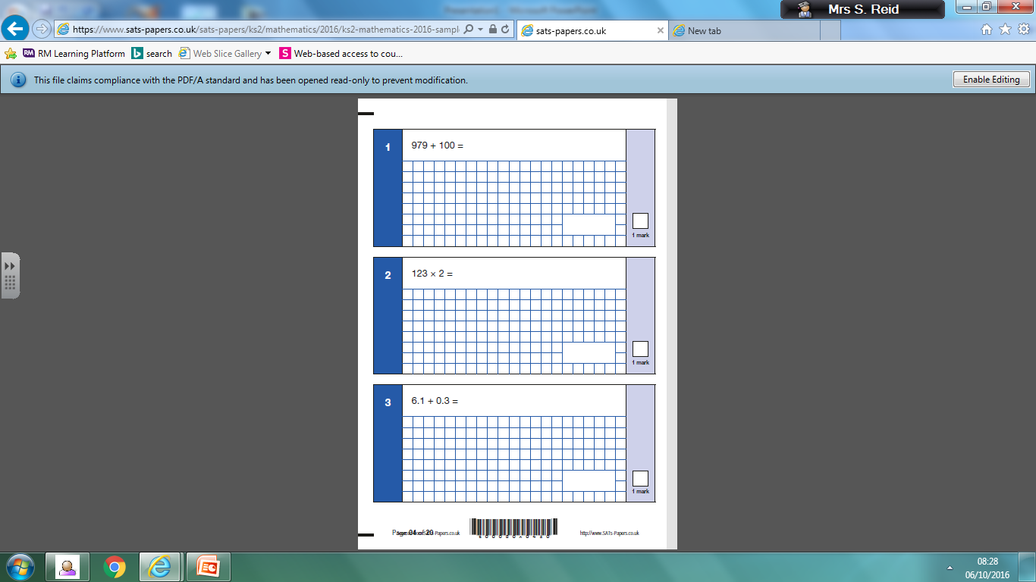
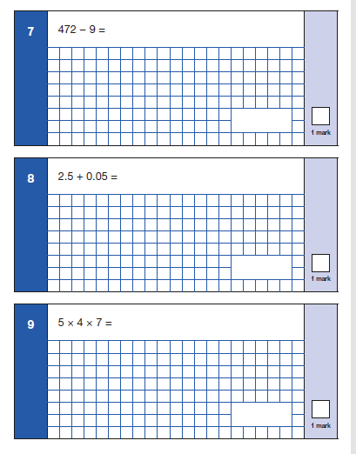
Paper 1 Arithmetic

Slide 7
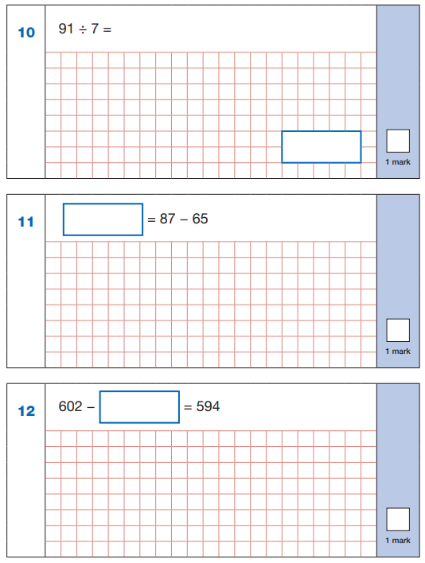
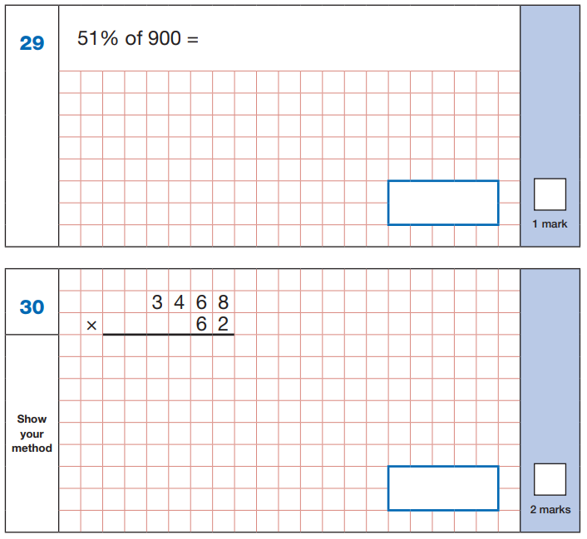

Slide 8
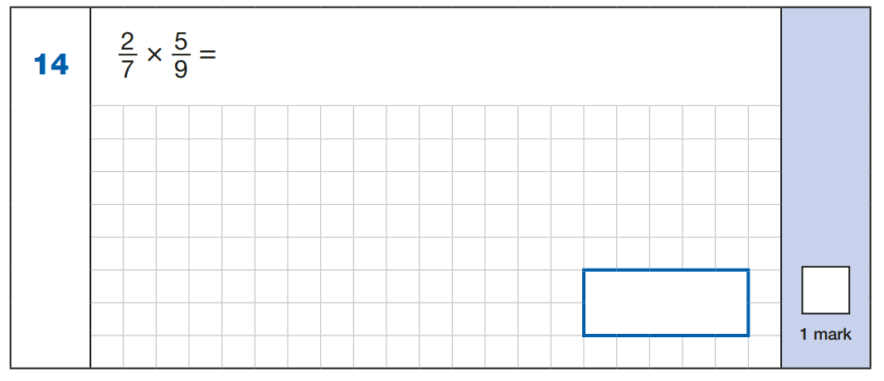
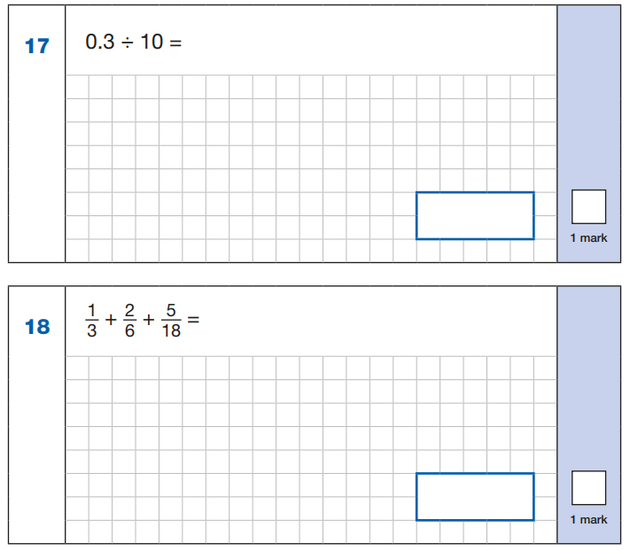
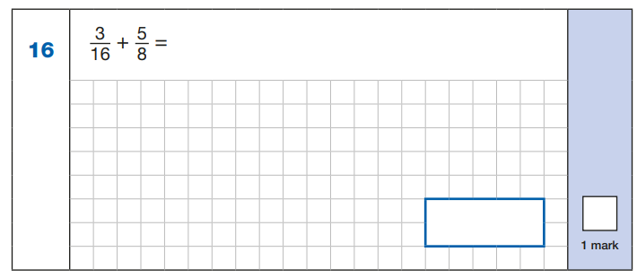

Slide 9
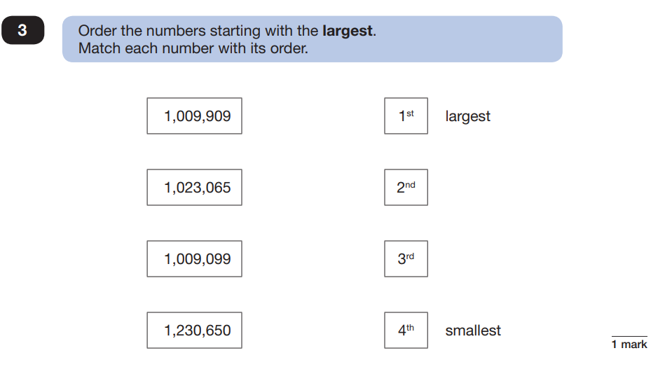
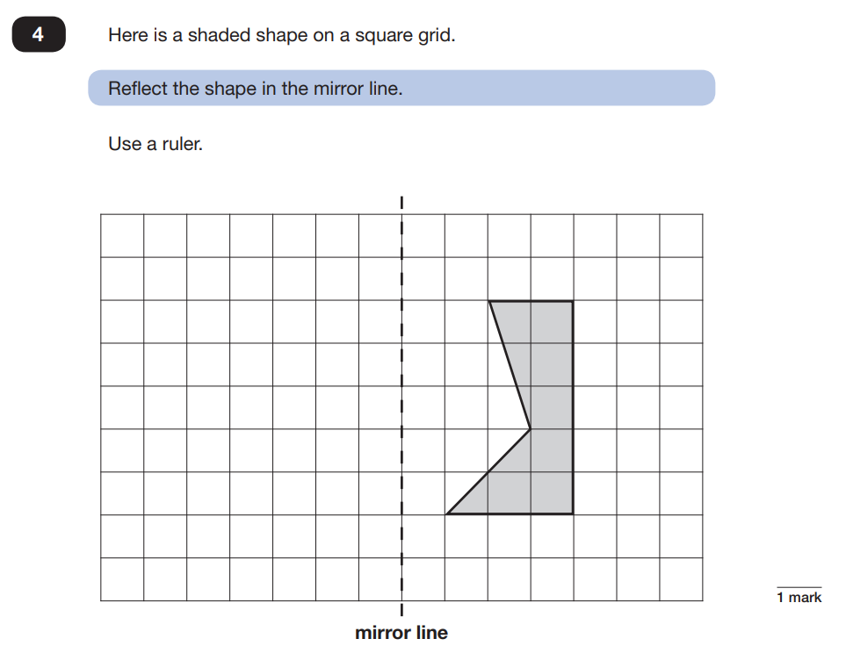
Paper2/3 Reasoning

Slide 10
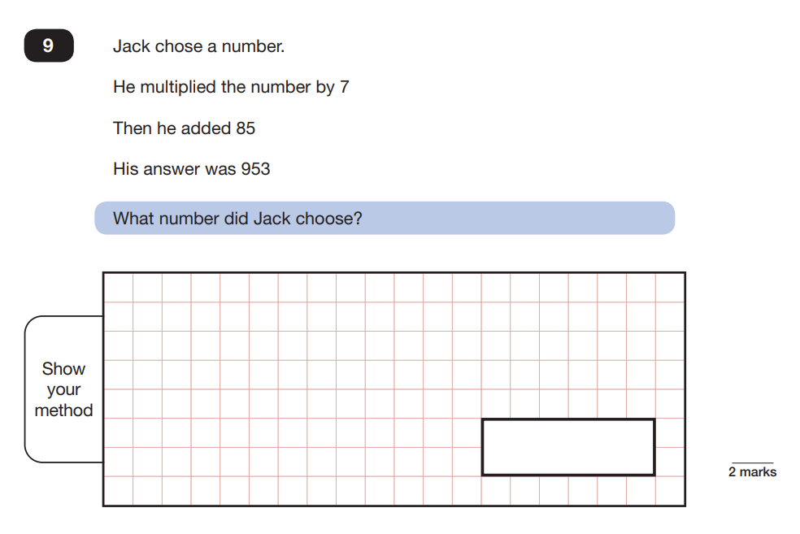
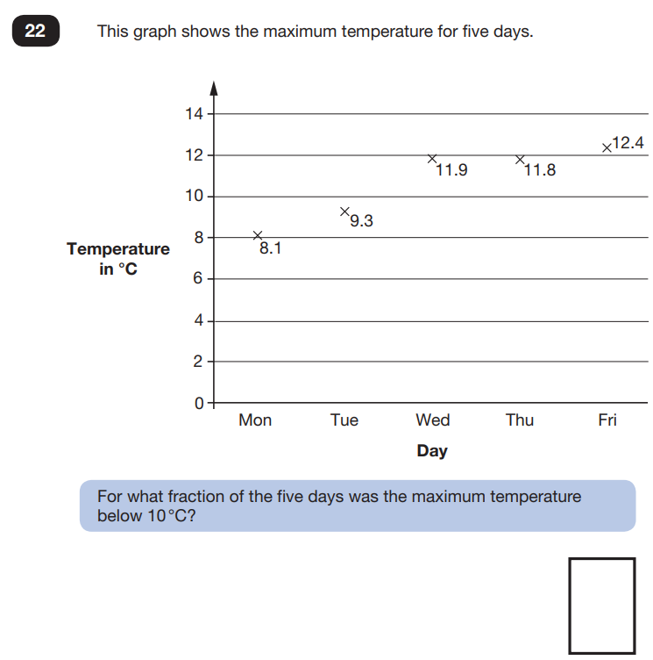

Slide 11
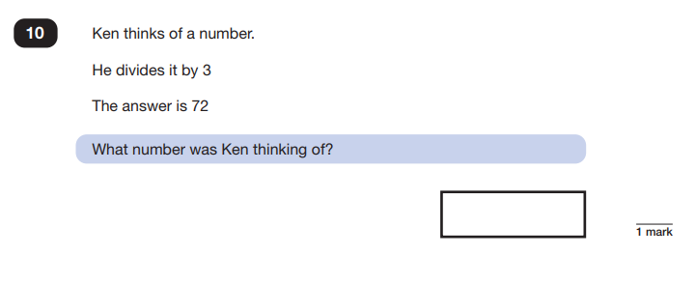
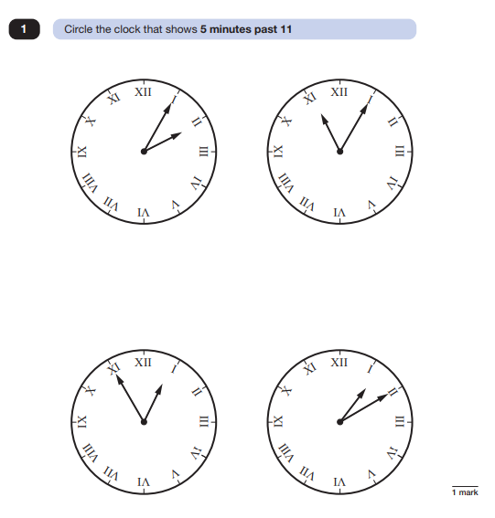
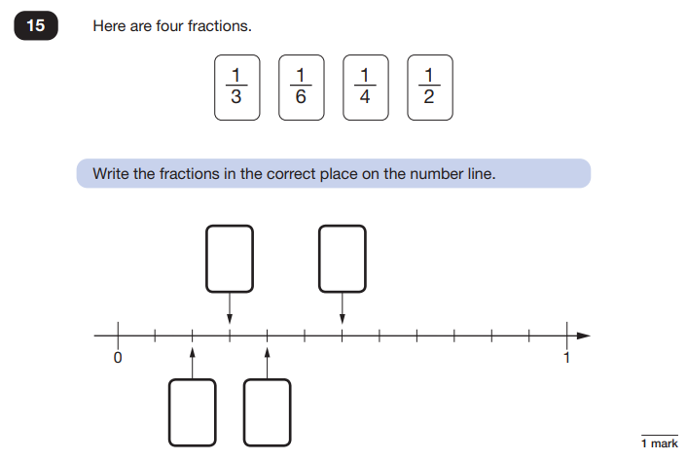

Slide 12
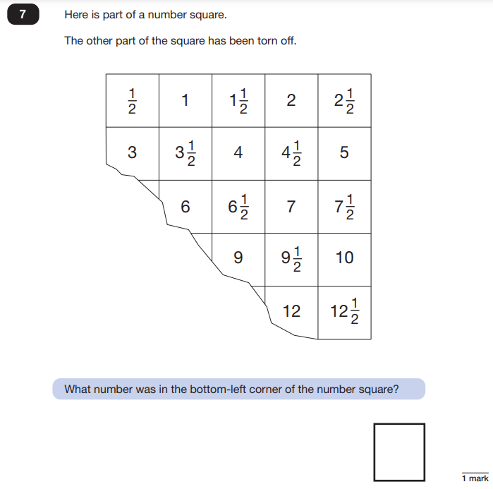
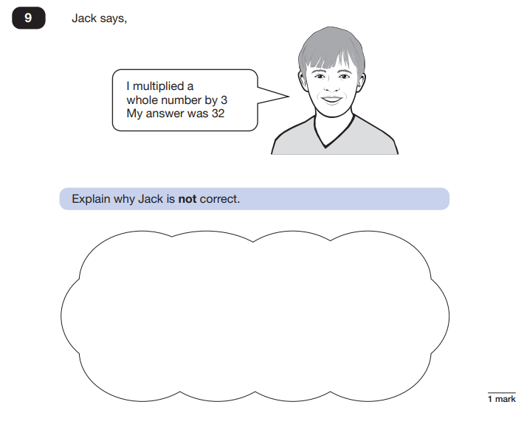

Slide 13
Reading Paper
The reading test is a single paper with questions based on three passages of text
60 minutes, including reading time, to complete the test

Slide 14
Question types:
Ranking/ordering, e.g. ‘Number the events below to show the order in which they happen in the story’
Labelling, e.g. ‘Label the text to show the title of the story’
Find and copy, e.g. ‘Find and copy one word that suggests what the weather is like in the story’
Short constructed response, e.g. ‘What does the bear eat?’
Open-ended response, e.g. ‘Look at the sentence that begins Once upon a time. How does the writer increase the tension throughout this paragraph? Explain fully, referring to the text in your answer.’

Slide 15
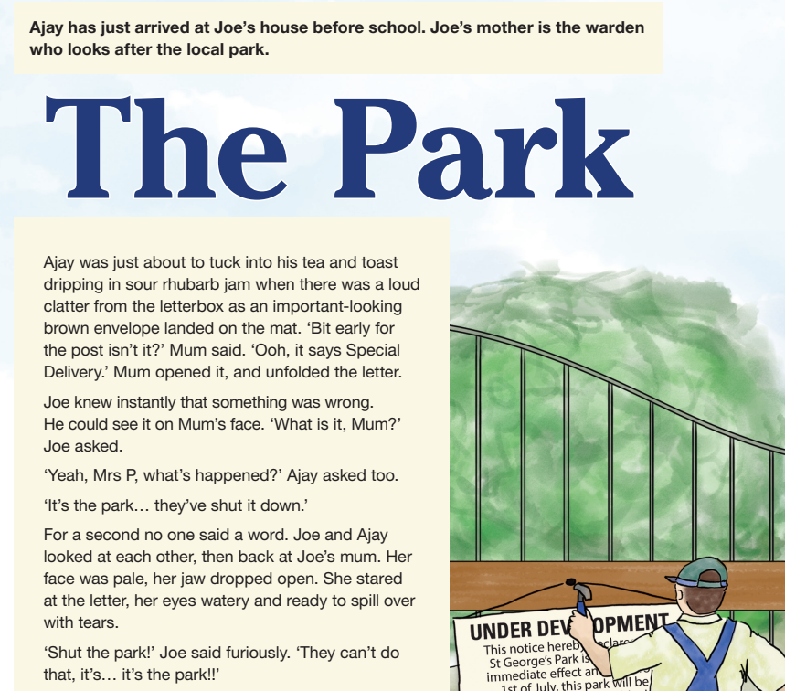

Slide 16
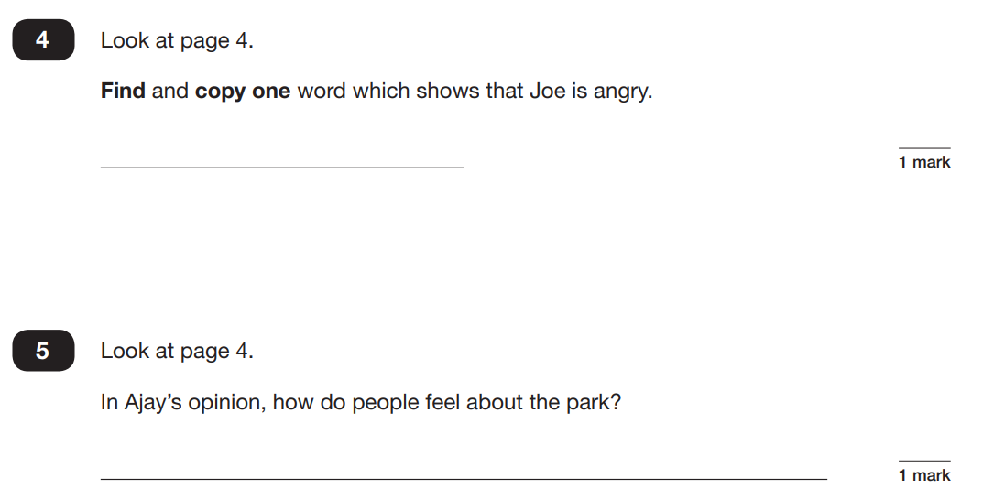
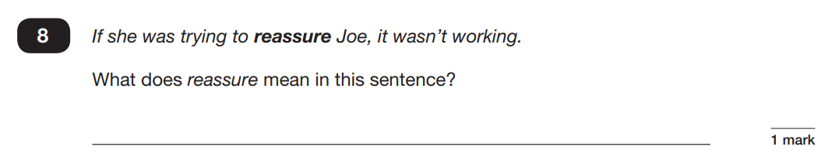
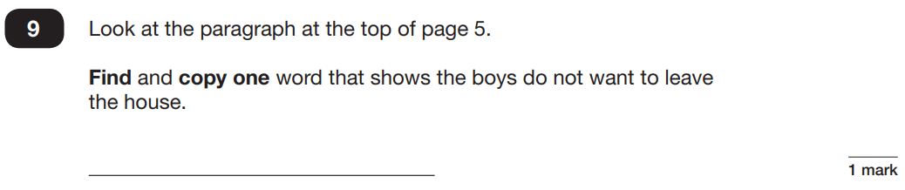

Slide 17
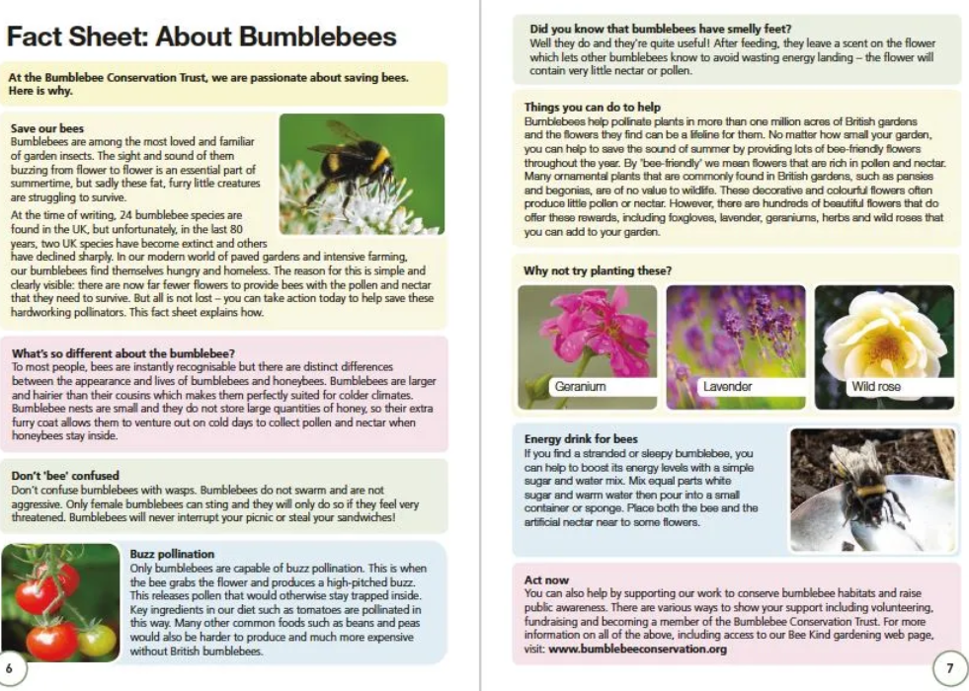

Slide 18
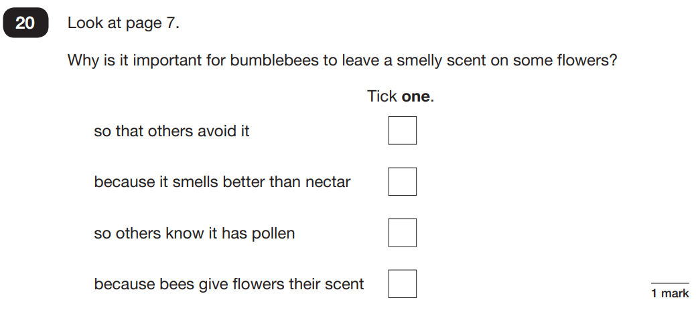
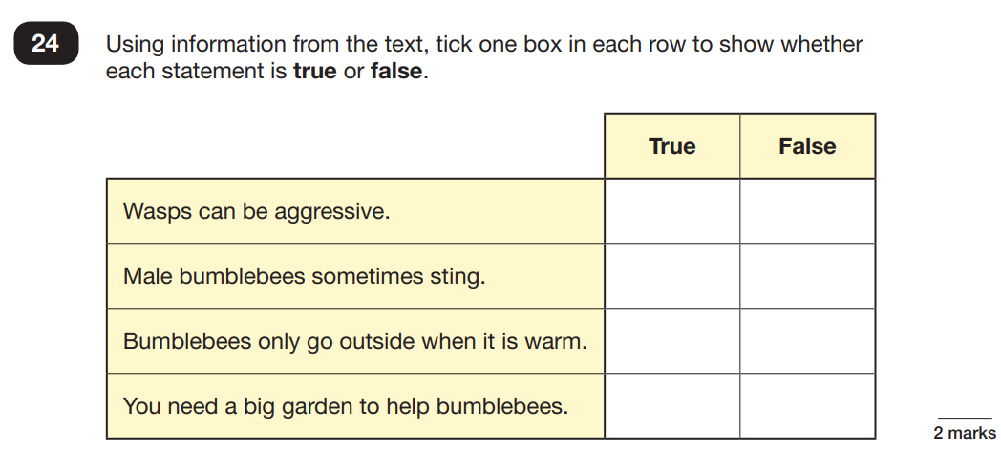
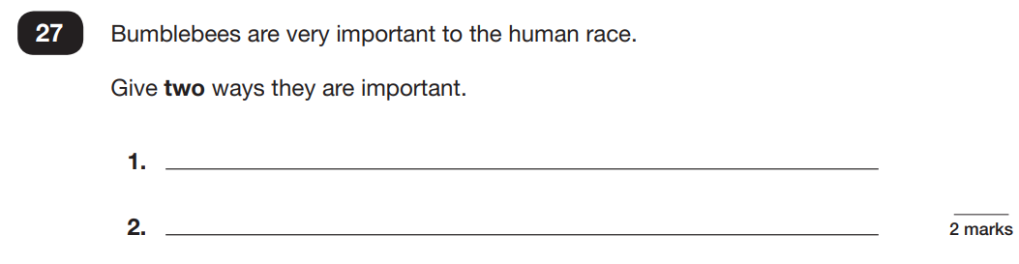

Slide 19
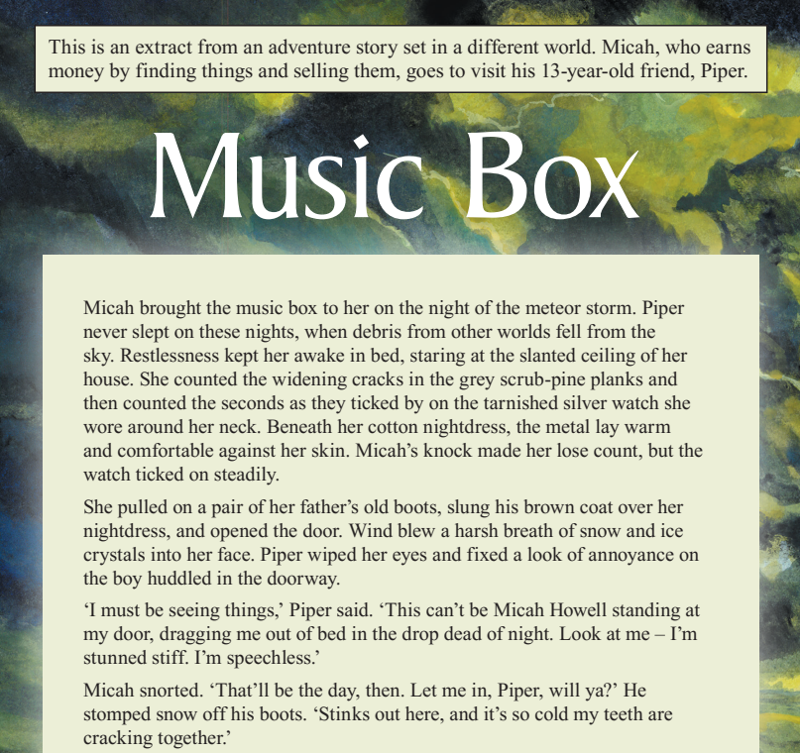

Slide 20
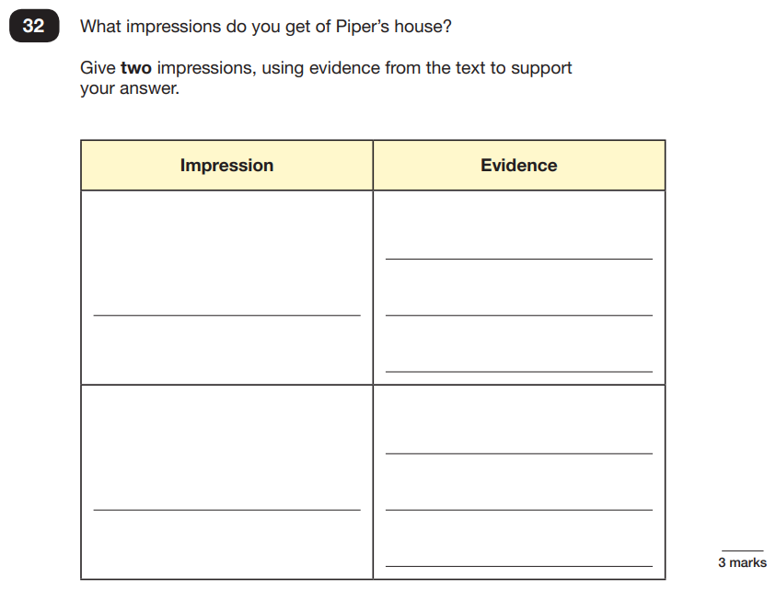

Slide 21
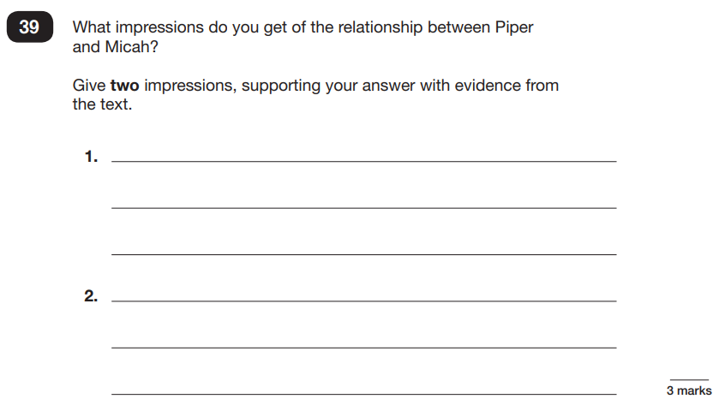

Slide 22
Grammar, Punctuation and Spelling Paper
The grammar, punctuation and spelling test consists of two parts: a grammar and punctuation paper requiring short answers, lasting 45 minutes, and an aural spelling test of 20 words, lasting around 15 minutes.
The grammar and punctuation test will include two sub-types of questions:
Selected response, e.g. ‘Identify the adjectives in the sentence below’
Constructed response, e.g. ‘Correct/complete/rewrite the sentence below,’ or, ‘The sentence below has an apostrophe missing. Explain why it needs an apostrophe.’

Slide 23
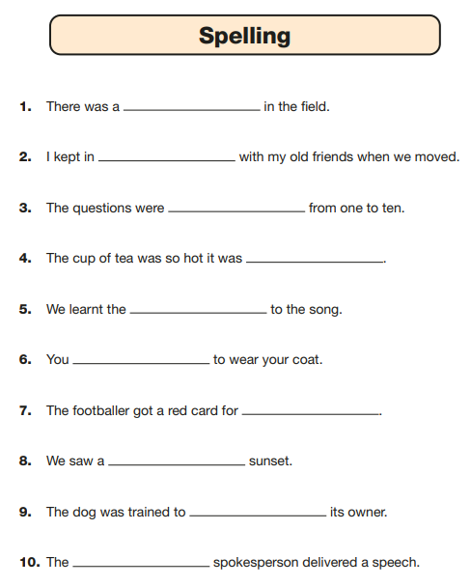
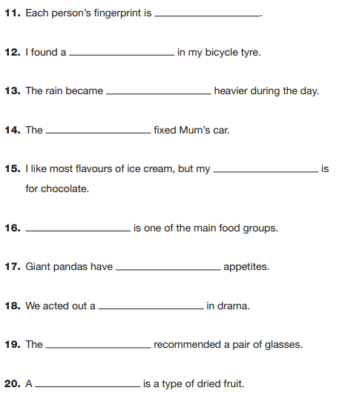

Slide 24
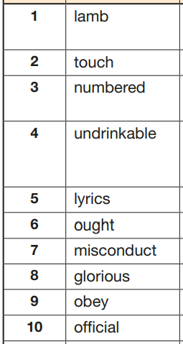
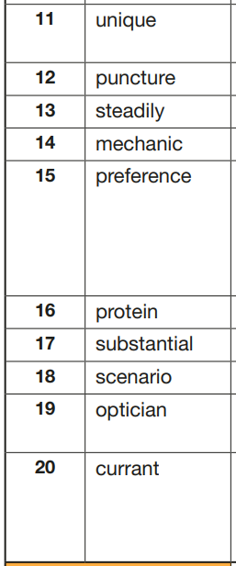

Slide 25
You will be given your child’s scaled score
The range of scaled scores available for each KS2 test is:
80 (the lowest scaled score that can be awarded)
120 (the highest scaled score)
The expected standard for each test is a scaled score of 100 or more. If a child is awarded a scaled score of 99 or less they won't have achieved the expected standard in the test
Click the link below:
Scaled Scores

