Slide 1
Year 4
Parents Meeting
Class Teacher: Miss Allen Teaching Assistant: Mrs Leech

Slide 2
Spiritual, moral, social and cultural development
Importance of our health and well-being in order to have the capacity to make the right choices and work at our best level
Positive reinforcement policy
Reflection times where needed to support children in understanding appropriate behaviour
Our behaviour links to the beatitudes
Mrs Bolton drop in sessions for children and parents

Slide 3
Our reward system for following the Golden Rules and showing God’s love to one another.
Golden time (Y1-6) and our reward assembly is on a Friday to celebrate the achievements of the week.
Classroom daily rewards - class dojo
Star of the Day
Compliments Sheets
V.I.P table
Golden cards

Slide 4
Sharing children's work
Sharing of great work in assembly
Wall of Fame
Head teacher awards
Sharing news with parents – phone call home
Website
Twitter
(cathedralschoolstpeterandjohn.com)

Slide 5
Homework and Spellings
Homework will be given out on Friday and returned to school to be marked on Tuesday.
Spelling tests will be carried out on Thursday. You can find your children's scores in their home spelling book and incorrect words will be highlighted so they can continue to practice these.
Homework will consist of one piece of Literacy and one piece of Maths work. Some weeks it may include a topic based piece of work.
Children are expected to read and have their reading record signed each night.
Children are expected to read at least 15 pages of their book each night.

Slide 6
Swimming and P.E
Children will be attending swimming lessons in the January term.
They need to bring swimming costume or shorts, a swimming cap and a towel.
Children will have P.E every Tuesday.
They need to bring plain black shorts a plain white t shirt and trainers or pumps each week.
Alternatively they can bring their P.E kit and leave it on their peg.

Slide 7
Times Table Test
In June 2020, the new Year 4 multiplication tables check became statutory. Your child will need to take a short online test to make sure their times tables knowledge is at the expected level.
The multiplication tables check is an online test for pupils in Year 4.
Pupils are asked to answer 25 questions on times tables from two to 12. They are given six seconds per question, with three seconds rest between each question, so the test should last less than five minutes.
The best way to keep the test stress-free is to work some times tables practice into your daily routine well in advance. With regular practice, your child will get used to tackling these kind of questions with confidence.
Help your child become comfortable reading and answering questions on a screen. Times table rockstars is set up to emulate the times table check.

Slide 8
The curriculum - Religion
Religion is at the heart of our school. We say prayers together and take part in class and whole school worship. We use the come and see programme which gives pupils the opportunity to explore the mystery of faith through scripture and tradition.
In year 4 we follow these topics:
Special people from the Bible
Baptism and confirmation
Advent and Christmas
Pentecost
Reconciliation
Universal Church
Other religions - Judaism, Sikhism
https://www.tentenresources.co.uk/life-to-the-full-primary/
Health and relationship curriculum
The entire teaching is underpinned with a Christian faith understanding that our deepest identity is as a child of God – created, chosen and loved by God.

Slide 9

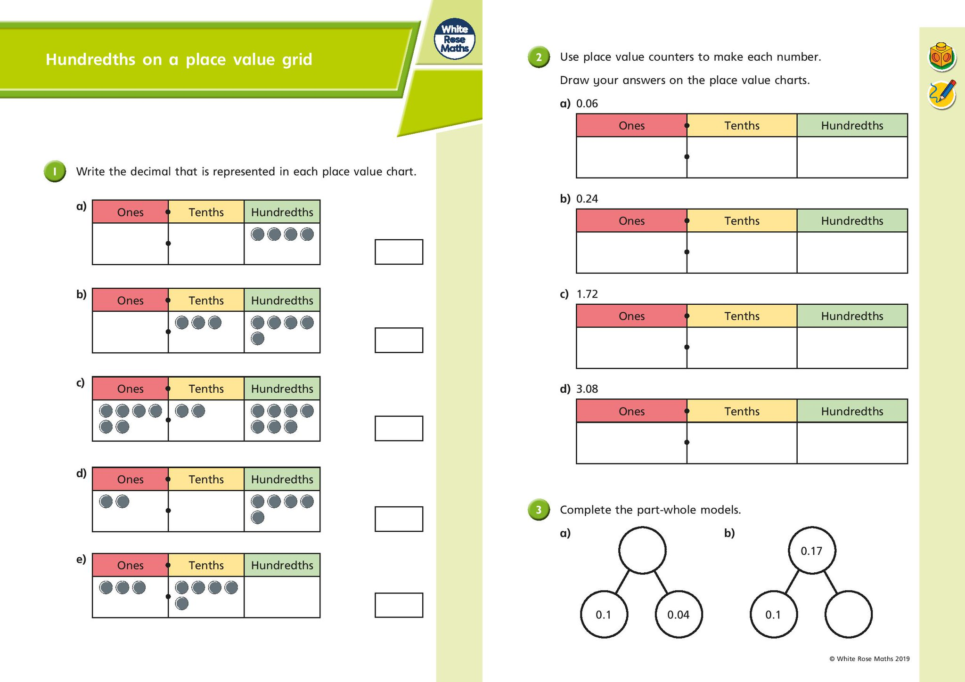
The curriculum - Maths
Maths - White Rose
Lessons and activities are designed to encourage children to become more fluent in their problem- solving and encourage a higher level of thinking in maths in order to deepen understanding and master concepts. Concepts merge from one chapter to the next. Chapters are then broken down into individual lessons.
We use lots of practical resources to support children’s learning and understanding of mathematical concepts. We also use real life problem solving so children can see and use real life contexts.

Slide 10
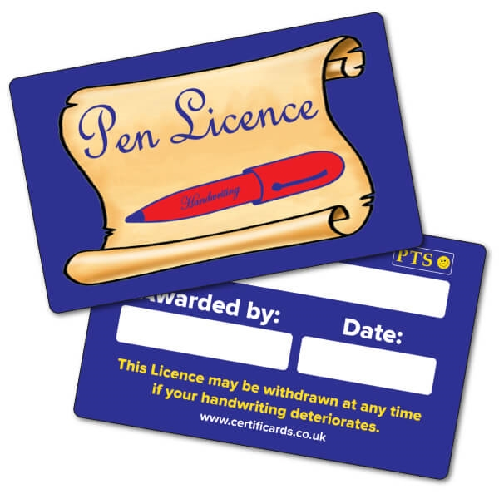
The curriculum - Literacy
Year 4 is also often the year that children earn their ‘pen licence’ – that peak of handwriting neatness that allows your child to write in pen at school.
In Year 4 children will:
Write for a variety of purposes.
Read and take inspiration from a variety of non-fiction and fiction texts.
Edit and improve their own writing.

Slide 11

The curriculum - Science
The Year 4 Science curriculum focuses on these main topics. The children will take part in hands on practical experiments.
Living things and their habitats
States of matter
Animals including humans - Teeth and digestion
Electricity
Sound

Slide 12
End of year expectations
Mathematics End of Year
Compare & order numbers beyond 1000 and find 1,000 more or less than any number
Read & write all numbers to 1000 in digits & words
Round any number to the nearest 10, 100 or 1,000
Count from 0 in multiples of 6, 7,9, 25 & 1000.
Recall & use multiplication & division facts for tables up to 12×12
Recognise Place Value of any 4-digit number.
Add & subtract 4-digit numbers
Add & subtract numbers with up to 4-digits using an efficient written method (column).
Use the inverse to check calculations.
Multiply & Divide 2 and 3-digit numbers by 1-digit numbers
Divide a two and three- digit number by a 1-digit number, or by 10 or 100 using a formal layout.
Count up/down in hundredths.
Recognise and write decimals fractions of any number of tenths or hundredths
+/- fractions with the same denominator
Recognise and write decimals equivalents of ½ ¼ ¾
Read, write and convert time between analogue and digital 12 and 24 hour clocks; and using Roman numerals.
Convert hours to minutes, minutes to seconds, years to months and weeks to days.
Re

Slide 13
Reading End of Year
Give a personal point of view on a text.
Can re-explain a text with confidence.
Justify inferences with evidence, predicting what might happen from details stated or implied.
Use appropriate voices for characters within a story
Identify how sentence type can be changed by altering word order, tenses, adding/deleting words or amending punctuation.
Skim & scan to locate information and/or answer a question.

Slide 14
Writing End of Year
Vary sentence structure, using different openers.
Use adjectival phrases (e.g. biting cold wind).
Appropriate choice of noun or pronoun.
Apostrophe for singular & plural possession.
Comma after fronted adverbial (e.g. Later that day, I heard bad news.).
Use commas to mark clauses.
Use connectives to link paragraphs.
Legible, joined handwriting of consistent quality.

Slide 15
Any Questions?
Please feel free to ask any questions regarding any issues you may have.
I am always happy to help with anything you may need.

