Slide 1
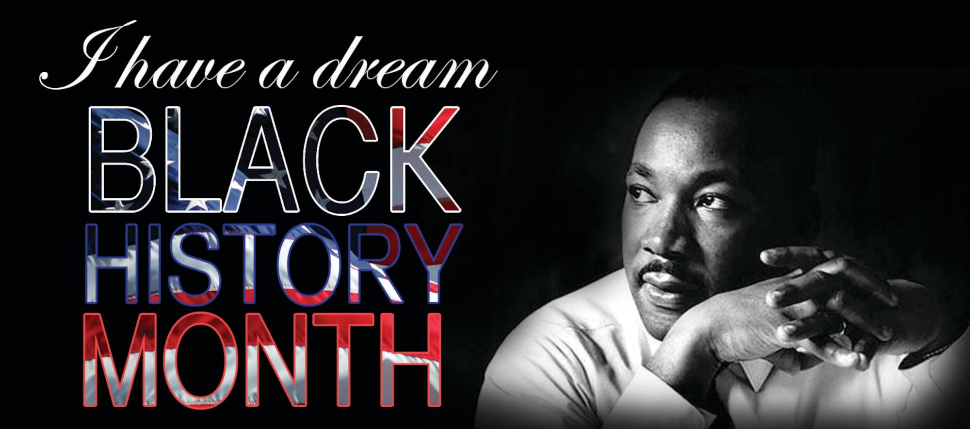
Black history month

Slide 2
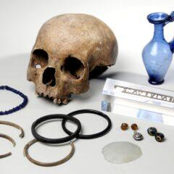
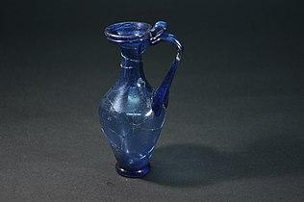
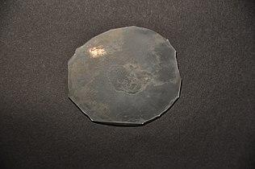
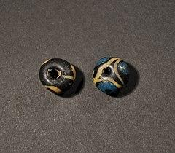
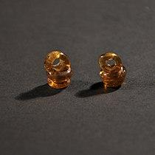
Ivory Bangle Lady
The Ivory Bangle Lady is a skeleton found in Sycamore Terrace, York in 1901. Her skeleton was found with bracelets, pendants, earrings as well as a glass jug and mirror.She appears to have been from North Africa.
Ivory Bangle lady was buried in York in the late fourth century.She was discovered in a stone coffin which means she was more protected than the wooden coffins.
Blue glass flask
Glass mirror
Glass beads
Earings

Slide 3
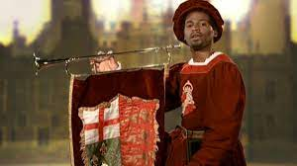
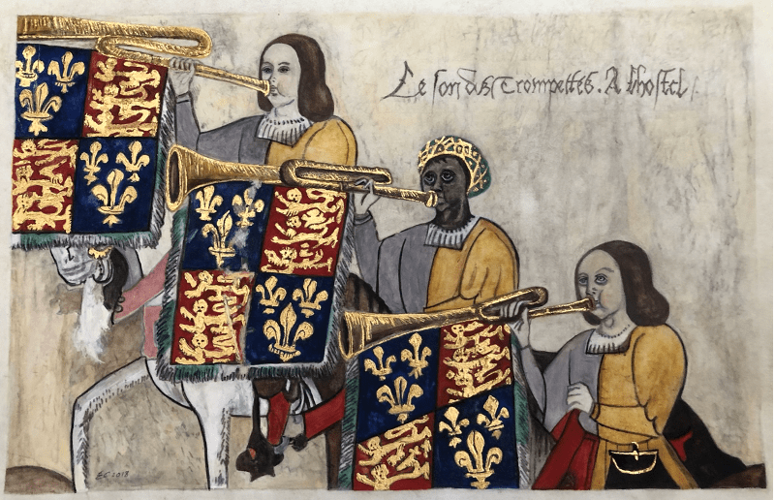
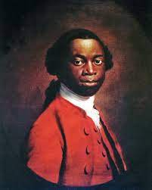
John Blanke
John Blanke was a musician of African descent in London in the early 16th century, who probably came to England as one of the african attendants of Catherine of Aragon in 1501. He is one of the earliest recorded black people in United Kingdom after the Roman period.
His name may refer to his name colour, derived either from the word Black or possibly from the French word Blanc.

Slide 4
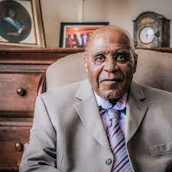
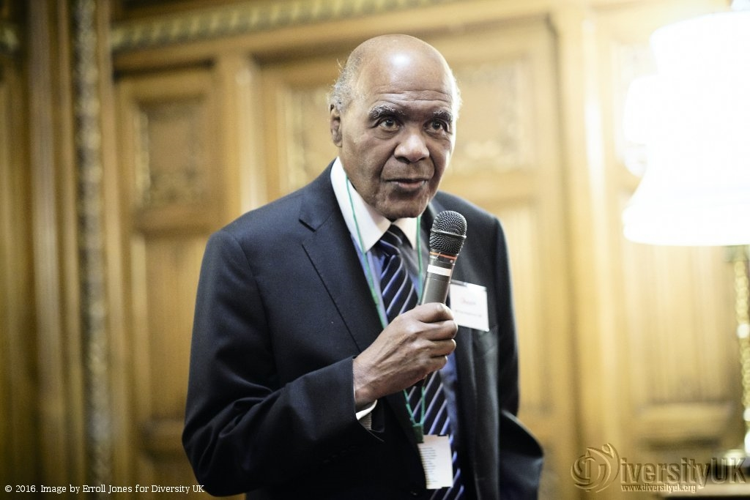
Paul Stephenson
Paul Stephenson born 6 of May 1937 is a community worker,activist and long-time campaigner for civil rights for the British African-Caribbean community in Bristol,England.
In 1964 Stephenson achieved national fame when he refused to leave a public house until he was served, resulting in a trail on a charge of failing to leave a licensed premises.

