Slide 1
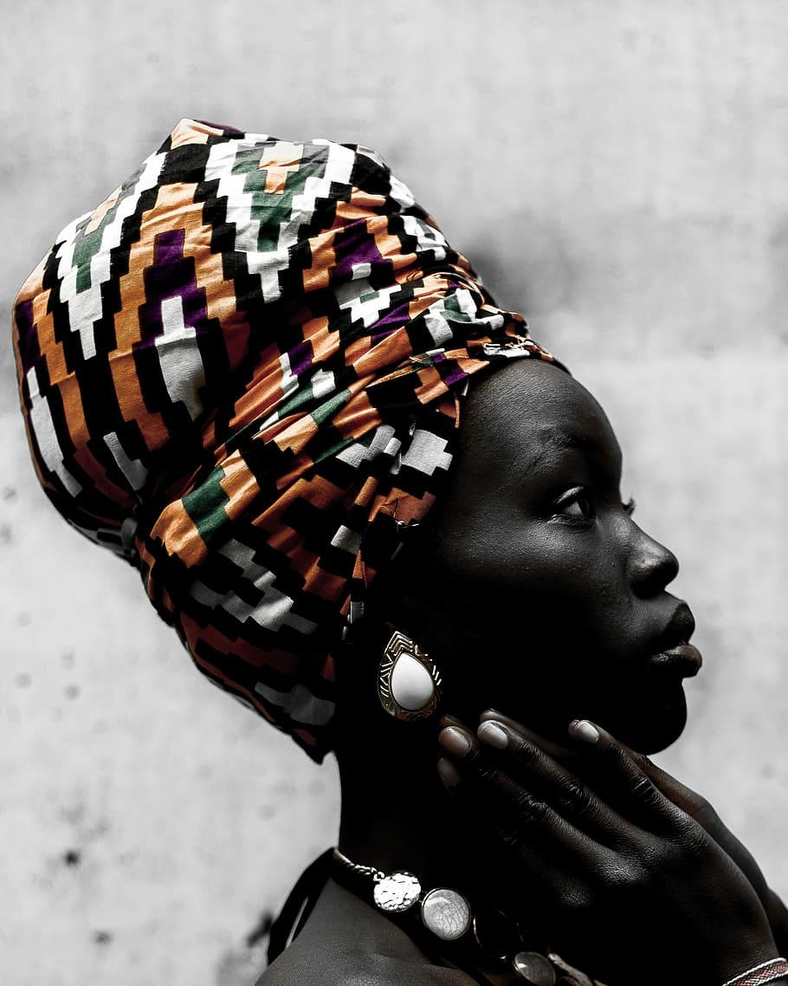

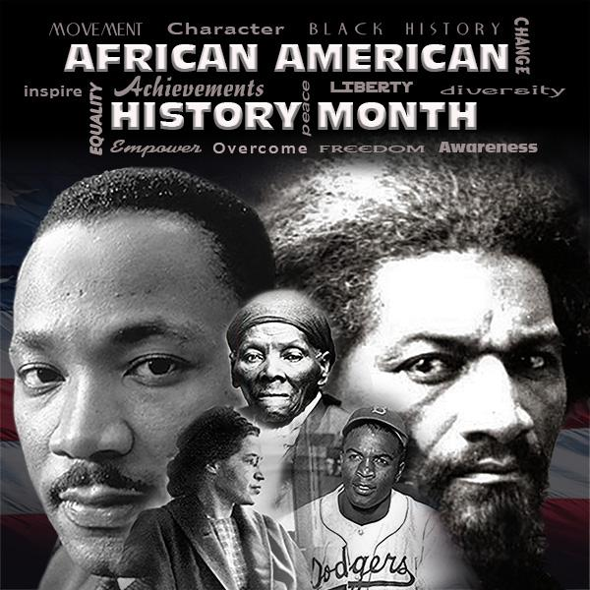

Slide 2
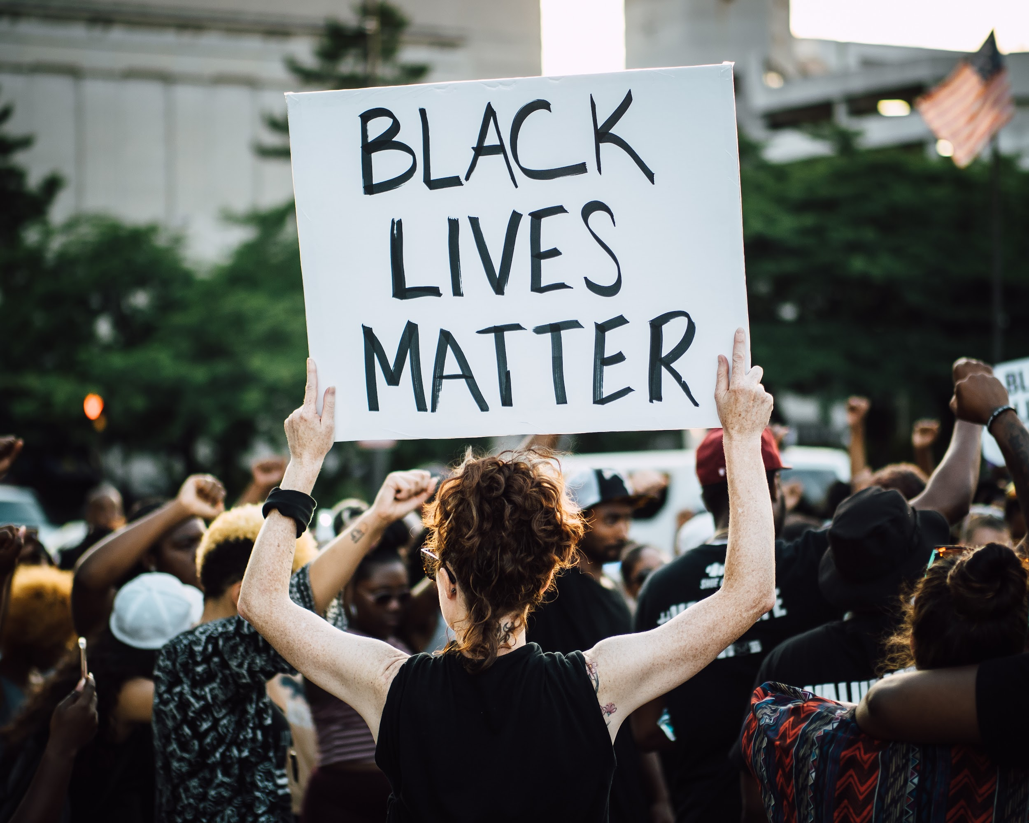
What is black history month?
Black History Month was created to focus attention on the controbutions of Africans Americans to the United States.It honors all Black people from all periods of U.S history ,from enslaved people that first brought over from Africa in the early 17th century to African Americans living in the United States today.

Slide 3
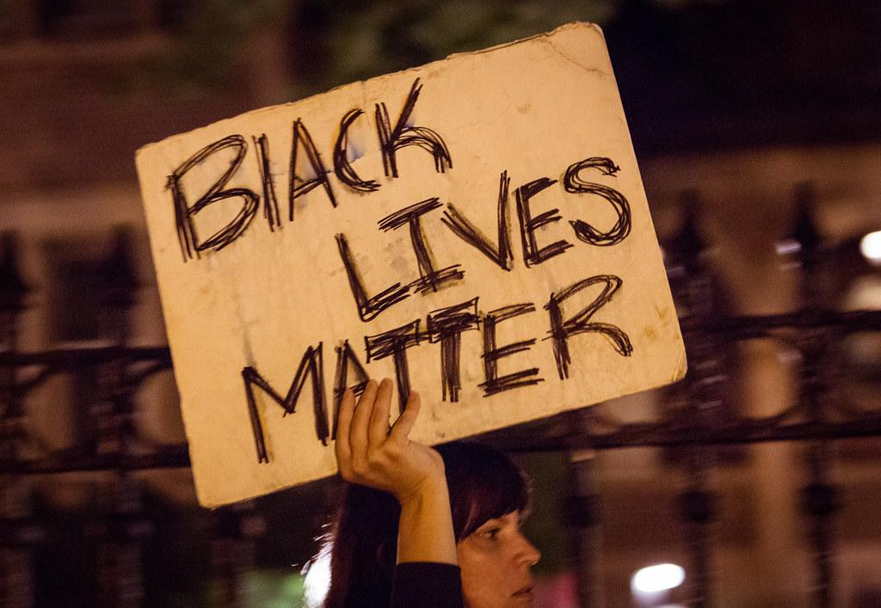
What is Black History Months origin?
The story of Black History Month begins in Chicago during the summer of 1915. An alumnus of the University of Chicago with many friends in the city, Carter G. Woodson traveled from Washington, D.C. to participate in a national celebration of the fiftieth anniversary of emancipation sponsored by the state of Illinois

Slide 4
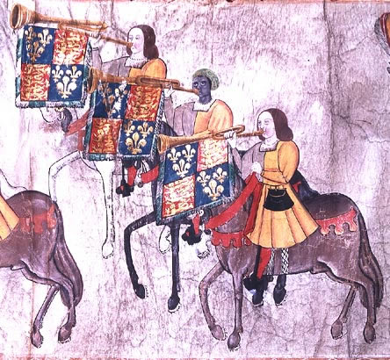
JOHN BLANKE
In 1511, on new years.
Henry VIIIs wife (catherine of aragon) gave birth to a boy.
Henry held a great tournament in westminster to celebrate.
Henry asked for a 60 feet long roll to mark this event.
On the roll were the trumpeters, and on that roll..
Was John Blanke, the only black person out of the entire roll.

Slide 5

PAUL STEPHENSON
Starting in 1963 Paul Stephenson started a boycott.
He started a boycott against a racist bus company.
He was just a normal social worker in Bristol, until he decided to stand up for his rights and equality.
He worked with many people and ended up fighting for black peoples equality and respect for more than 60 years.
In his seventies he set up a company with Mohamed Ali for young people who want to get involved in sports.
In his time he ended up getting multiple medals and honour from the queen.

Slide 6
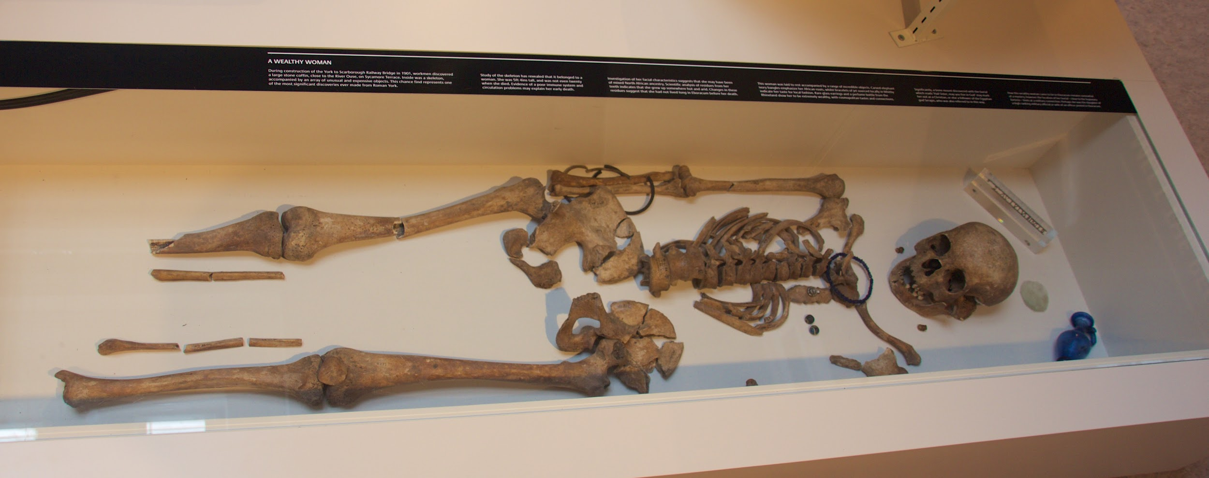
IVORY BANGLE LADY
She was discovered in 1901.
And was Found in roman burial site on sycmore terrace.
One of the richest graves in a stone coffin.
She was Found with luxury goods, like pendants, earrings, beads, glass jar, and a mirror.
She was apparently 18-23 years old.
And was black and white mixed.

Slide 7
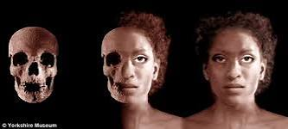
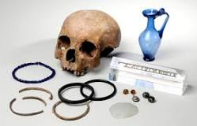
Why is the ivory bangle lady important?
The remains of a Roman woman known as the Ivory Bangle Lady have helped archaeologists discover that wealthy people from across the Empire were living in fourth century York.

Slide 8
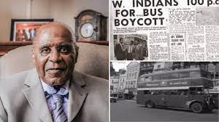
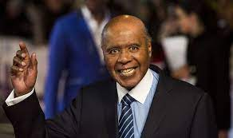
Why is paul stephenson important?
In 1964 Stephenson achieved national fame when he refused to leave a public house until he was served, resulting in a trial on a charge of failing to leave a licensed premises. His campaigns were instrumental in paving the way for the first Race Relations Act, in 1965.

Slide 9

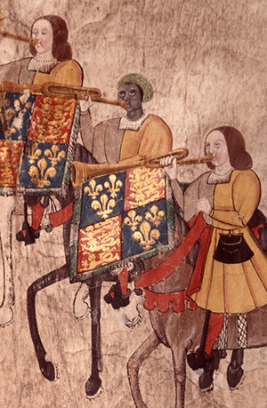
Why was John Blanke important?
John Blanke was a royal trumpeter in the courts of Henry VII and Henry VIII, and remains the only black Tudor for whom we have an identifiable image. While serving two kings, he bore witness to some of the great moments in England's history and contributed to some of the greatest spectacles of the Tudor age.

