Slide 1

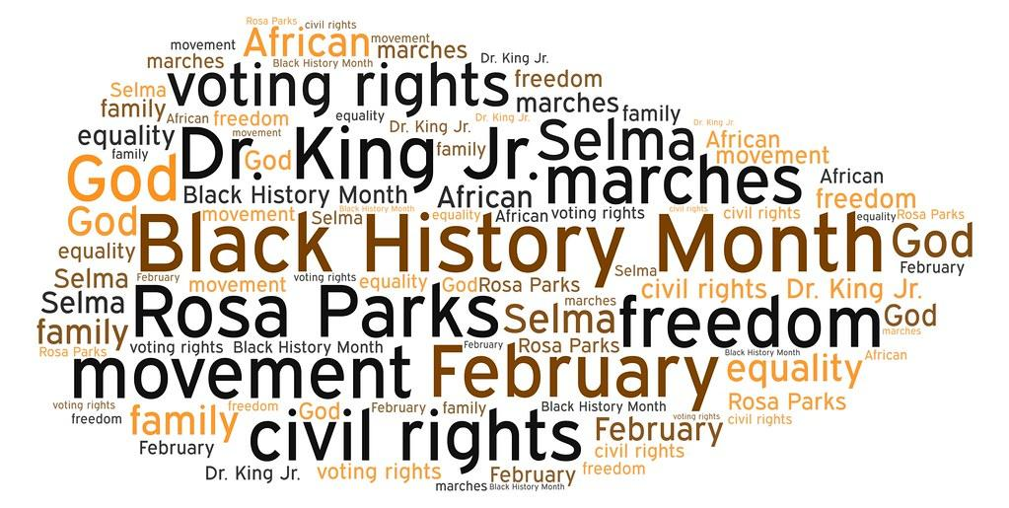

Black history month
By Heidi Smith & Ava hardy

Slide 2
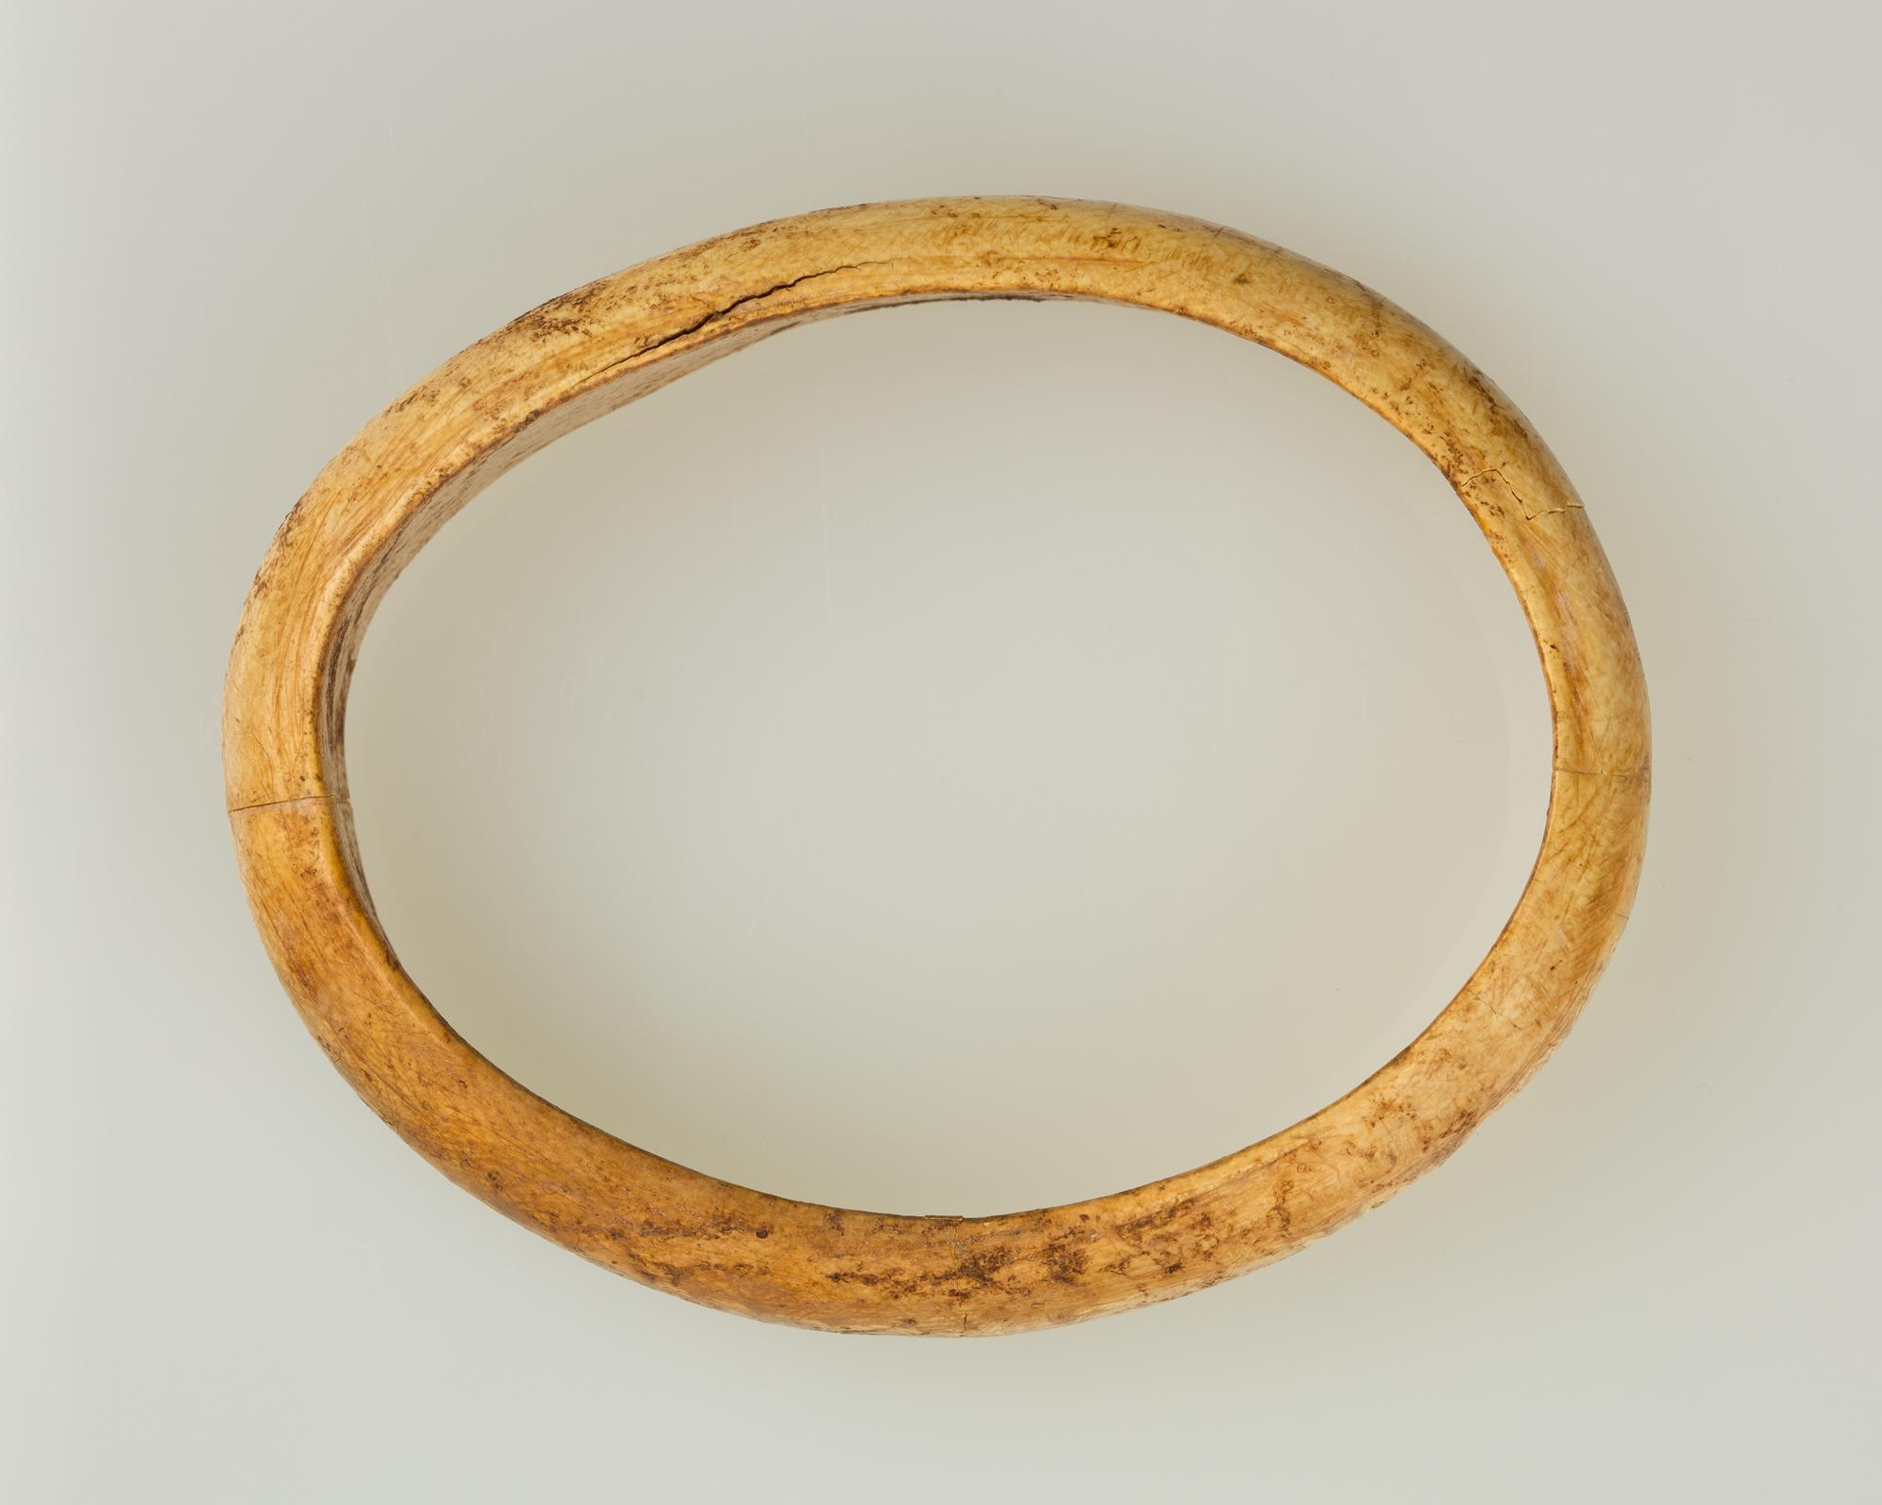
Ivory bangle lady:
The ivory bangle lady was discovered in 1901 in a roman burial site on sycamore terrace. She also had a very rich stone grave with her luxury goods! She was found wearing these bangles made from ivory from central Africa. Scientific research found she was between 18-23 years with a mixture of ‘black’ and ‘white’ ancestral traits. She was lady of north African descent .

Slide 3
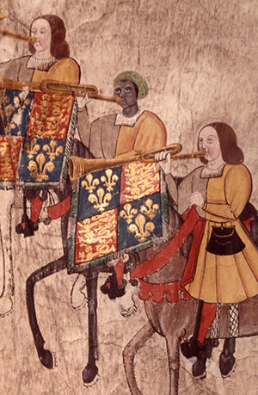
John Blanke
John Blanke was an African trumpeter! . He was a regular musician at the courts of both Henry VII and Henry VIII. Musicians payments were noticed in the accounts of the treasurer of the Chamber, who was responsible for paying the wages. There are several payments recorded to a ‘John blanke, the blacke trumpeter’.
This trumpeter was payed 8d a day, first by Henry VII and then from 1509 by Henry VIII

Slide 4

Paul Stephenson
Paul Stephenson was born to a british mother and west african father in Rochford, Essex in 1937 and was determined to confront the racism he’d encountered both growing up in in east London, and since arriving in Bristol as a community development officer in 1962. In 1963, when it was still legal to discriminate against a person based on their colour, So when a Bristol bus firm refused to employ black or Asian people, Paul began a 60-day boycott of the company. He also had a good friendship with Muhammad Ali

Slide 5

Civil rights
Everybody should be treated equally no matter what. Even if they are black. Everybody should have a name in this world. Everybody should be treated the same even if they are a woman or a black slave.
Thank you for listening!
EQUAL RIGHTS FOR ALL!!!!!

