Slide 1
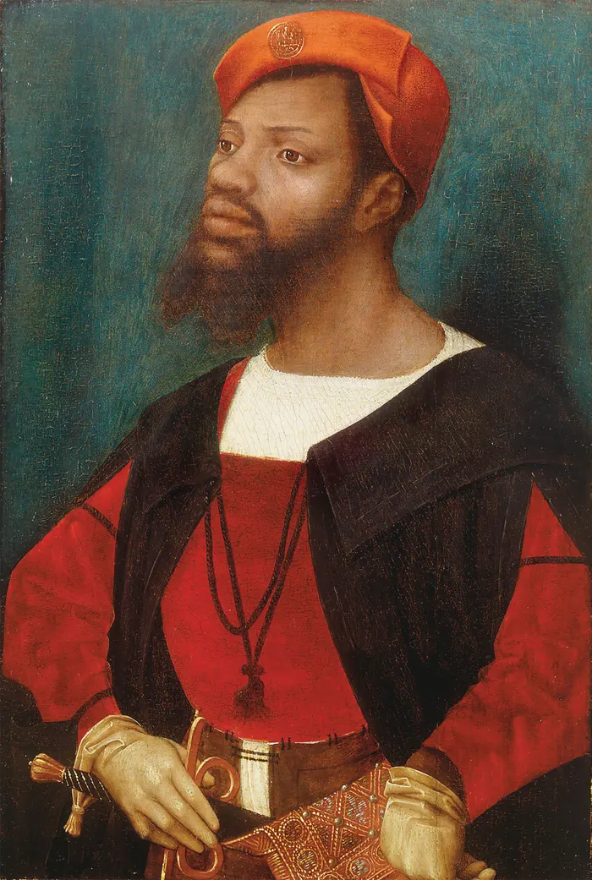
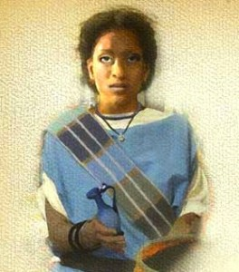
Black History Month
By Vittoria Sordo

Slide 2
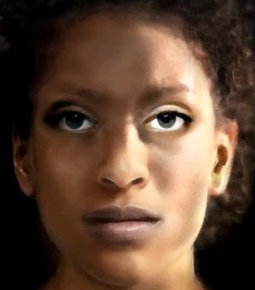
The Ivory Bangle Lady
The Ivory Bangle Lady was discovered in 1901 in a
Roman burial site on Sycamore Terrace.
She had one of the richest graves and was buried
In a stone coffin with luxury goods.
She was found wearing bangles made of Ivory from
Central Africa and ashby jet.

Slide 3
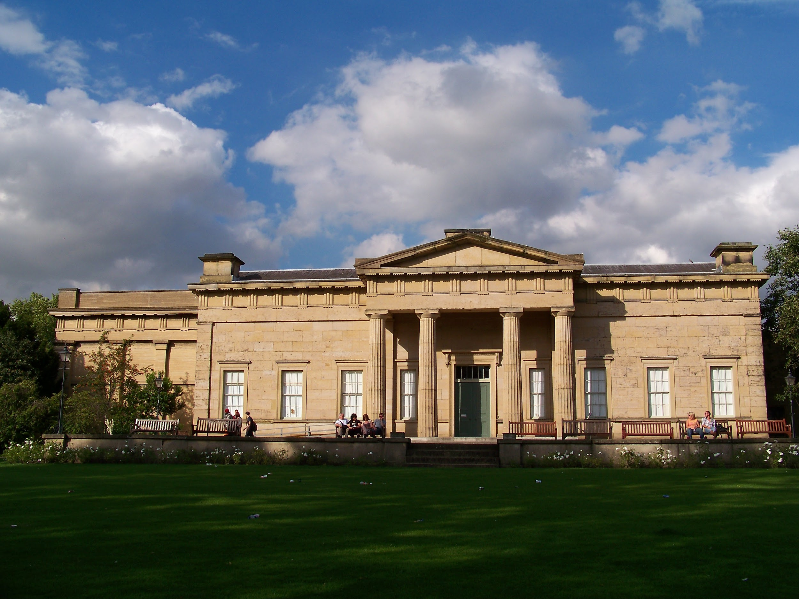
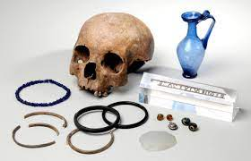
Scientific research found she was between 18-23 years with a mixture of black and white ancestral traits.
It is surmised that the Ivory Bangle Lady was of North African descent and may have migrated to York from somewhere warmer, possibly the Mediterranean.
The skeleton and the grave goods of the Ivory Bangle Lady are on display in the Yorkshire Museum (pictured)

Slide 4
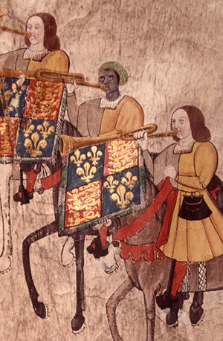
John Blanke
John Blanke was a musician of african descent in London in
The early 16th century, who probably came to England as
One of the african attendants of Catherine of Aragon in 1501.
He is one of the earliest recorded black people in United
Kingdom after the roman period.

