Slide 1

Welcome to year 6

Slide 2
Growing together within God’s loving family, we support, challenge and inspire each other to become the best that we can be.

Slide 3
Spiritual, moral, social and cultural development
Importance of our health and well-being in order to have the capacity to make the right choices and work at our best level
Positive reinforcement policy
Reflection times where needed to support children in understanding appropriate behaviour
Our behaviour links to the beatitudes
Mrs Bolton drop in sessions for children and parents

Slide 4
Good to be green
Our daily reward system for following the Golden Rules and showing God’s love to one another.
Golden time and our reward assembly is on a Friday to celebrate the achievements of the week.
Classroom daily rewards – Class Dojo points leading to bingo tickets
Star of the Day
ClassDojo for Teachers

Slide 5
Sharing the fantastic work of your children
Sharing of great work in assembly
Work for the working walls
Wall of Fame
Head teacher awards
Sharing news with parents – phone call home
Website
Twitter

Slide 6
Year 6 Weekly Homework
Spellings each Friday - Spelling words will be a mix of words from the year 5/6 spelling list and spelling rules
Reading every night
English and Maths homework – given Friday and returned on Tuesday
Reinforces the learning from the week

Slide 7
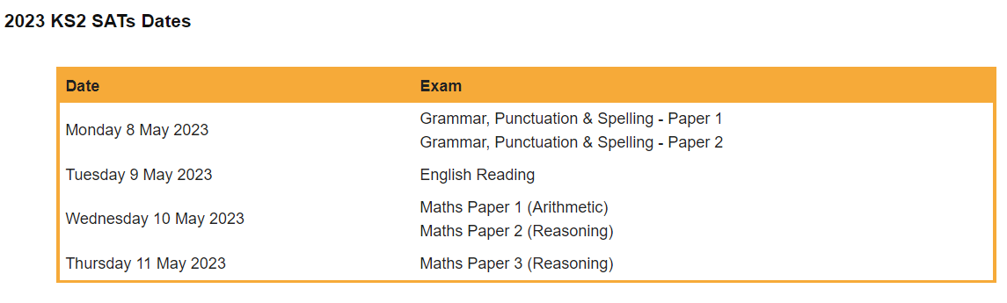
SATs

Slide 8
Any questions?

