Slide 1


Welcome to year 2
2022 - 2023

Slide 2
Growing together within God’s loving family, we support, challenge and inspire each other to become the best that we can be.

Slide 3
Introductions
The Year 2 team:
Mrs Ginns
Mrs Kehoe
And of course your wonderful children

Slide 4
General reminders
Doors open at 8.40am for a 8.45am start.
New water bottles are available from the school office
Toast and milk are payable half termly in advance.
All monies are to be paid using Parent Pay.
The school day ends at 3.15pm – please collect your youngest first.
Breakfast club and After school club are available although are heavily subscribed!

Slide 5
Uniform
School jumpers and cardigans are available from the school office.
Blue sweatshirt or cardigan with school logo
White polo shirt or blouse/shirt
Dark grey/black trousers
Navy/black/grey knee length skirt or pinafore dress
Plain black/white or grey socks/tights
Black shoes
(no trainers, boots or open toe sandals)
Jewellery
Small plain studs-one in each ear
All items of clothing should be marked with your child’s name please!

Slide 6

PE
PE will be on a Thursday.
We recommend you leave your child’s PE bag at school for the half term, taking it home to wash in the holidays. Or if you prefer, bring it in to school on a Monday and take it home on a Friday.
PE kit – white T-shirt, black shorts and trainers.

Slide 7

Class Dojo
Children receive dojo points for going ‘above and beyond.’
These can be saved up to claim rewards.

Slide 8
Good to be green
Our daily reward system for following the Golden Rules and showing God’s love to one another.
Golden Time is on a Friday to celebrate the achievements of the week.

Slide 9
Year 2 Reading
School reading – your child will read a new book every week at school. They will read this for 3 days to build on decoding, prosody and understanding.
They will bring this home on a Wednesday. They should be able to read this independently or without much support.
Your child will also bring home a book of their choice to read for pleasure. This is a book to share. There is no expectation for them to read it independently.
Your child needs to bring their reading folder into school every day.

Slide 10
Year 2 Weekly activities
Spellings
We will have a spelling test on a Thursday. New words will be given on a Friday.
You should practice your spellings regularly at home.
Some words will be those they have already taken home to practise before as they will be words that we discover they have not remembered and so need more practise on.
Some will be words they already know in order to build confidence but new words will be put into the lists also.

Slide 11

Homework
Homework will be given on a Friday to be returned by Tuesday
There will be English and maths homework each week
In addition, there will be something set on Google Classrooms

Slide 12
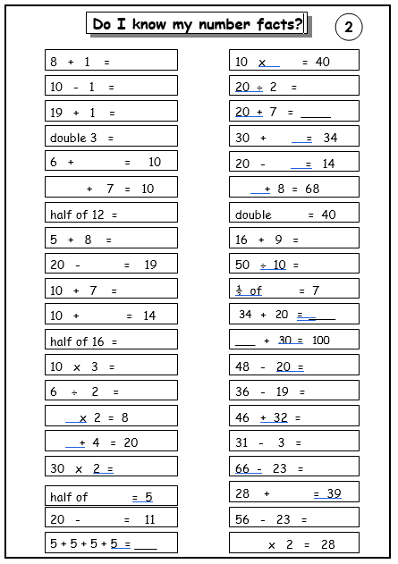
Number Facts
These are to be learnt by heart
Rapid recall

Slide 13
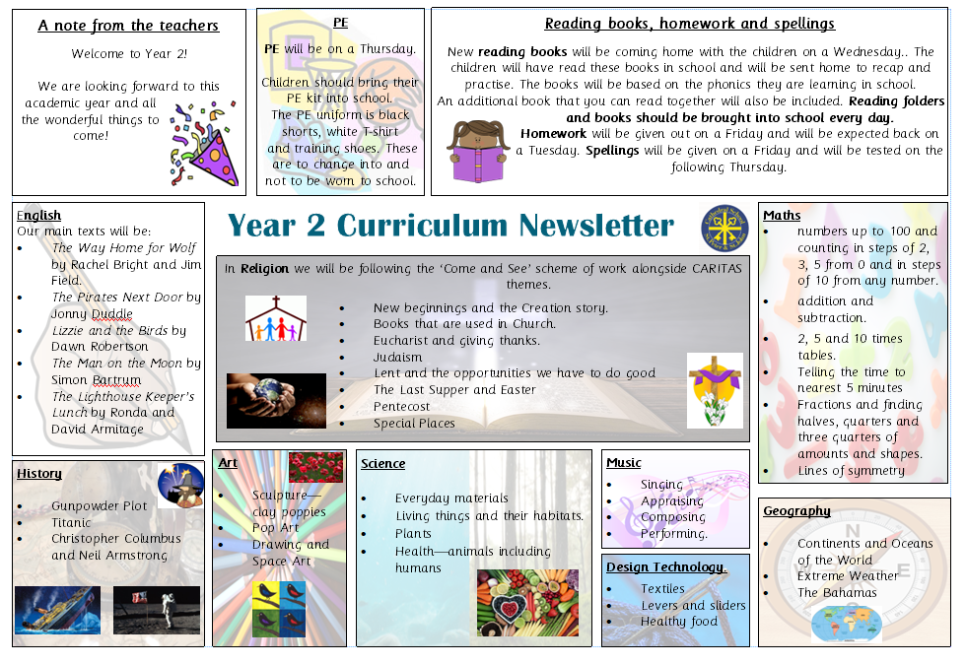

Slide 14
SATs
SATs stands for Standard Attainment Tests. These are national tasks set by the government.
Children are required to sit these tests when in Year 2.
The tasks are just one part of a range of assessments which have been carried out throughout your child’s time in Key Stage 1 (Year 1 and Year 2).
Children are assessed in;
Reading
Mathematics
Spelling (Optional)
Grammar and Punctuation (Optional)
against the National Curriculum
In KS1 the emphasis is on teacher assessment (our knowledge of what the child can do in their day to day work), the tests support this judgement.

Slide 15
How can you help?
Support your child with their homework they bring home each week.
Regular reading with your child – asking lots of questions about characters actions and feelings, authors use of language, vocabulary – what word in the text means…
Maths number facts – addition, subtraction, multiplication and division. Number problems e.g. I need 18 eggs, they come in boxes of 6, how many boxes will I need?
Practising their weekly spellings and the common exception words sent home.
Explicit revision is not necessary. Children will be familiar with question format through subtle teaching and practise throughout the year.

Slide 16
Any questions?

