Slide 1


Welcome to Early Years Foundation Stage
2022- 2023

Slide 2
Growing together within God’s loving family, we support, challenge and inspire each other to become the best that we can be.

Slide 3
Introductions
The Early Years Team
Nursery:
Mrs Dent (Class Teacher)
Miss Elouadi
Reception:
Mrs Hamer(Class Teacher)
Miss Linton (Teaching Assistant)
Mrs Culkin (HLTA) Speech and Language Specialist TA

Slide 4
General Reminders
The school day begins at 8.45 am prompt. Gates open at 8.40am
New water bottles are available from the school office.
School lunches must be ordered on the Dolce website (School Grid). Please choose these with your children.
Toast and milk are payable half termly in advance.
All monies are to be paid using Parent Pay.
The school day ends at 3.10pm for EYFS children.
PE is on a Tuesday afternoon (please leave black pumps in a bag on your child’s peg.

Slide 5
Uniform
School jumpers and cardigans are available from the school office.
Blue sweatshirt or cardigan with school logo
White polo shirt or blouse/shirt
Dark grey/black trousers
Navy/black/grey knee length skirt or pinafore dress
Plain black/white or grey socks/tights
Black shoes
(no trainers, boots or open toe sandals)
Jewellery
Small plain studs-one in each ear
PLEASE, PLEASE, PLEASE LABEL JUMPERS
All items of clothing should be marked with your child’s name please! Please make sure that, if your child’s name is written on, it hasn’t faded after you wash the item of clothing.

Slide 6
What is EYFS?
The Early Years Foundation Stage is all about learning through play!
Nursery is a careful balance of unstructured play interjected with small group tasks to support the children in their development. Through the year, the children will participate in an increasing number of group sessions including phonics, maths, religion, literacy and understanding of the world.
Reception becomes a little more structured to help prepare the children for Key Stage One. The children are expected to concentrate for longer periods of time and complete increasingly challenging tasks such as writing sentences or solving problems in maths.

Slide 7
Key Areas of Learning
We follow the Early Years Foundation Stage Statutory Framework (2021)
Key areas:
Prime areas:
Communication and Learning
Personal Social and Emotional Development
Physical Development
Literacy
Mathematics
Understanding of the World
Expressive Arts and Design

Slide 8
Curriculum
Our curriculum overviews for both Nursery and Reception are available on the school website. Please have a look at these so you can become familiar with what the children will be learning about in class.
Our planning is a basic outline to ensure we cover all the areas of the curriculum however it is flexible. We always aim to plan to the interests of the children and therefore the overviews should be considered as a working document and can alter slightly as the year progresses.
We are always looking for ways to enrich our curriculum so if you have any links that you feel might benefit our children, please let us know for example, if you or a member of your family is a key worker, it would be wonderful if you could come in and talk to the children during our ‘People Who Help Us’ unit.
In addition to our curriculum, we are also involved in the whole school super learning days.

Slide 9

Phonics
Nursery will be taught all about sounds. They will learn how to distinguish between different sounds in the environment, instrumental sounds and listen for sounds in words. Later in the year, they will learn to blend sounds together into words and segment words into sounds.
Reception build on this and begin to learn how letters represent the sounds in words and how we blend sounds together to form words. They will then begin to apply this in their writing.
FIND OUT MORE… PHONICS/EARLY READING MEETING 12th OCTOBER 9am

Slide 10
Reading in Reception
In Reception, your child will read a new book every week at school. They will read this for 3 days to build on decoding, prosody (reading with expression) and understanding.
They will bring the same book they have read in class home on a Wednesday. They should be able to read this independently or without much support. The purpose of this is to practise the phonics they have learnt in class and build on their fluency.
Your child will also bring home a book of their choice to read for pleasure. This is a book to share. There is no expectation for them to read it independently.

Slide 11
Mathematics
By the end of Nursery, we want the children to have a secure understanding of numbers to 5. This means more than just counting. The children need to know that numbers can be made from two or more smaller numbers.
Reception build on this and look at numbers to 10 and beyond. We use 10s frames and part, part whole frames to support the children’s understanding of number.

Slide 12
Home Learning
Every Wednesday, the children will be set a task to do at home. This may be a practical activity or a talking point to discuss with the family.
Keep checking Google Classroom for updates and additional activities.
Reading books will be sent home on Wednesdays and must be returned the following Monday. We only have a set number of books and another group of children will need the book on the Monday.

Slide 13

Class Dojo
Children receive dojo points for going ‘above and beyond.’
When the children reach 10 dojo points, they will be able to choose a prize from the prize box.
After they have received their prize, the dojos will be reset to 0, ready for them to start earning their next 10 dojos.
You will be sent messages through the Dojo website when your child receives points.

Slide 14
Reception Baseline
Every child is assessed at the beginning of Reception. This allows us to track your child’s progress as they move through the school.
These assessments are completed in class with the teacher or TA. They take about 20 minutes.
Every child in the country will complete the same assessments.

Slide 15
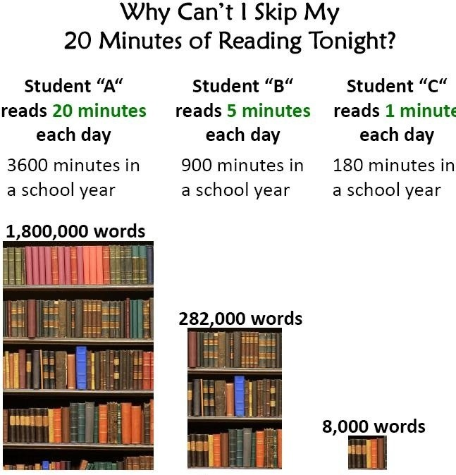
How can I help my child at home?
Talking to your child is the most fundamental way you can help your child in Early Years. Communication is key to so many areas of a child’s development.
Reading stories together is not only educational but what a lovely time to spend together!
Listening to and supporting your child with their reading book. Please comment on anything you notice in their reading record – your opinion and comments can really help us to help them.

Slide 16
Parent/School Partnerships
Dialogue between parents’ and teachers is extremely important to us. No one knows your child better than you do!
We aim to have an open door policy and will always make time to speak to you. If you need to speak to us at the end of the day, please appreciate you will need to wait until the other children have gone for safety reasons. Alternatively, we can speak over the phone or make an appointment.
We will also have the opportunity to speak at pupil progress meetings that we have three times each year. You will be given written achievements and targets prior to pupil progress meetings.
You can also see all the wonderful things your children have been doing on the school website, on the school twitter page and in our half termly newsletters.

Slide 17
Educational Visits
We are incredibly lucky to have the use of the school minibus and aim to take the children on educational visits as regularly as possible.
Over the course of this year, the children in Early Years will be visiting:
Heaton Park or Peel Park to see the signs of Autumn and Spring.
We will visit Salford Cathedral as part of our Religion lessons and to experience Mass.
We will be walking around our local area to see the different types of houses there are as part of our homes topic.
We will visit Barton Airfield as part of our transport topic.
We will visit The Bridgewater RHS to explore the amazing gardens and nature there.

Slide 18
Any questions?

