Slide 1
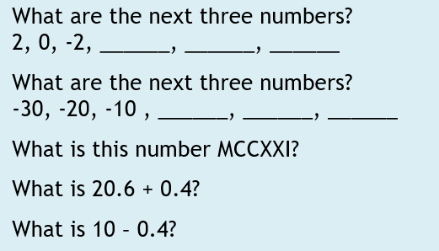
Starter Activity

Slide 2
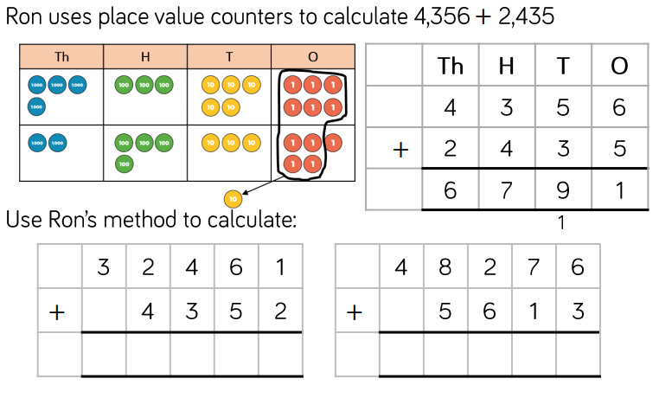

Slide 3
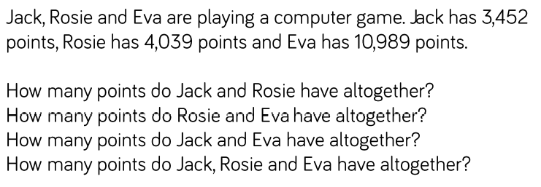
Use the Place Value Counters link to help you answer these questions.
You may want to use your books/paper to use the column method.

Slide 4
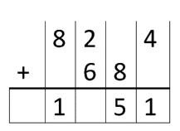
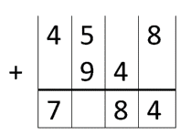
Complete the missing numbers:

Slide 5


