Slide 1



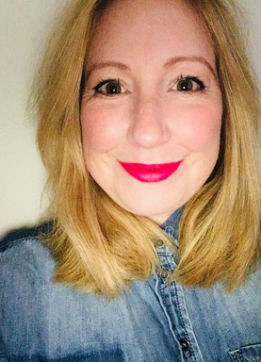

A Note from Denee
May 23
K E Y D A T E S
11th May: Understanding the Threat of Incel Violence 10-12pm
11th May: Online Hate Crime Briefing 10-11AM
18th May: Small Steps Right Wing Extremism 1-3pm
23RD May: How to Talk About Andrew Tate 12:30-1:30pm
13th June: Workshop to raise awareness of prevent 1-3pm
20th June: Hate Crime Reporting Centre Training 1-3:30pm
13th July: Understanding the Threat of Incel Violence 10-12pm
Hello Everyone
Welcome to May! The clocks have sprung forward, and British summertime is afoot (apparently.)
In this month's edition of the Prevent newsletter we are going to be exploring the different support there is for those who have been a victim of a terrorist attack in the UK. When we talk about victims we are talking about survivors, witnesses, family members, and all those affected. There is no time limit on accessing these services after an incident and can be accessed in various ways.
In other news, due to popular demand we have added another Andrew Tate training session, please book via Debbie Hulme.
Check out our back page for We Invented the Weekend events and activities.
Thanks,
Denee
If you would like to attend one of these training sessions, please email debbie.hulme@salford.gov.uk
If you want to find out more about training packages for your organisation please contact denee.cassidy@salford.gov.uk
Have a question about Prevent or Counter Terrorism and how it affects your organisation?
Drop me a line at denee.cassidy@salford.gov.uk

Slide 2
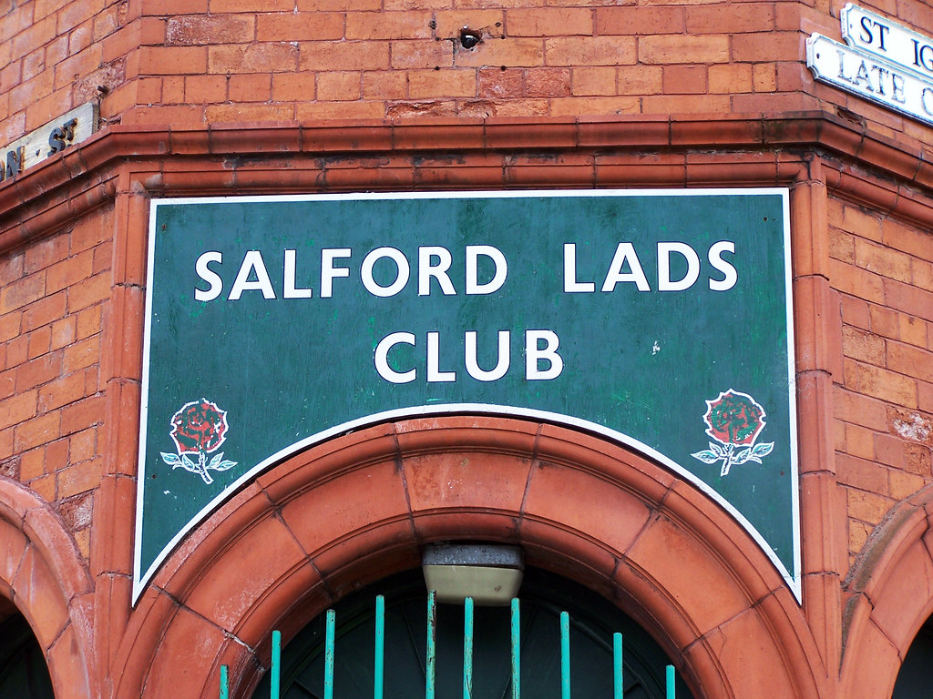
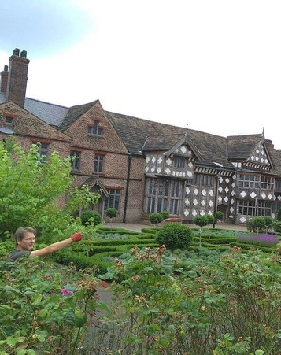
Page 3
May 2023
Victim Support
How are people affected by terrorist attacks?
Victims of an attack may have suffered a bereavement, been physically injured, or experienced emotional or psychological trauma.
There is no single pattern of response or recovery after a terrorist attack – every person will have a different experience. It’s important that you treat your colleague, friend or family member with compassion and respect. Listen to their needs and check in on their recovery regularly.
People who have been affected by a terrorist attack may show feelings that others find hard to understand. These are natural in the aftermath of an attack and can settle in time.
Feelings can include:
•Fear, shock, horror and helplessness
•Anger that this has happened
•Loss of control, of being a target and unable to control their emotional response
•That they might have done something to lessen the trauma or avoid the attack
•Guilt for surviving when others did not
•Grief for those who have died
DID YOU KNOW?
That alternative subculture is a strand of hate crime (after the murder of Sophie Lancaster in 2007 https://www.sophielancasterfoundation.com/)
Have a question about Prevent or Counter Terrorism and how it affects your organisation?
Drop me a line at denee.cassidy@salford.gov.uk

Slide 3
Page 2
May 2023
The Home Office funds organisations, like the ones below, as part of a victim and survivor pathway. This helps victims and survivors cope with, and recover from, the impact and consequences of a terrorist attack. Victims are referred or can self-refer.
Victim Support - conducts terror incident needs assessments (TINA) for each survivor - they refer individuals on to the following services if appropriate.
The victim or survivor owns the TINA and takes it with them as they access each support organisation in the pathway, so that they don’t have to repeat their story.
South London and Maudsley NHS Foundation Trust (SLAM) – provides clinical mental health assessments and onward referral for those affected by terrorism.
Tim Parry Johnathan Ball Peace Foundation – facilitates a long-term, peer support network to help victims and survivors of terrorism support each other.
Local support services will also be part of supporting people after an attack. Your local authority would provide you with this information at that point.
DID YOU KNOW?
That race is the highest reported strand of hate crime followed by sexual orientation, disability, religion, transgender and alternative subculture.
Have a question about Prevent or Counter Terrorism and how it affects your organisation?
Drop me a line at denee.cassidy@salford.gov.uk

Slide 4
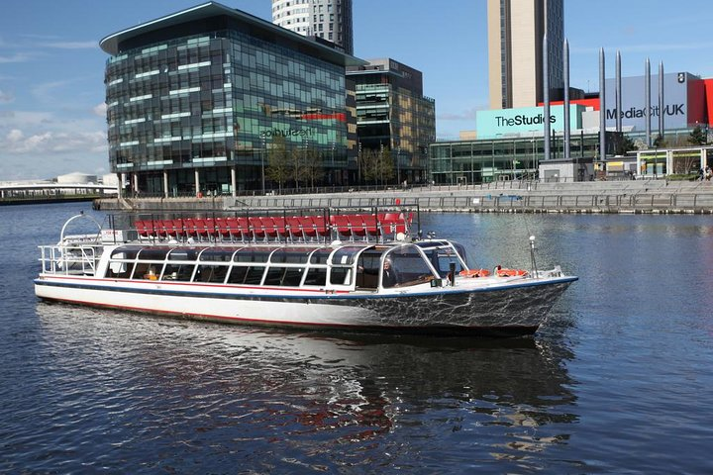
Page 3
May 2023
Support services are available for victims or survivors of attacks in the UK, or when returning to the UK following an attack overseas, as well as those affected by historic attacks who would need more support.
If you feel that you, or someone you know, needs support following an attack, emotional and practical support is available for you.
Victim Support - contact their free 24/7 support line on 0808 168 9111, or on live chat by visiting http://www.victimsupport.org.uk/live-chat
Cruse Bereavement Support provides counselling, support and services to the friends and relatives of someone who has died, to help them understand their grief and cope with their loss.
Mind is a mental health charity providing advice and support to empower anyone experiencing mental health problems, as well as their friends and family. Including post traumatic stress disorder. Mind has branches around the country and a list can be found on their website.
Relate provides information and support to help people with their relationships including face-to-face counselling, online and telephone counselling for people at any age and any stage of couple, family and social relationships.
The Samaritans provide confidential, unbiased emotional support, 24 hours a day, for people who feel distressed, desperate or suicidal. Helpline: 08457 90 90 90
DID YOU KNOW?
Reporting hate crime gives witnesses and victims the opportunity to be heard and take action around hate crime within their communities.
Have a question about Prevent or Counter Terrorism and how it affects your organisation?
Drop me a line at denee.cassidy@salford.gov.uk

Slide 5

May 2023
Young Person Support
When an attack occurs, children will hear about it in different ways, some of which may be inaccurate, untrue, or based on rumor or speculation. Wherever they happen, events may create feelings of anxiety and fear that children can find hard to articulate.
The NSPCC helpline can provide parents and carers with advice on how to speak to a child about a terrorist incident. This is also the number to dial if you are worried that a child is being radicalised or at risk of radicalisation: 0808 800 5000.
Childline is a free, private and confidential service for those under 19 in the UK, helping them deal with any issue which causes distress or concern. They can be contacted on 0800 1111.
The Department for Education has developed an Incident Response template for education leaders to refer to, in the event of a terrorist incident that impacts upon a school or college.
The We Love Manchester emergency fund has developed an animation for professionals within education as an introduction to trauma and recovery, and to facilitate the work they do in supporting students who have been affected by trauma.
DID YOU
KNOW?
Salford City Council offer free training on hate crime SCC Prevent and hate crime training
Link
SCC Prevent and hate crime training

Slide 6


We Invented the Weekend is funded by Salford City Council, MediaCity (a Peel Media Ltd and Landsec partnership), GMCA Culture Fund, Bupa and supported by Salford’s Culture & Place Partnership, a cross-city collective delivering Suprema Lex, Salford’s strategy for culture, creativity and place which is led by The Lowry, Arts Council England, Salford City Council, Peel Media Ltd and the University of Salford.
The event delivery partner is Hemingway Design who hold an impressive track record of delivering large-scale public engagement events across the country.
We Invented the Weekend is a true partnership project with generous contribution to the festival content from a number of key partners including the BBC, The Lowry, University of Salford, the RHS, as well as many other arts and community organisations across the city.

